Slide 1
Network Applications: HTTP/1.1/2; Operational Analysis
Qiao Xiang, Congming Gao
https://sngroup.org.cn/courses/cnns-xmuf24/index.shtml
10/15/2024
This deck of slides are heavily based on CPSC 433/533 at Yale University, by courtesy of Dr. Y. Richard Yang.

Slide 2
Outline
Admin and recap
HTTP
Basic design: HTTP 1.0
HTTP "acceleration"
Operational analysis

Slide 3
Admin
Lab assignment 2 due Oct. 18

Slide 4
Recap: From Opaque Files to Web Pages
Web page:
authored in HTML
addressed by a URL
URL has two components:
host name, port number and
path name
Most Web pages consist of:
base HTML page, and
several referenced objects
E.g., image
http request
User agent: Explorer
http response
http://qiaoxiang.me:80/index.html
http request
Server
running
Apache Web
server
http response
User agent:
Firefox
The Web pages are requested through HTTP: hypertext transfer protocol

Slide 5
Recap: HTTP 1.0 Message Flow
Server waits for requests from clients
Client initiates TCP connection (creates socket) to server, port 80
Client sends request for a document
Web server sends back the document
TCP connection closed
Client parses the document to find embedded objects (images)
repeat above for each image

Slide 6
HTTP Request Message Example: GET
Virtual host multiplexing
request line
(GET, POST,
HEAD, PUT, DELETE, TRACE … commands)
GET /somedir/page.html HTTP/1.0 Host: www.somechool.edu Connection: close
User-agent: Mozilla/4.0
Accept: text/html, image/gif, image/jpeg
Accept-language: en
(extra carriage return, line feed)
Connection management
header
lines
Carriage return,
line feed
indicates end
of message
Content negotiation

Slide 7
HTTP Response Message
status line
(protocol
status code
status phrase)
HTTP/1.0 200 OK
Date: Wed, 23 Jan 2008 12:00:15 GMT
Server: Apache/1.3.0 (Unix)
Last-Modified: Mon, 22 Jun 1998 …...
Content-Length: 6821
Content-Type: text/html
data data data data data ...
header
lines
data, e.g.,
requested
html file

Slide 8
Basic HTTP Server Workflow
Create ServerSocket(6789)
128.36.232.5 128.36.230.2
TCP socket space
state: listening
address: {*.6789, *.*}
completed connection queue: sendbuf:
recvbuf:
connSocket = accept()
read request from connSocket
state: established
address: {128.36.232.5:6789, 198.69.10.10.1500}
sendbuf:
recvbuf:
Map URL to file
state: listening
address: {*.25, *.*}
completed connection queue:
sendbuf:
recvbuf:
Read from file/ write to connSocket
close connSocket

Slide 9
Static -> Dynamic Content
Create ServerSocket(6789)
connSocket = accept()
It does not have to be a static file
read request from connSocket
Map URL to file
Read from file/ write to connSocket
close connSocket

Slide 10
Dynamic Content Pages
There are multiple approaches to make dynamic web pages:
Embed code into pages (server side include)
http server includes an interpreter for the type of pages
Invoke external programs (http server is agnostic to the external program execution)
E.g., Common Gateway Interface (CGI)
http://www.cs.yale.edu/index.shtml
http://www.cs.yale.edu/cgi-bin/ureserve.pl
http://www.google.com/search?q=Yale&sourceid=chrome

Slide 11
Example SSI
See programming/examples-java-socket/BasicWebServer/ssi/index.shtml, header.shtml, …
Notes:
https://httpd.apache.org/docs/2.2/howto/ssi.html

Slide 12
Example SSI
See programming/examples-java-socket/BasicWebServer/ssi/index.shtml, header.shtml, …
To enable ssi, need configuration to tell the web server (see conf/apache-htaccess)
https://httpd.apache.org/docs/2.2/howto/htaccess.html (Server Side Includes example)
Notes:
https://httpd.apache.org/docs/2.2/howto/ssi.html

Slide 13
CGI: Invoking External Programs
Two issues
Input: Pass HTTP request parameters to the external program
Output: Redirect external program output to socket

Slide 14
Example: Typical CGI Implementation
Starts the executable as a child process
Passes HTTP request as environment variables
http://httpd.apache.org/docs/2.2/env.html
CGI standard: http://www.ietf.org/rfc/rfc3875
Redirects input/output of the child process to the socket

Slide 15
Example: CGI
Example:
GET /search?q=Yale&sourceid=chrome HTTP/1.0
setup environment variables, in particular $QUERY_STRING=q=Yale&sourceid=chrome
start search and redirect its input/output
https://docs.oracle.com/javase/7/docs/api/java/lang/ProcessBuilder.html

Slide 16
Example
https://httpd.apache.org/docs/2.2/howto/htaccess.html (CGI Example)
http://172.28.229.215/BasicWebServer/cgi/price.cgi?appl
#!/usr/bin/perl -w
$company = $ENV{'QUERY_STRING'};
print "Content-Type: text/html\r\n";
print "\r\n";
print "<html>";
print "<h1>Hello! The price is ";
if ($company =~ /appl/) {
my $var_rand = rand();
print 450 + 10 * $var_rand;
} else {
print "150";
}
print "</h1>";
print "</html>";
Notes:
https://httpd.apache.org/docs/2.2/howto/htaccess.html

Slide 17
Client Using Dynamic Pages
See ajax.html and wireshark for client code example
http://172.28.229.215/BasicWebServer/cgi/ajax.html

Slide 18
Discussions
What features are missing in HTTP that we have covered so far?

Slide 19
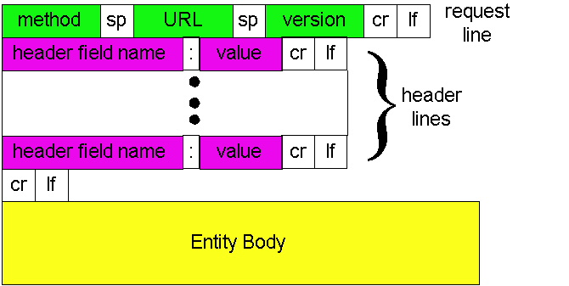
HTTP: POST
If an HTML page contains forms or parameter too large, they are sent using POST and encoded in message body

Slide 20
HTTP: POST Example
POST /path/script.cgi HTTP/1.0
User-Agent: MyAgent
Content-Type: application/x-www-form-urlencoded
Content-Length: 15
item1=A&item2=B
Example using nc: programming/examples-java-socket/BasicWebServer/nc/

Slide 21
Stateful User-server Interaction: Cookies
client
server
Goal: no explicit application level session
Server sends “cookie” to client in response msg
Set-cookie: 1678453
Client presents cookie in later requests
Cookie: 1678453
Server matches presented-cookie with server-stored info
authentication
remembering user preferences, previous choices
usual http request msg
usual http response +
Set-cookie: #
usual http request msg
Cookie: #
cookie-
specific
action
usual http response msg
usual http request msg
Cookie: #
cookie-
specific
action
usual http response msg

Slide 22
Authentication of Client Request
client
server
Authentication goal: control access to server documents
stateless: client must present authorization in each request
authorization: typically name, password
Authorization: header line in request
if no authorization presented, server refuses access, sends
WWW-authenticate:
header line in response
usual http request msg
401: authorization req.
WWW-authenticate:
usual http request msg
+ Authorization:line
usual http response msg
usual http request msg
+ Authorization:line
usual http response msg
time
Browser caches name & password so
that user does not have to repeatedly enter it.

Slide 23
Example: Amazon S3
Amazon S3 API
http://docs.aws.amazon.com/AmazonS3/latest/API/APIRest.html

Slide 24
HTTP as the Thin Waist
WebMail
WebApp…
HTTP
TCP
UDP
Ethernet
Wireless
Cable/DSL

Slide 25
Protocol Flow of Basic HTTP/1.0
>= 2 RTTs per object:
TCP handshake --- 1 RTT
client request and server responds --- at least 1 RTT (if object can be contained in one packet)
TCP SYN
TCP ACK
TCP/ACK; HTTP GET
base page
TCP SYN
TCP ACK
TCP/ACK; HTTP GET
image 1
Notes:
Typical approaches to reduce latency:
parallel TCP connections
persistent HTTP
cache and conditional GET

Slide 26
Outline
Admin and recap
HTTP/1.0
HTTP “acceleration”

Slide 27
Substantial Efforts to Speedup Basic HTTP/1.0
Reduce the number of objects fetched [Browser cache]
Reduce data volume [Compression of data]
Header compression [HTTP/2]
Reduce the latency to the server to fetch the content [Proxy cache]
Remove the extra RTTs to fetch an object [Persistent HTTP, aka HTTP/1.1]
Increase concurrency [Multiple TCP connections]
Asynchronous fetch (multiple streams) using a single TCP [HTTP/2]
Server push [HTTP/2]

Slide 28
Browser Cache and Conditional GET
client
server
Goal: don’t send object if client has up-to-date stored (cached) version
client: specify date of cached copy in http request
If-modified-since: <date>
server: response contains no object if cached copy up-to-date:
HTTP/1.0 304 Not Modified
http request msg
If-modified-since: <date>
object
not
modified
http response
HTTP/1.0
304 Not Modified
http request msg
If-modified-since: <date>
object
modified
http response
HTTP/1.1 200 OK
…
<data>

Slide 29
Web Caches (Proxy)
Goal: satisfy client request without involving origin server
origin
server
Proxy
server
http request
http request
client
http response
http response
http request
http request
http response
http response
client
origin
server

Slide 30
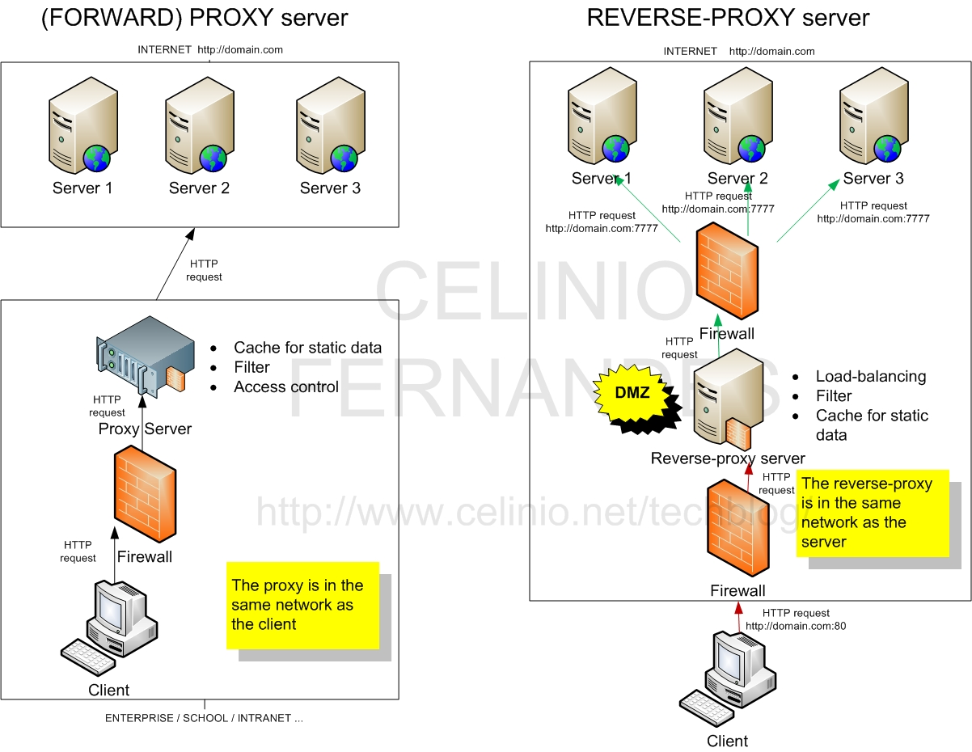
Two Types of Proxies
http://www.celinio.net/techblog/?p=1027
Typically in the same network as the client
Typically in the same network as the server

Slide 31
Benefits of Forward Proxy
origin
servers
Assume: cache is “close” to client (e.g., in same network)
smaller response time: cache “closer” to client
decrease traffic to distant servers
link out of institutional/local ISP network often is bottleneck
public
Internet
1.5 Mbps
access link
institutional
network
10 Mbps LAN
institutional
cache

Slide 32
No Free Lunch: Problems of Web Caching
The major issue of web caching is how to maintain consistency
Two ways
pull
Web caches periodically pull the web server to see if a document is modified
push
whenever a server gives a copy of a web page to a web cache, they sign a lease with an expiration time; if the web page is modified before the lease, the server notifies the cache

Slide 33
HTTP/1.1: Persistent (keepalive/pipelining) HTTP
HTTP/1.0 allows a single request outstanding, while HTTP/1.1 allows request pipelining
On same TCP connection: server parses request, responds, parses new request, …
Client sends requests for all referenced objects as soon as it receives base HTML
Benefit
Fewer RTTs
See Joshua Graessley WWDC 2012 talk: 3x within iTunes

Slide 34
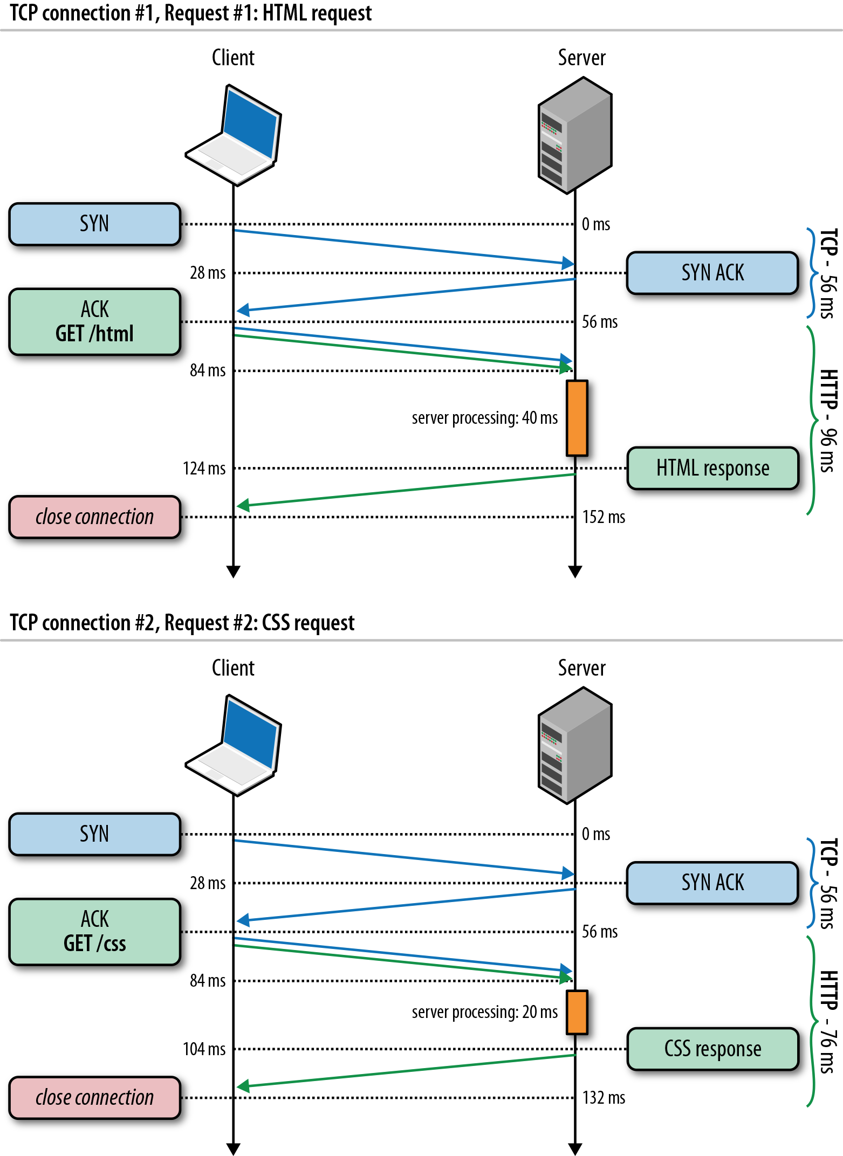
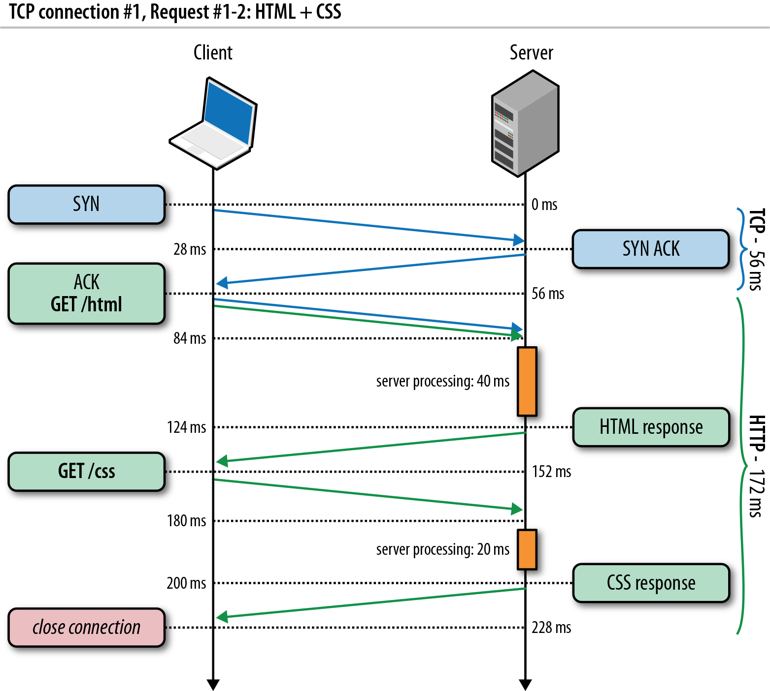
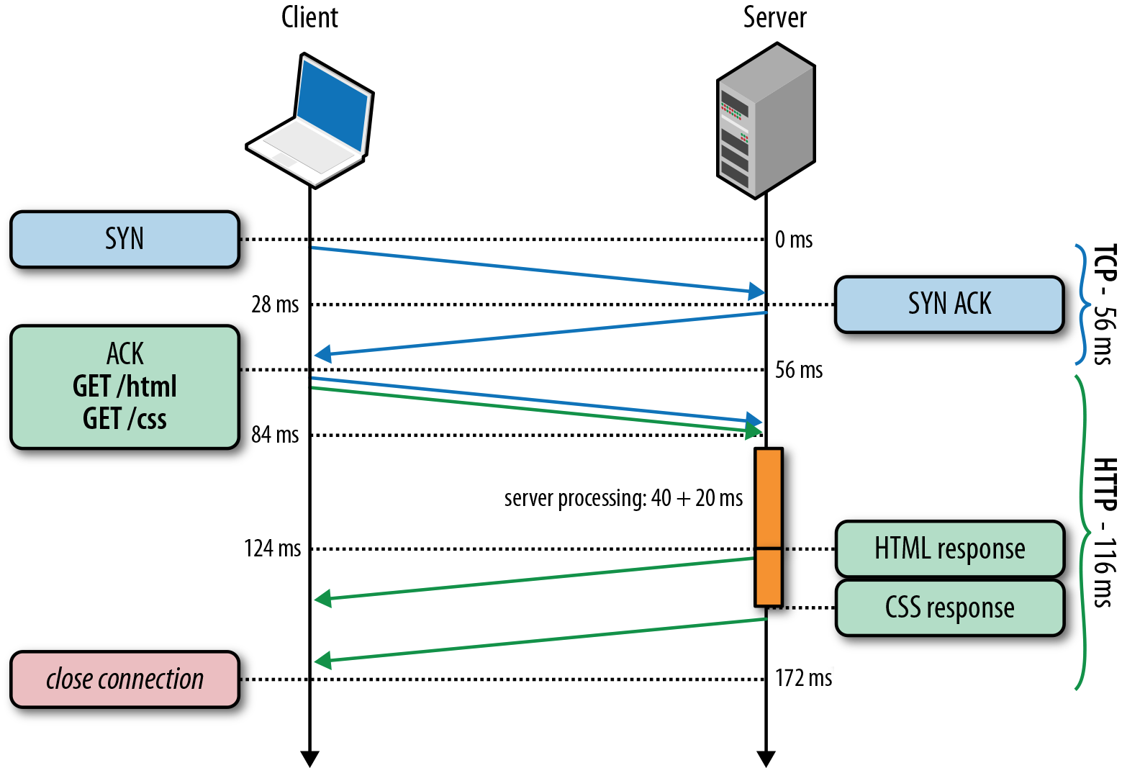
HTTP/1.0, Keep-Alive, Pipelining
Is this the best we can do?
Source: http://chimera.labs.oreilly.com/books/1230000000545/ch11.html
Notes:
https://httpd.apache.org/docs/2.2/howto/ssi.html

Slide 35
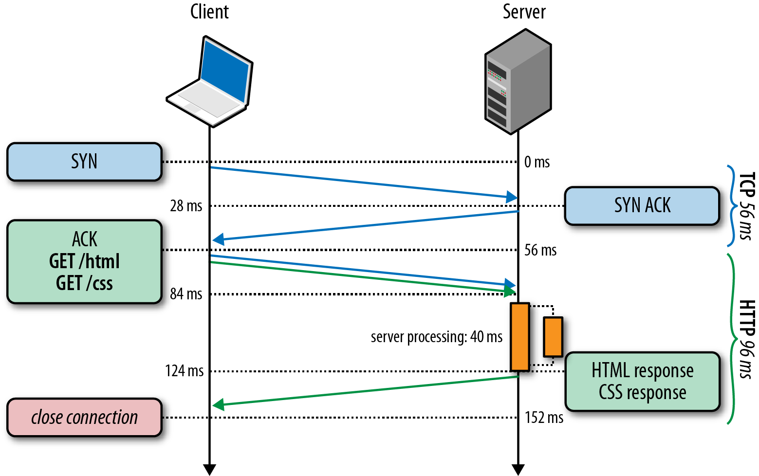
HTTP/2 Basic Idea: Remove Head-of-Line Blocking in HTTP/1.1
Data flows for sequential to parallel: two requests must be concurrent.
Demo: https://http2.akamai.com/demo
Source: http://chimera.labs.oreilly.com/books/1230000000545/ch11.html
Notes:
https://httpd.apache.org/docs/2.2/howto/ssi.html

Slide 36
Recap: Latency of Basic HTTP/1.0
>= 2 RTTs per object:
TCP handshake --- 1 RTT
client request and server responds --- at least 1 RTT (if object can be contained in one packet)
TCP SYN
TCP ACK
TCP/ACK; HTTP GET
base page
TCP SYN
TCP ACK
TCP/ACK; HTTP GET
image 1
Notes:
Typical approaches to reduce latency:
parallel TCP connections
persistent HTTP
cache and conditional GET

Slide 37
Recap: Substantial Efforts to Speedup HTTP/1.0
Reduce the number of objects fetched [Browser cache]
Reduce data volume [Compression of data]
Header compression [HTTP/2]
Reduce the latency to the server to fetch the content [Proxy cache]
Remove the extra RTTs to fetch an object [Persistent HTTP, aka HTTP/1.1]
Increase concurrency [Multiple TCP connections]
Asynchronous fetch (multiple streams) using a single TCP [HTTP/2]
Server push [HTTP/2]

Slide 38
Recap: HTTP/1.0, Keep-Alive, Pipelining
Is this the best we can do?
Source: http://chimera.labs.oreilly.com/books/1230000000545/ch11.html
Notes:
https://httpd.apache.org/docs/2.2/howto/ssi.html

Slide 39
HTTP/2 Basic Idea: Remove Head-of-Line Blocking in HTTP/1.1
Data flows for sequential to parallel: two requests must be concurrent.
Demo: https://http2.akamai.com/demo
Source: http://chimera.labs.oreilly.com/books/1230000000545/ch11.html
Notes:
https://httpd.apache.org/docs/2.2/howto/ssi.html

Slide 40
Observing HTTP/2
export SSLKEYLOGFILE=/tmp/keylog.txt
Start Chrome, e.g.,
Mac: /Applications/Google Chrome.app/Contents/MacOS/Google Chrome
Ubuntu: firefox
Visit HTTP/2 pages, such as https://www.tmall.com
Wireshark:
Mac: Wireshark -> preferences -> protocol -> TSL
(pre)-master-secret log file name
Ubuntu: edit -> perferences -> protocol -> SSL
(pre)-master-secret log file name

Slide 41
HTTP/2 Design: Multi-Streams
HTTP/2 Binary Framing
https://hpbn.co/http2/
https://tools.ietf.org/html/rfc7540

Slide 42
HTTP/2 Header Compression

Slide 43
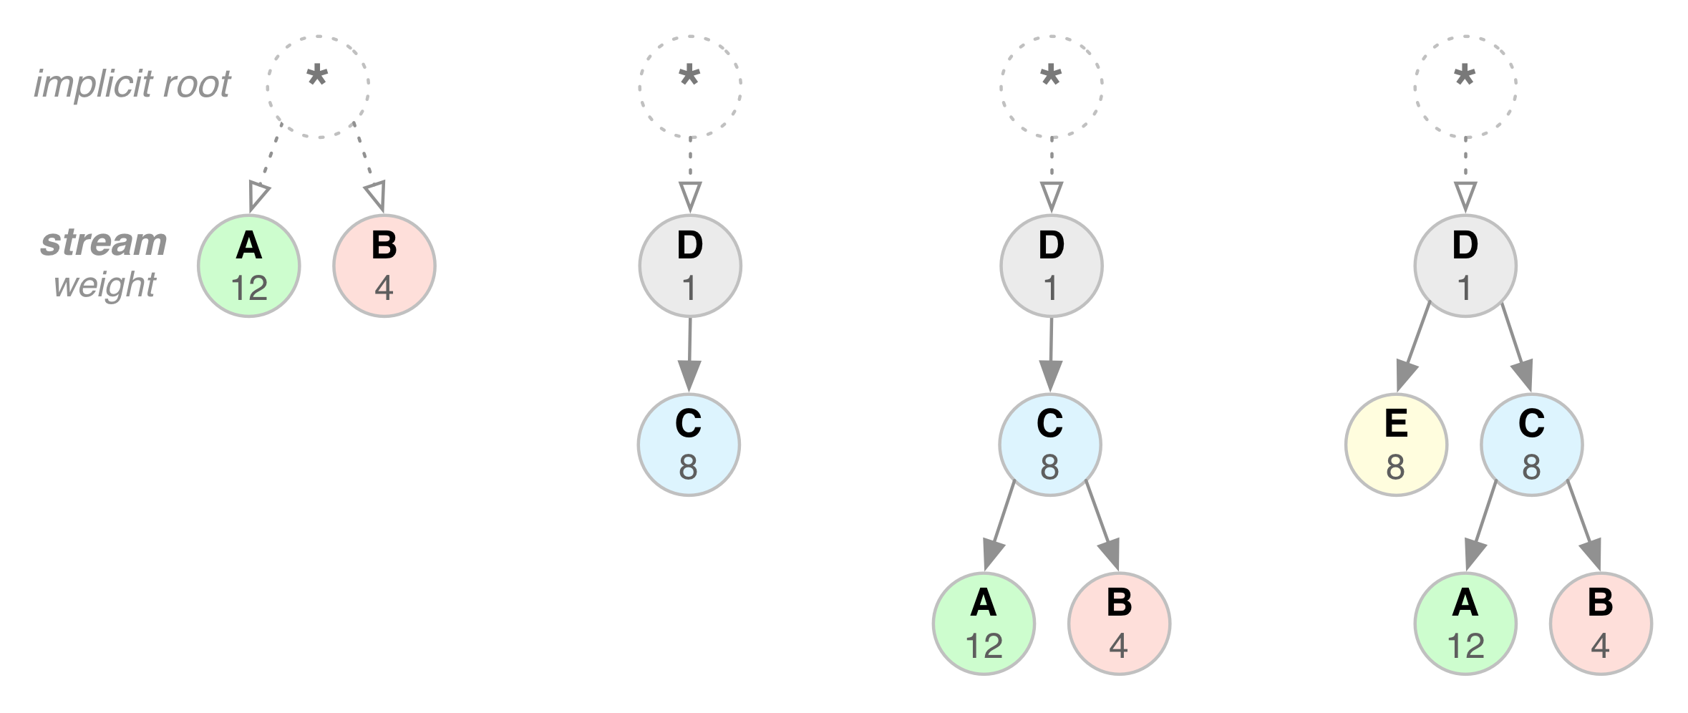
HTTP/2 Stream Dependency and Weights

Slide 44
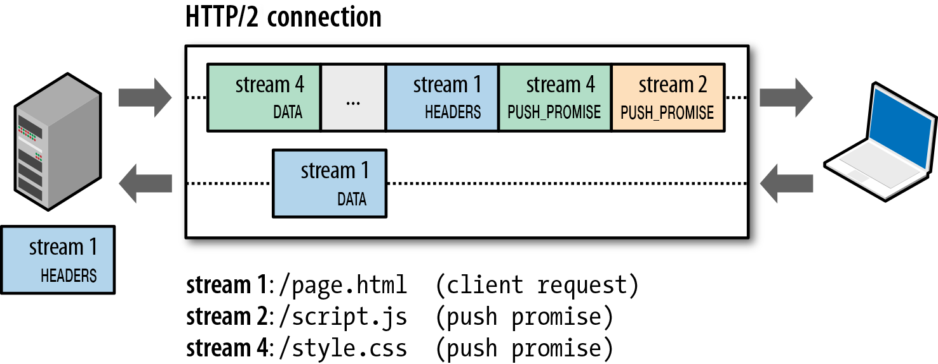
HTTP/2 Server Push

