Slide 1
Network Layer:
Distance Vector Protocols Variations
Qiao Xiang, Congming Gao
https://sngroup.org.cn/courses/cnns-xmuf24/index.shtml
11/28/2024
This deck of slides are heavily based on CPSC 433/533 at Yale University, by courtesy of Dr. Y. Richard Yang.

Slide 2
Outline
Admin and recap
Network overview
Network control plane
  Routing
    Link weights assignment
    Routing computation
      Distance vector protocols (distributed computing)
      Link state protocols (distributed state synchronization)

Slide 3
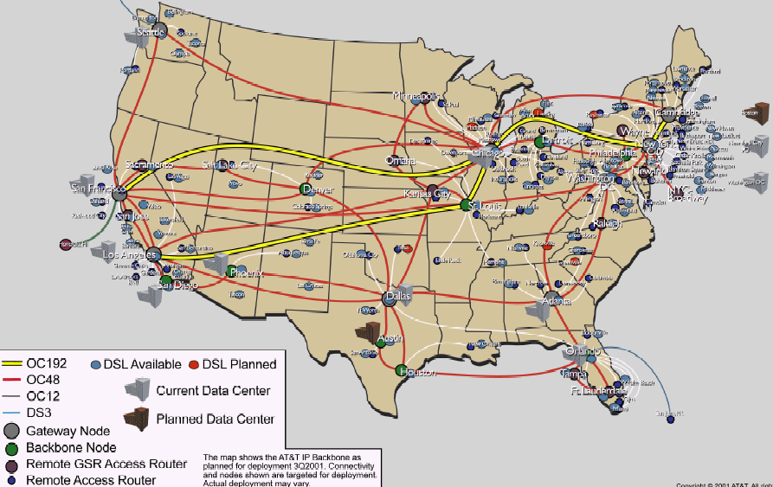
Recap: Routing Context
Routing
Goal: determine “good” paths
(sequences of routers) thru
networks from source to dest.
Often depends on a graph abstraction:
graph nodes are routers
graph edges are physical links
  links have properties: delay, capacity, $ cost, policy
5
B
3
C
2
5
A
2
1
F
3
1
2
D
E
1

Slide 4
Recap: Routing Design Space
Routing has a large design space
  who decides routing?
    source routing: end hosts make decision
    network routing: networks make decision
  how many paths from source s to destination d?
    multi-path routing
    single path routing
  what does routing compute?
    network cost minimization (shortest path routing)
    QoS aware
  will routing adapt to network
  traffic demand?
    adaptive routing
    static routing
  …
5
B
3
C
2
5
A
2
1
F
1
3
D
E
2
1

Slide 5
Recap: Distance Vector Routing: Basic Idea (Bellman-Ford Alg)
At node i, the basic update rule
where
- d_{i} denotes the distance
estimation from i to the
destination,
- N(i) is set of neighbors of
node i, and
- d_{ij} is the distance of
the direct link from i to j
destination
j
i

Slide 6
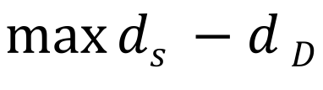
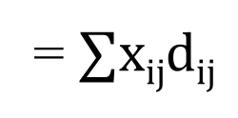
Understanding BFA and an Exercise of Primal-Dual
$$\max_{}{ds −d}D$$
$$for any edge i→j: di−dj≤dij$$
$$di≥0$$
D$ual:D\left(x\right)=\max{(ds −dD+∑xij\left(di−dj−dij\right))}$
= $∑xijdij$
x_{ij} is a flow from s to D
https://en.wikipedia.org/wiki/Shortest_path_problem#Linear_programming_formulation

Slide 7
Recap: Synchronous Bellman-Ford (SBF)
Nodes update in rounds:
  there is a global clock;
  at the beginning of each round, each node sends its estimate to all of its neighbors;
  at the end of the round, updates its estimation
A
B
E
C
D

Slide 8
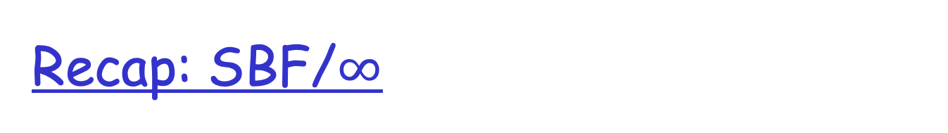
Recap: SBF/$∞$
7
B
1
C
A
8
2
10
E
D
2
Initialization (time 0):

Slide 9
Example
B
1
C
7
A
8
2
10
Consider D as destination; d(t) is a vector consisting of
estimation of each node at round t
E
D
2
A B C E D
d(0)
$∞$ $∞$ $∞$ $∞$ 0
d(1)
$∞$ $∞$ 2 2 0
d(2)
12 3 2 2 0
d(3)
10 3 2 2 0
d(4)
10 3 2 2 0
Observation: d(0) $≥$ d(1) $≥$d(2) $≥$d(3) $≥$ d(4) =d*

Slide 10
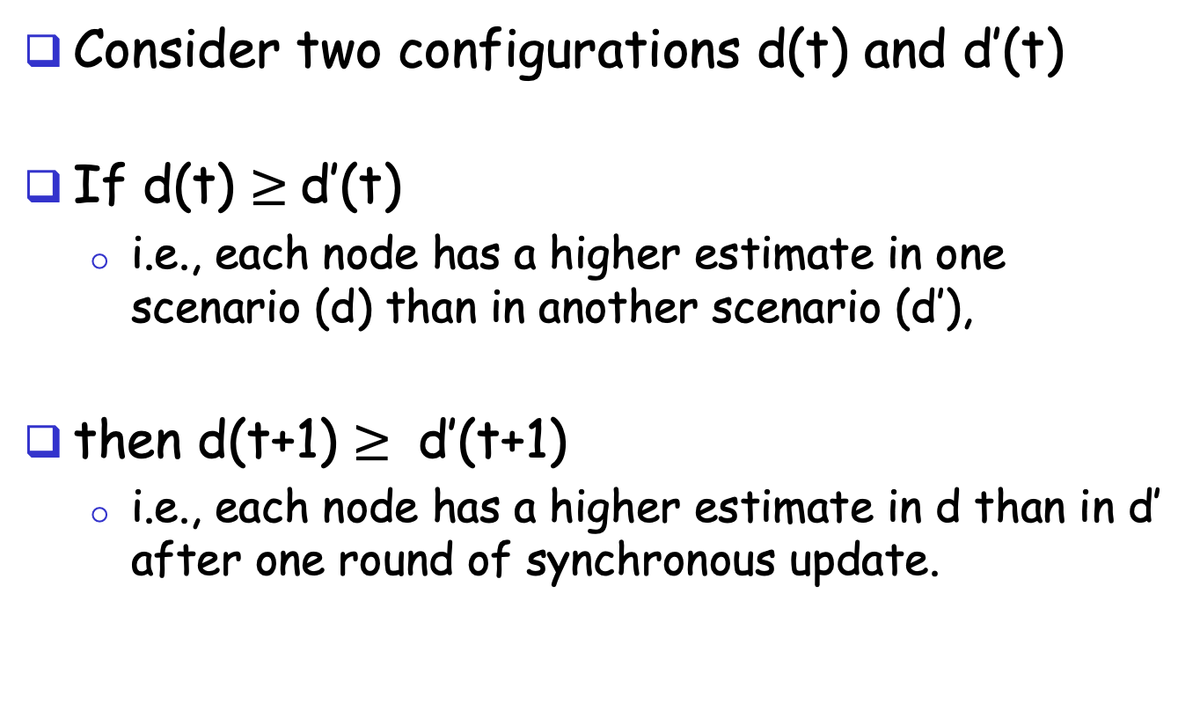
A Nice Property of SBF: Monotonicity
Consider two configurations d(t) and d’(t)
If d(t) $≥$d’(t)
  i.e., each node has a higher estimate in one scenario (d) than in another scenario (d’),
then d(t+1) $≥$ d’(t+1)
  i.e., each node has a higher estimate in d than in d’ after one round of synchronous update.

Slide 11
Correctness of SBF/$∞$
Claim: d_{i}(h) is the length L_{i}(h) of a shortest path from i to the destination using ≤ h hops
  base case: h = 0 is trivially true
  assume true for ≤ h,
  i.e., L_{i}(h)= d_{i}(h), L_{i}(h-1)= d_{i}(h-1), …

Slide 12
Correctness of SBF/$∞$
consider ≤ h+1 hops:
since d_{i}(h) ≤ d_{i}(h-1)

Slide 13
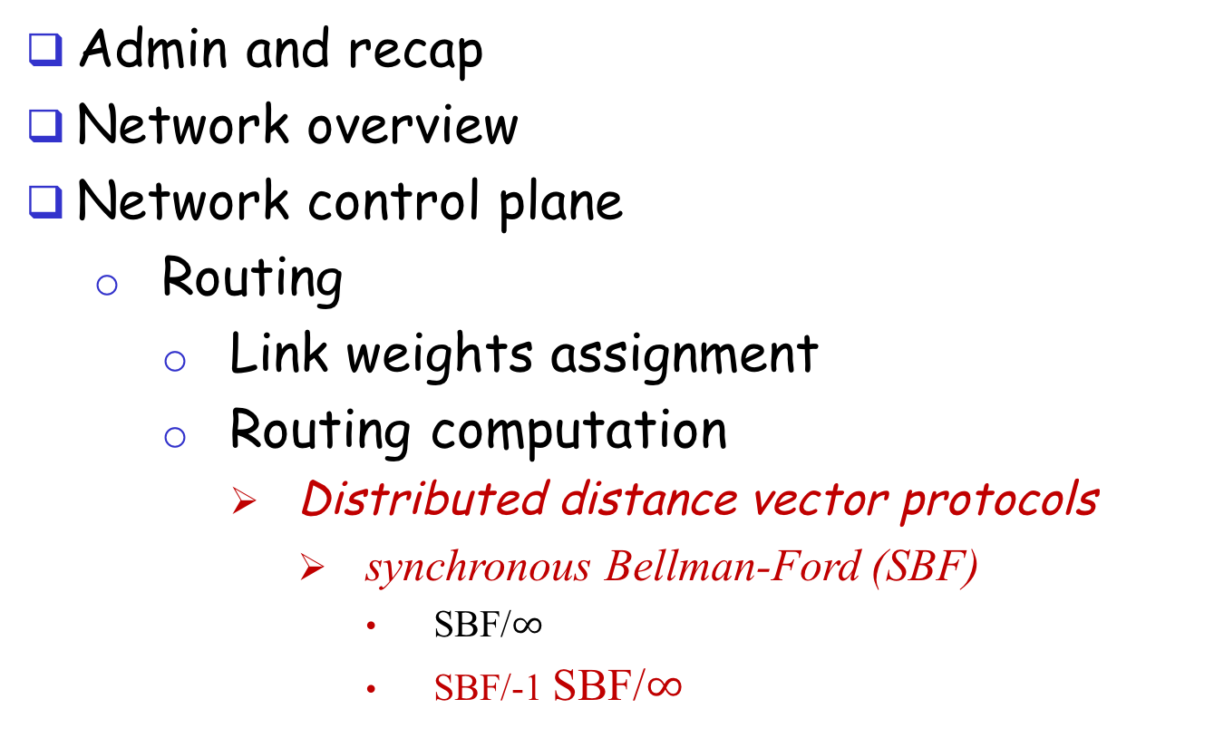
Outline
Admin and recap
Network overview
Network control plane
  Routing
    Link weights assignment
    Routing computation
      Distributed distance vector protocols
        synchronous Bellman-Ford (SBF)
          SBF/$∞$
          SBF/-1 SBF/$∞$

Slide 14
SBF at another
Initial Configuration: SBF/-1
7
B
1
C
A
8
2
10
E
D
2
Initialization (time 0):

Slide 15
Example
B
1
C
7
A
8
2
10
Consider D as destination
E
D
2
A B C E D
d(0)
-1 -1 -1 -1 0
d(1)
6 0 0 2 0
d(2)
7 1 1 2 0
d(3)
8 2 2 2 0
d(4)
9 3 3 2 0
d(5)
10 3 3 2 0
d(6)
10 3 3 2 0
Observation: d(0) $≤$d(1) $≤$d(2) $≤$d(3) $≤$ d(4) $≤$ d(5) = d(6) = d*

Slide 16
Correctness of SBF/-1
SBF/-1 converges due to monotonicity
Remaining question:
  Can we guarantee that SBF/-1 converges to shortest path?

Slide 17
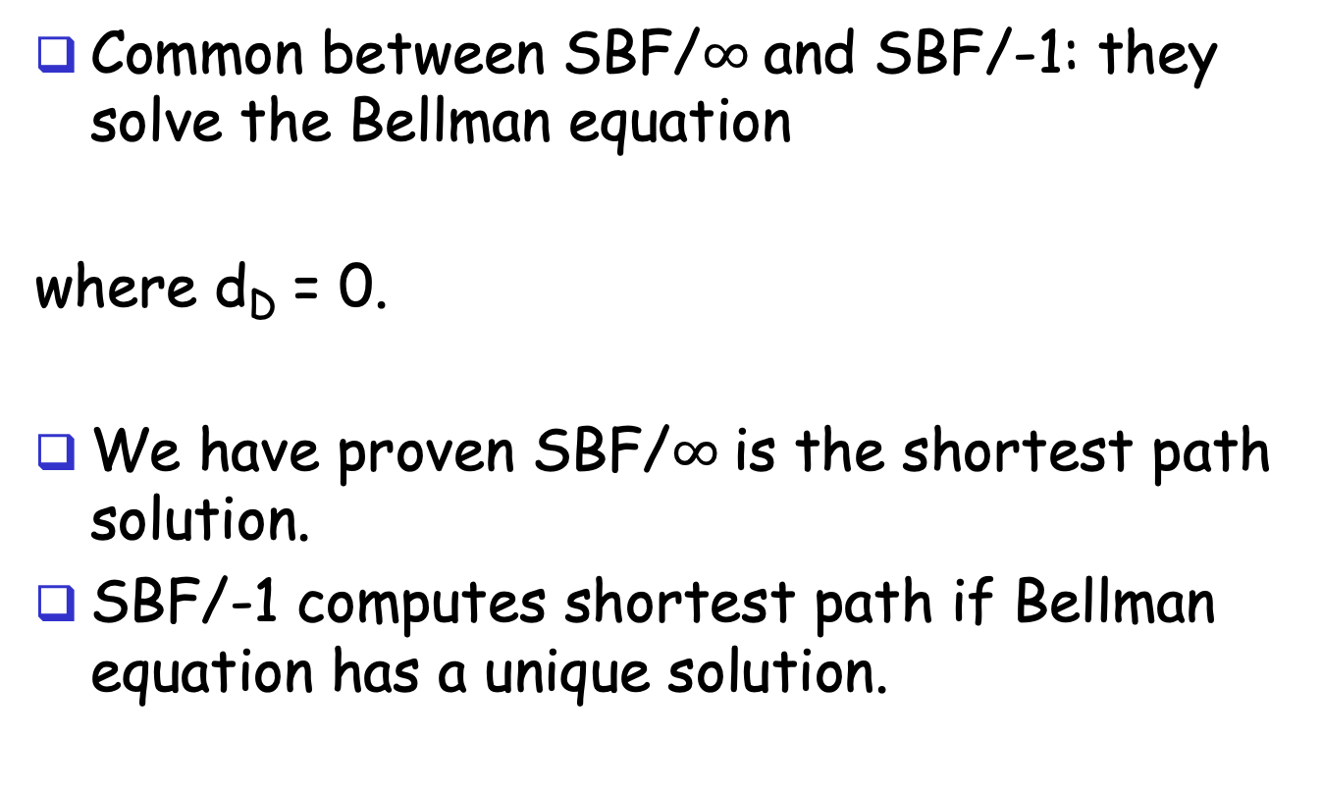
Correctness of SBF/-1
Common between SBF/$∞$and SBF/-1: they solve the Bellman equation
where d_{D} = 0.
We have proven SBF/$∞$is the shortest path solution.
SBF/-1 computes shortest path if Bellman equation has a unique solution.

Slide 18

Uniqueness of Solution to BE
Assume another solution d, we will show that d = d*
case 1: we show d $≥$d*
Since d is a solution to BE, we can construct
paths as follows: for each i, pick a j which
satisfies the equation; since d* is shortest, d $≥$ d*
3
2
7
B
1
C
10
A
8
2
10
E
D
2
2

Slide 19
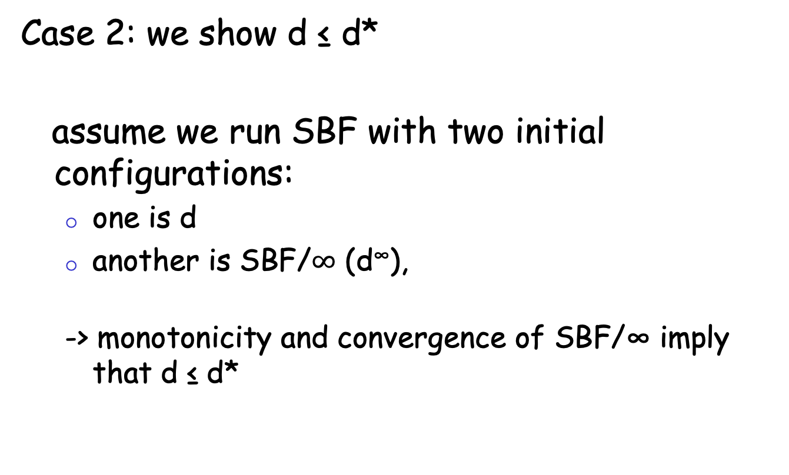
Uniqueness of Solution to BE
Case 2: we show d ≤ d*
assume we run SBF with two initial configurations:
  one is d
  another is SBF/$∞$ (d∞),
  -> monotonicity and convergence of SBF/∞ imply that d ≤ d*

Slide 20
Discussion
Will SBF converge under other non-negative initial conditions?
Problems of running synchronous BF?

Slide 21
Outline
Admin and recap
Network overview
Network control plane
  Routing
    Link weights assignment
    Routing computation
      Distributed distance vector protocols
        synchronous Bellman-Ford (SBF)
        asynchronous Bellman-Ford (ABF)

Slide 22
Asynchronous Bellman-Ford (ABF)
No notion of global iterations
  each node updates at its own pace
Asynchronously each node i computes
  using last received value d^{i}_{j} from neighbor j.
Asynchronously node j sends its estimate to its neighbor i:
  We assume that there is an upper bound on the delay of estimate packet
Notes:
Ti infinite
T^i_j infinite

Slide 23
ABF: Example
B
1
C
7
A
8
2
Below is just one step! The protocol repeats forever!
10
E
D
2
distance tables
from neighbors
computation
E’s
distance
table
distance
table E sends
to its neighbors
d ()
A
B
C
D
A B D
A B D
A: 10
B: 8
C: 4
D: 2
E: 0
E
0 7 $∞$
10 15 $∞$
A: 10
7 0 $∞$
17 8 $∞$
B: 8
destinations
$∞$ 1 2
$∞$ 9 4
D: 4
$∞ ∞$ 0
$∞ ∞$ 2
D: 2
10 8 2

Slide 24
Asynchronous Bellman-Ford (ABF)
ABF will eventually converge to the shortest path
  links can go down and come up – but if topology is stabilized after some time t and connected, ABF will eventually converge to the shortest path !

Slide 25
ABF Convergence Proof Complexity: Complex System State
j
i
What is system state?
Notes:
There are three types of distance estimates from node i:
d_i: current distance estimate at node i
- d^j_i: last d_i that neighbor j received
- d^j_i: d_i that are in transit to neighbor j

Slide 26
System State
three types of distance state from node j:
d_{j}: current distance estimate state at node j
- d^{i}_{j}: last d_{j} that neighbor i received
- d^{i}_{j}: those d_{j} that are still in transit to neighbor i
dj
d^{i}_{j}
d^{i}_{j}
d_{i}

Slide 27
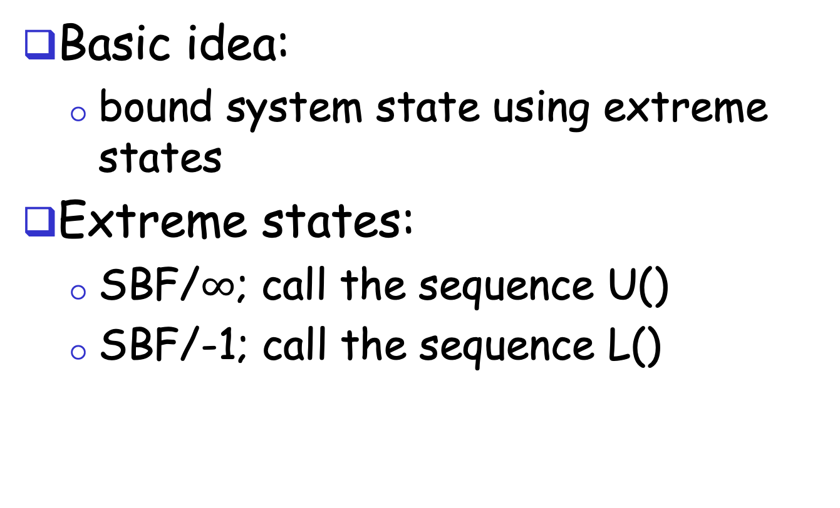
ABF Convergence Proof:
The Sandwich Technique
Basic idea:
  bound system state using extreme states
Extreme states:
  SBF/$∞$; call the sequence U()
  SBF/-1; call the sequence L()
Notes:
The state includes di, di_j, and messages containing di_j

Slide 28
ABF Convergence
Consider the time when the topology is stabilized as time 0
U(0) and L(0) provide upper and lower bounds at time 0 on all corresponding elements of states
  L_{j} (0) ≤ d_{j} ≤ U_{j} (0) for all d_{j} state at node j
  L_{j} (0) ≤ d^{i}_{j} ≤ U_{j} (0)
  L_{j} (0) ≤ update messages d^{i}_{j} ≤ U_{j} (0)
Notes:
The state includes di, di_j, and messages containing di_j

Slide 29
ABF Convergence
d_{j}
  after at least one
  update at node j:
  d_{j} falls between
  L_{j} (1) ≤ d_{j} ≤ U_{j} (1)
d^{i}_{j} :
  eventually all d^{i}_{j} that
  are only bounded by
  L_{j} (0) and U_{j} (0) are
  replaced with in
  L_{j}(1) and U_{j}(1)
dj
d^{i}_{j}
d^{i}_{j}
d_{i}
Notes:
The state includes di, di_j, and messages containing di_j

Slide 30
Asynchronous Bellman-Ford: Summary
Distributed
  each node communicates its routing table to its directly-attached neighbors
Iterative
  continues periodically or when link changes, e.g. detects a link failure
Asynchronous
  nodes need not exchange info/iterate in lock step!
Convergence
  in finite steps, independent of initial condition if network is connected

Slide 31
Summary: Distributed Distance-Vector
Tool box: a key technique for proving convergence (liveness) of distributed protocols: monotonicity and bounding-box (sandwich) design
  Consider two configurations d(t) and d’(t):
    if d(t) <= d’(t), then d(t+1) <= d’(t+1)
  Identify two extreme configurations to sandwich any real configurations

Slide 32
Outline
Admin and recap
Network control plane
  Routing
    Link weights assignment
    Routing computation
      Distance vector protocols (distributed computing)
        synchronous Bellman-Ford (SBF)
        asynchronous Bellman-Ford (ABF)
        properties of DV

Slide 33
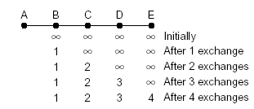
Properties of Distance-Vector Algorithms
Good news propagate fast

Slide 34
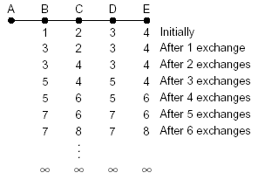
Properties of Distance-Vector Algorithms
Bad news propagate slowly
This is called the counting-to-infinity problem
Q: what causes counting-to-infinity?
A-B link down

Slide 35
Counting-To-Infinity is Because of Routing Loop
Counting-to-infinity is caused by a routing loop, which is a global state (consisting of the nodes’ local states) at a global moment (observed by an oracle) such that there exist nodes A, B, C, … E such that A (locally) thinks B as next hop, B thinks C as next hop, … E thinks A as next hop

Slide 36
Discussion
Why avoid routing loops is hard?
Any proposals to avoid routing loops?

Slide 37
Outline
Admin and recap
Network control plane
  Routing
    Link weights assignment
    Routing computation
      Distance vector protocols (distributed computing)
        synchronous Bellman-Ford (SBF)
        asynchronous Bellman-Ford (ABF)
        properties of DV
          DV w/ loop prevention
            reverse poison

Slide 38
The Reverse-Poison
(Split-horizon) Hack
B
1
C
7
A
8
2
If the path to dest is through neighbor h, report
∞ to neighbor h for dest.
1
E
D
2
distance tables
from neighbors
computation
E’s
distance
table
distance
table E sends
to its neighbors
E
D
$$∞$$
$$∞$$
4
2
D ()
A
B
C
D
A
0
7
$$∞$$
$$∞$$
1
c(E,A)
B
7
0
1
$$∞$$
8
c(E,B)
D
$$∞$$
$$∞$$
2
0
2
c(E,D)
A
1
8
$$∞$$
$$∞$$
B
15
8
9
$$∞$$
1, A
8, B
4, D
2, D
To A
A: $∞$
B: 8
C: 4
D: 2
E: 0
To B
A: 1
B: $∞$
C: 4
D: 2
E: 0
To D
A: 1
B: 8
C: $∞$
D: $∞$
E: 0
destinations
distance
through
neighbor
38

Slide 39
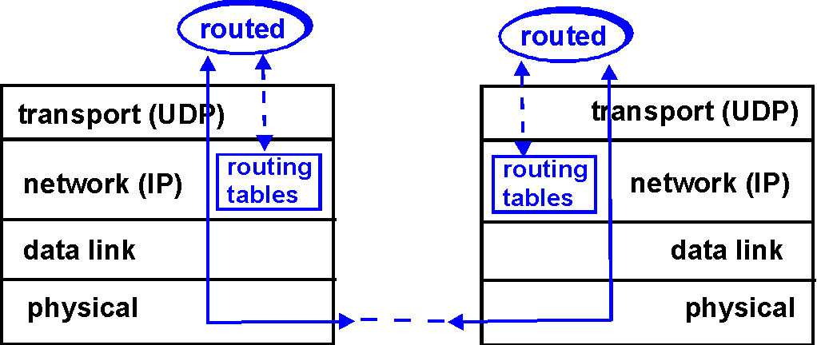
DV+RP => RIP
( Routing Information Protocol)
Included in BSD-UNIX
Distribution in 1982
Link cost: 1
Distance metric: # of
hops
Distance vectors
  exchanged every 30 sec via Response Message (also called advertisement) using UDP
  each advertisement: route to up to 25 destination nets
39

Slide 40
RIP: Link Failure and Recovery
If no advertisement heard after 180 sec --> neighbor/link declared dead
  routes via neighbor invalidated
  new advertisements sent to neighbors
  neighbors in turn send out new advertisements
  (if tables changed)
  link failure info quickly propagates to entire net
  reverse-poison used to prevent ping-pong loops
  set infinite distance = 16 hops (why?)
40

Slide 41
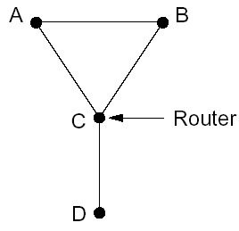
General Routing Loops and Reverse-poison
Exercise: Can Reverse-poison guarantee no loop for this network?

Slide 42
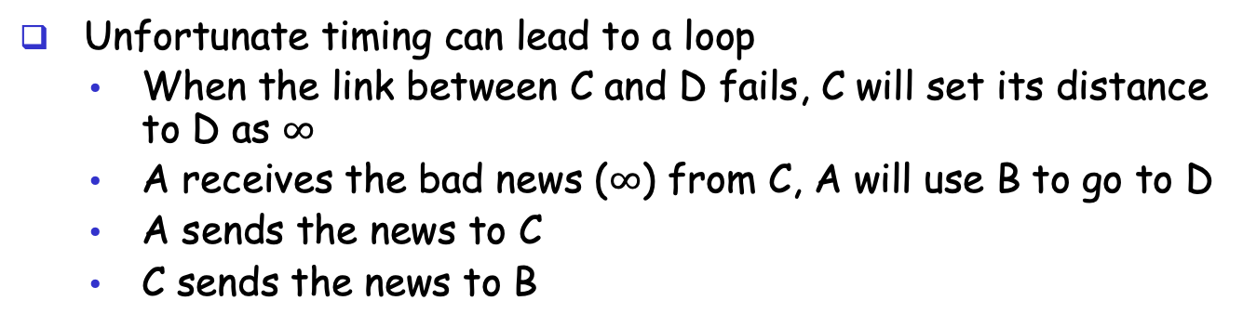
General Routing Loops and Reverse-poison
Reverse-poison removes two-node loops but may not remove more-node loops
I can reach
D w/ cost 3
Unfortunate timing can lead to a loop
  When the link between C and D fails, C will set its distance to D as $∞$
  A receives the bad news ($∞$) from C, A will use B to go to D
  A sends the news to C
  C sends the news to B

Slide 43
Outline
Admin and recap
Network control plane
  Routing
    Link weights assignment
    Routing computation
      Distance vector protocols (distributed computing)
        synchronous Bellman-Ford (SBF)
        asynchronous Bellman-Ford (ABF)
        properties of DV
          DV w/ loop prevention
            reverse poison
            destination-sequenced DV (DSDV)

Slide 44
Destination-Sequenced
Distance Vector protocol (DSDV)
Basic idea: use sequence numbers to partition computation
  tags each route with a sequence number
  each destination node D periodically advertises monotonically increasing even-numbered sequence numbers
  when a node realizes that the link it uses to reach destination D is broken, it advertises an infinite metric and a sequence number which is one greater than the previous route (i.e., an odd seq. number)
    the route is repaired by a later even-number advertisement from the destination

Slide 45
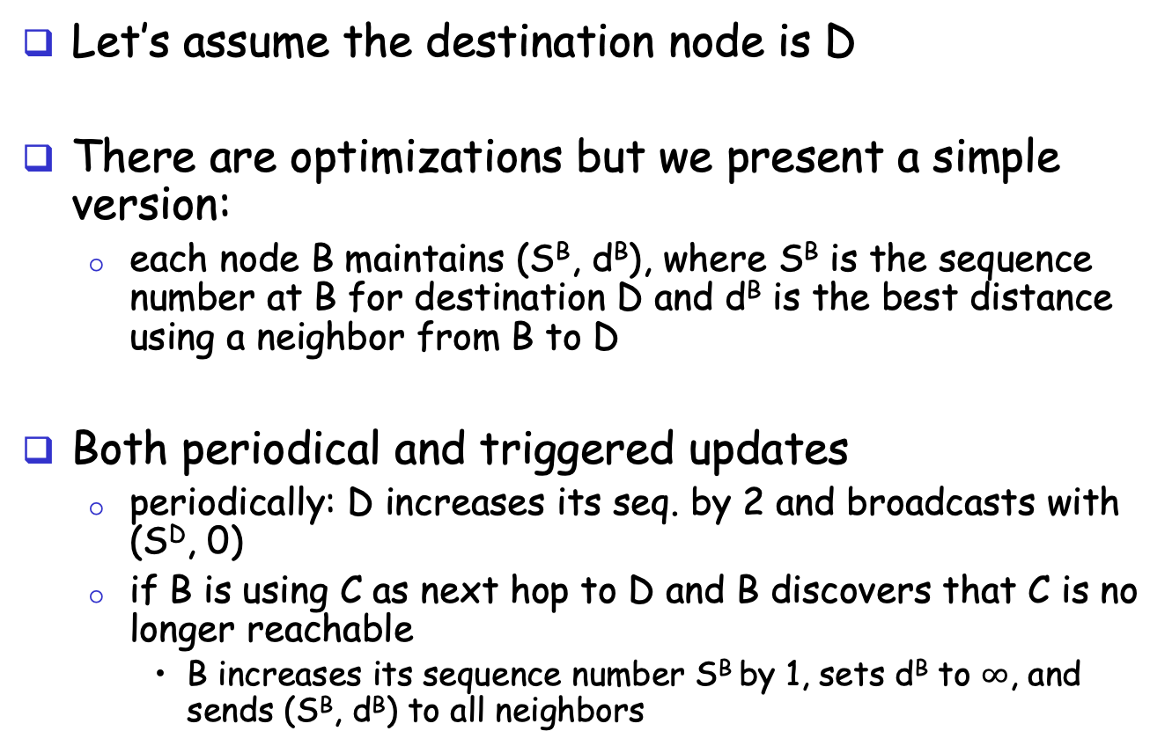
DSDV: More Detail
route update
A
B
Let’s assume the destination node is D
There are optimizations but we present a simple version:
  each node B maintains (S^{B}, d^{B}), where S^{B} is the sequence number at B for destination D and d^{B} is the best distance using a neighbor from B to D
Both periodical and triggered updates
  periodically: D increases its seq. by 2 and broadcasts with (S^{D}, 0)
  if B is using C as next hop to D and B discovers that C is no longer reachable
    B increases its sequence number S^{B} by 1, sets d^{B} to $∞$, and sends (S^{B}, d^{B}) to all neighbors
Notes:
The step if S^{A} > S^{B}, then update may not be good because it maybe a cross talk.

Slide 46
Example
1
5
X
1
1
Will this trigger an update?

Slide 47
Example
1
5
X
1
1
Will this trigger an update?

Slide 48
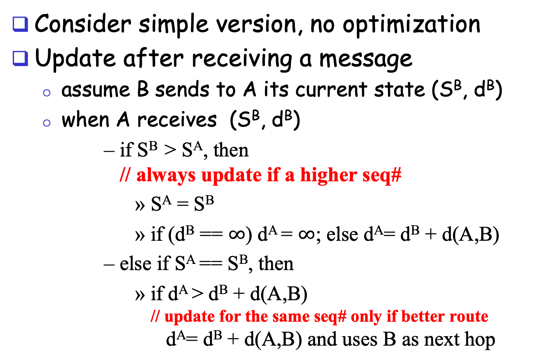
DSDV: Update Alg.
route update
A
B
Consider simple version, no optimization
Update after receiving a message
  assume B sends to A its current state (S^{B}, d^{B})
  when A receives (S^{B}, d^{B})
      if S^{B} > S^{A}, then
      // always update if a higher seq#
        S^{A} = S^{B}
        if (d^{B} == $∞$) d^{A} = $∞$; else d^{A}= d^{B} + d(A,B)
      else if S^{A} == S^{B}, then
        if d^{A} > d^{B} + d(A,B)
        // update for the same seq# only if better route
        d^{A}= d^{B} + d(A,B) and uses B as next hop
Notes:
The step if S^{A} > S^{B}, then update may not be good because it maybe a cross talk.

