Slide 1
Network Applications: HTTP/1.1/2; Operational Analysis
Qiao Xiang, Congming Gao, Qiang Su
https://sngroup.org.cn/courses/cnns-xmuf25/index.shtml
10/09/2025
This deck of slides are heavily based on CPSC 433/533 at Yale University, by courtesy of Dr. Y. Richard Yang.

Slide 2
Outline
Admin and recap
HTTP
HTTP “acceleration”
Operational analysis

Slide 3
Admin
Lab assignment 2 due Oct. 14
Lab assignment 3 to be posted

Slide 4
Outline
Admin and recap
HTTP/1.0
HTTP “acceleration”

Slide 5
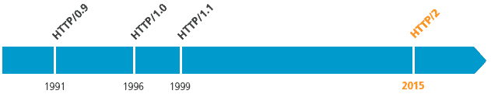
Recap: Substantial Efforts to Speedup Basic HTTP/1.0
Reduce the number of objects fetched [Browser cache]
Reduce data volume [Compression of data]
Header compression [HTTP/2]
Reduce the latency to the server to fetch the content [Proxy cache]
Remove the extra RTTs to fetch an object [Persistent HTTP, aka HTTP/1.1]
Increase concurrency [Multiple TCP connections]
Asynchronous fetch (multiple streams) using a single TCP [HTTP/2]
Server push [HTTP/2]

Slide 6
Browser Cache and Conditional GET
client
server
Goal: don’t send object if client has up-to-date stored (cached) version
client: specify date of cached copy in http request
If-modified-since: <date>
server: response contains no object if cached copy up-to-date:
HTTP/1.0 304 Not Modified
http request msg
If-modified-since: <date>
object
not
modified
http response
HTTP/1.0
304 Not Modified
http request msg
If-modified-since: <date>
object
modified
http response
HTTP/1.1 200 OK
…
<data>

Slide 7
Web Caches (Proxy)
Goal: satisfy client request without involving origin server
origin
server
Proxy
server
http request
http request
client
http response
http response
http request
http request
http response
http response
client
origin
server

Slide 8
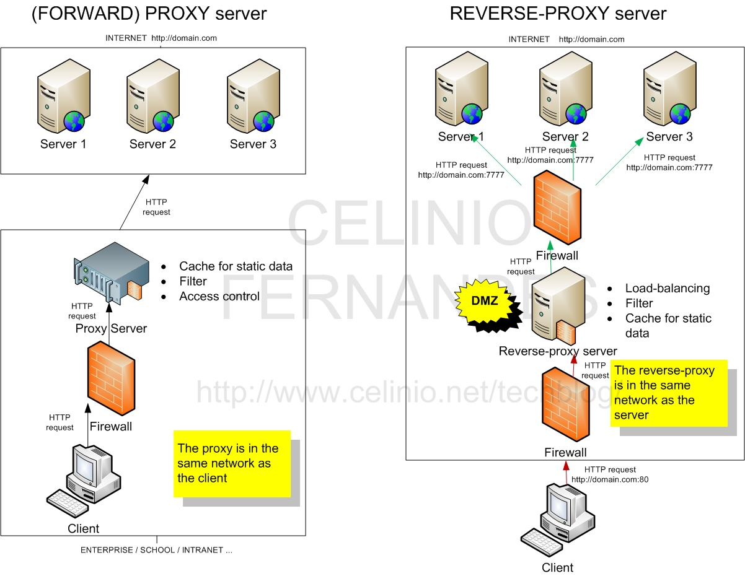
Two Types of Proxies
http://www.celinio.net/techblog/?p=1027
Typically in the same network as the client
Typically in the same network as the server

Slide 9
Benefits of Forward Proxy
origin
servers
Assume: cache is “close” to client (e.g., in same network)
smaller response time: cache “closer” to client
decrease traffic to distant servers
link out of institutional/local ISP network often is bottleneck
public
Internet
1.5 Mbps
access link
institutional
network
10 Mbps LAN
institutional
cache

Slide 10
No Free Lunch: Problems of Web Caching
The major issue of web caching is how to maintain consistency
Two ways
pull
Web caches periodically pull the web server to see if a document is modified
push
whenever a server gives a copy of a web page to a web cache, they sign a lease with an expiration time; if the web page is modified before the lease, the server notifies the cache

Slide 11
HTTP/1.1: Persistent (keepalive/pipelining) HTTP
HTTP/1.0 allows a single request outstanding, while HTTP/1.1 allows request pipelining
On same TCP connection: server parses request, responds, parses new request, …
Client sends requests for all referenced objects as soon as it receives base HTML
Benefit
Fewer RTTs
See Joshua Graessley WWDC 2012 talk: 3x within iTunes

Slide 12
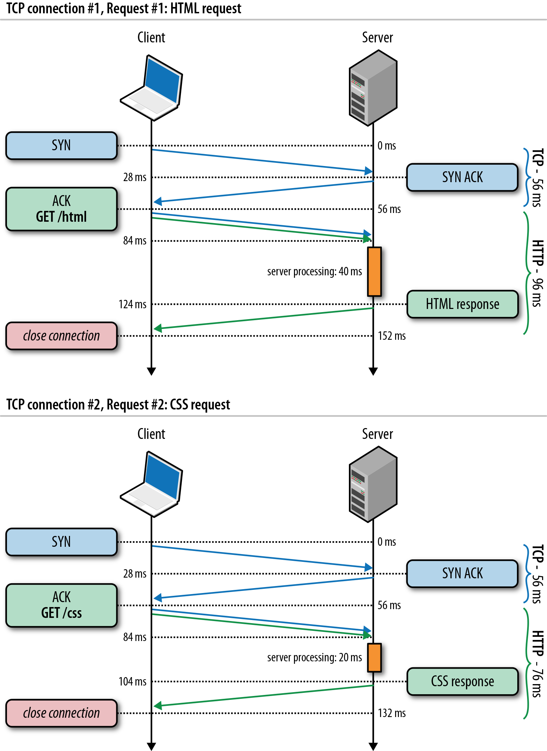
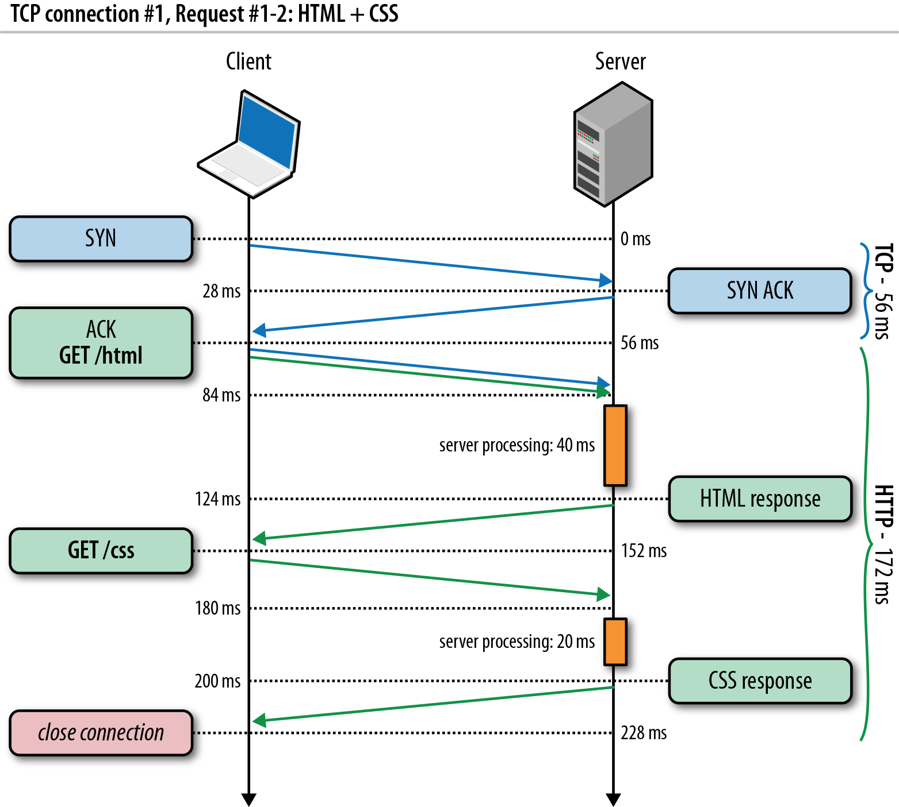
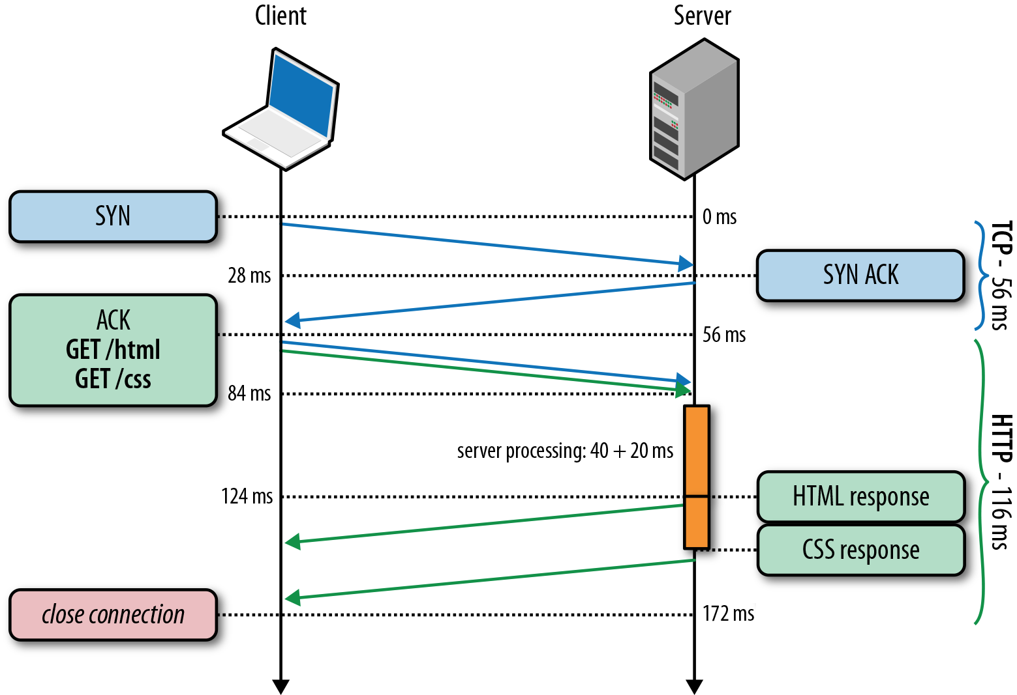
HTTP/1.0, Keep-Alive, Pipelining
Is this the best we can do?
Source: http://chimera.labs.oreilly.com/books/1230000000545/ch11.html
Notes:
https://httpd.apache.org/docs/2.2/howto/ssi.html

Slide 13
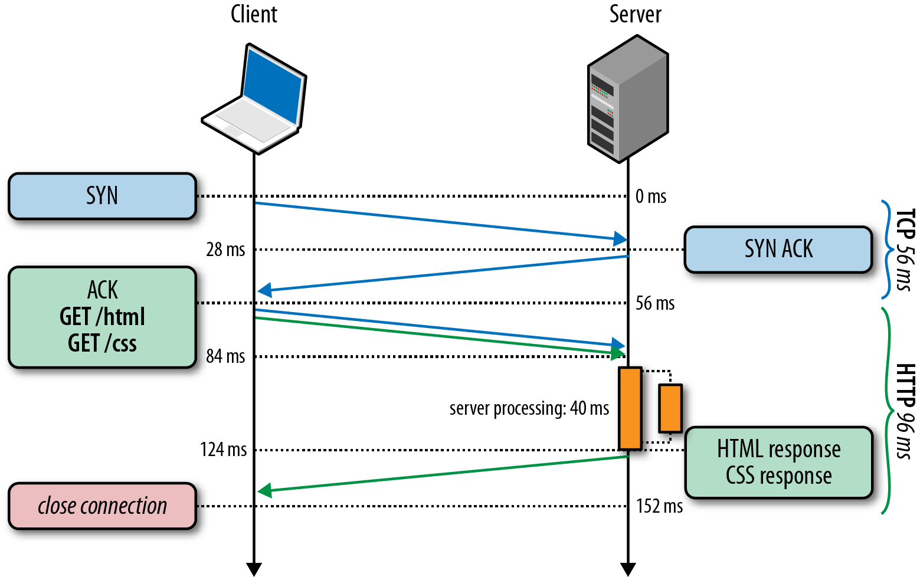
HTTP/2 Basic Idea: Remove Head-of-Line Blocking in HTTP/1.1
Data flows for sequential to parallel: two requests must be concurrent.
Demo: https://http2.akamai.com/demo
Source: http://chimera.labs.oreilly.com/books/1230000000545/ch11.html
Notes:
https://httpd.apache.org/docs/2.2/howto/ssi.html

Slide 14
Observing HTTP/2
export SSLKEYLOGFILE=/tmp/keylog.txt
Start Chrome, e.g.,
Mac: /Applications/Google Chrome.app/Contents/MacOS/Google Chrome
Ubuntu: firefox
Visit HTTP/2 pages, such as https://www.tmall.com
Wireshark:
Mac: Wireshark -> preferences -> protocol -> TSL
(pre)-master-secret log file name
Ubuntu: edit -> perferences -> protocol -> SSL
(pre)-master-secret log file name

Slide 15
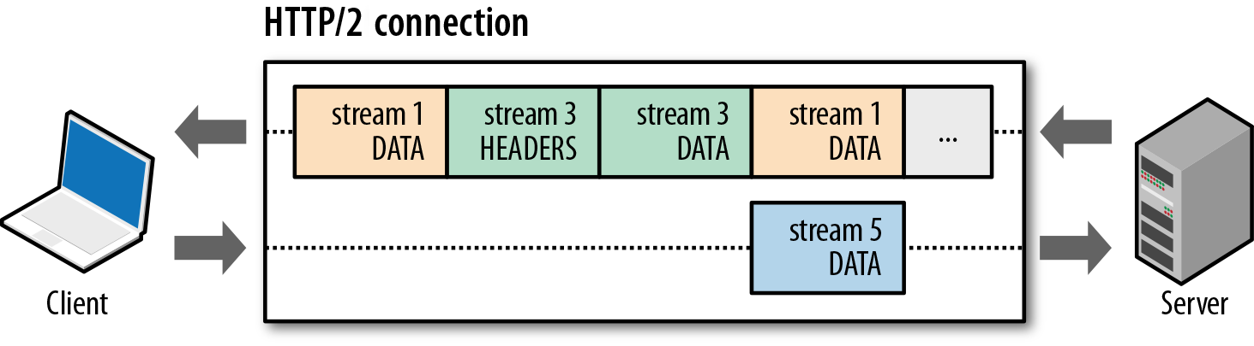
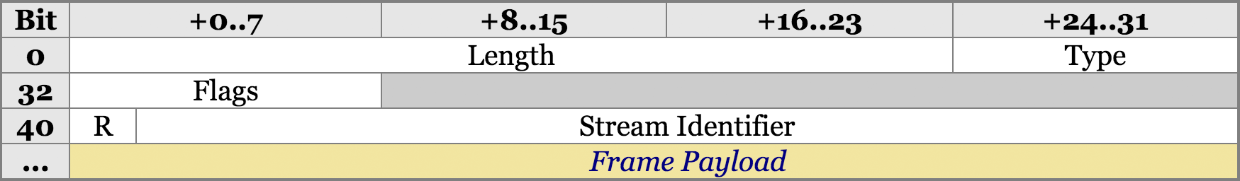
HTTP/2 Design: Multi-Streams
HTTP/2 Binary Framing
https://hpbn.co/http2/
https://tools.ietf.org/html/rfc7540

Slide 16
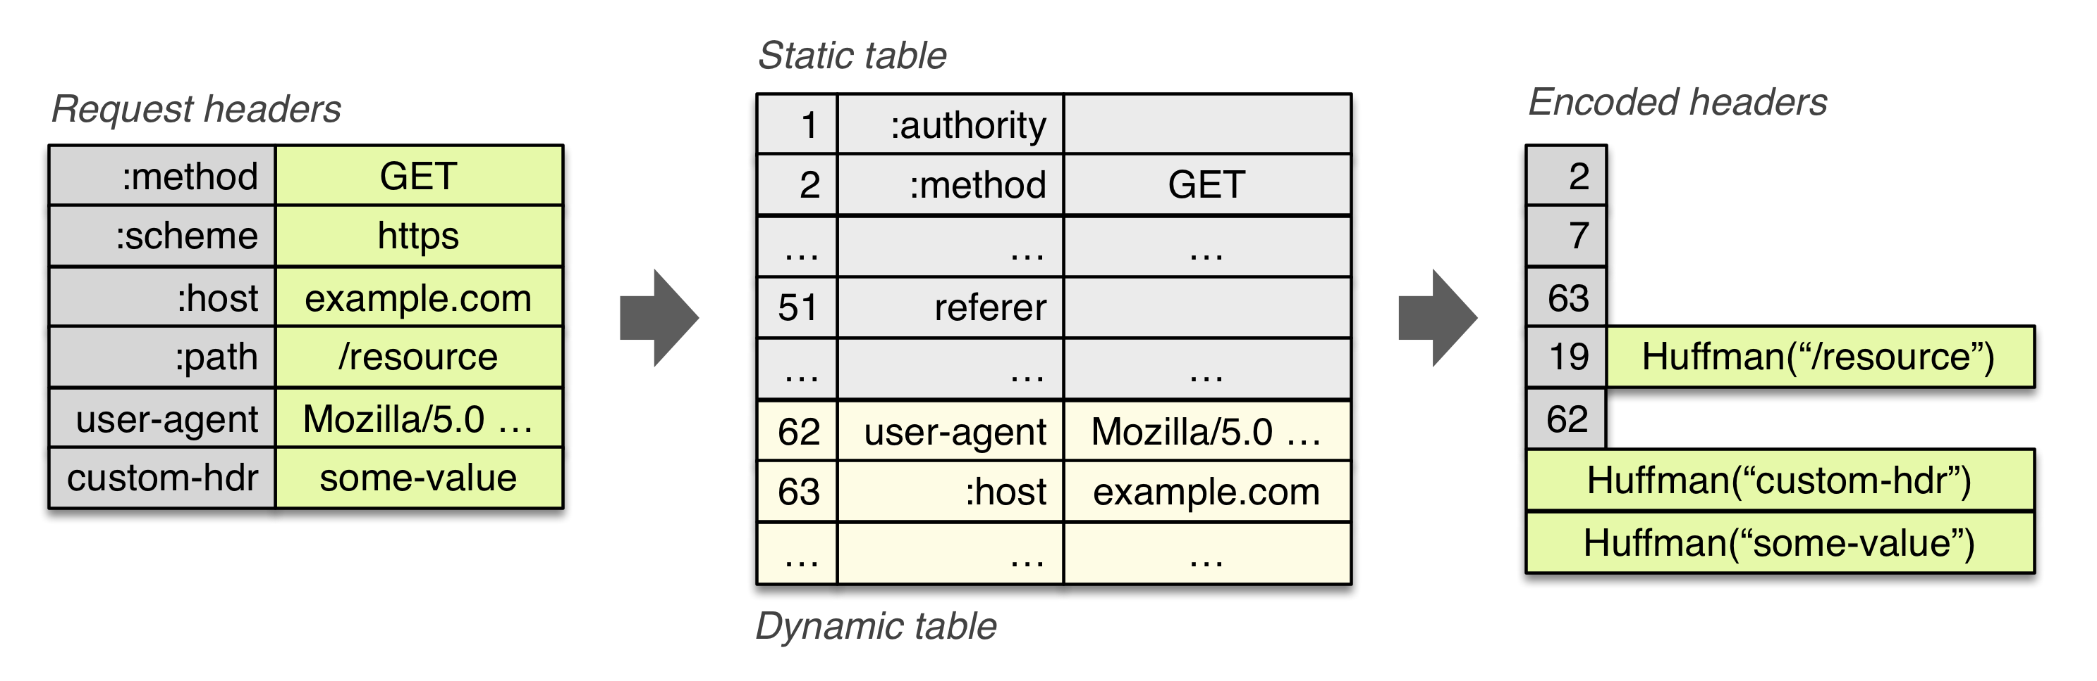
HTTP/2 Header Compression

Slide 17
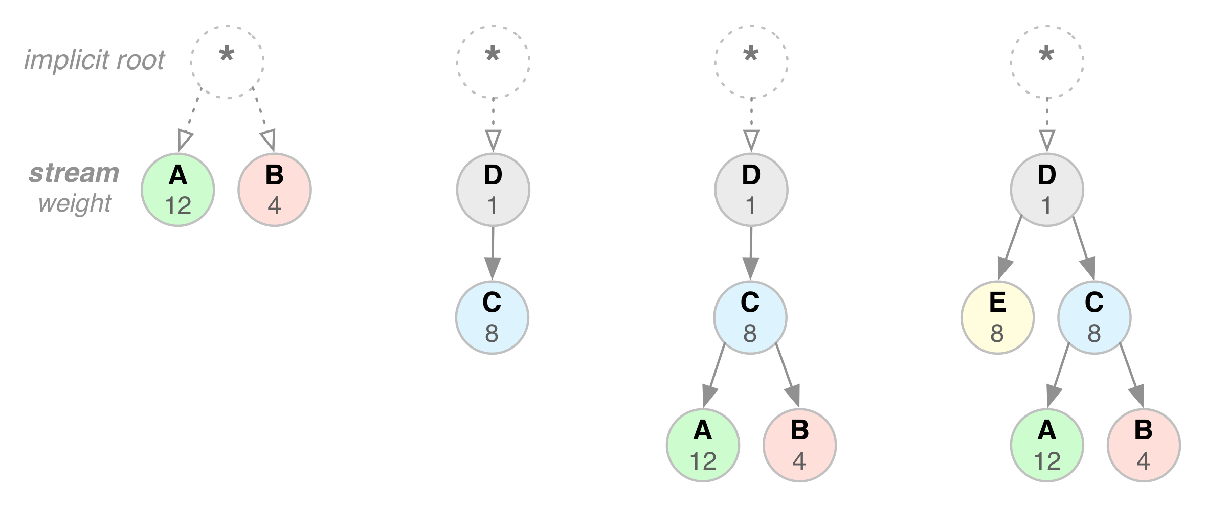
HTTP/2 Stream Dependency and Weights

Slide 18
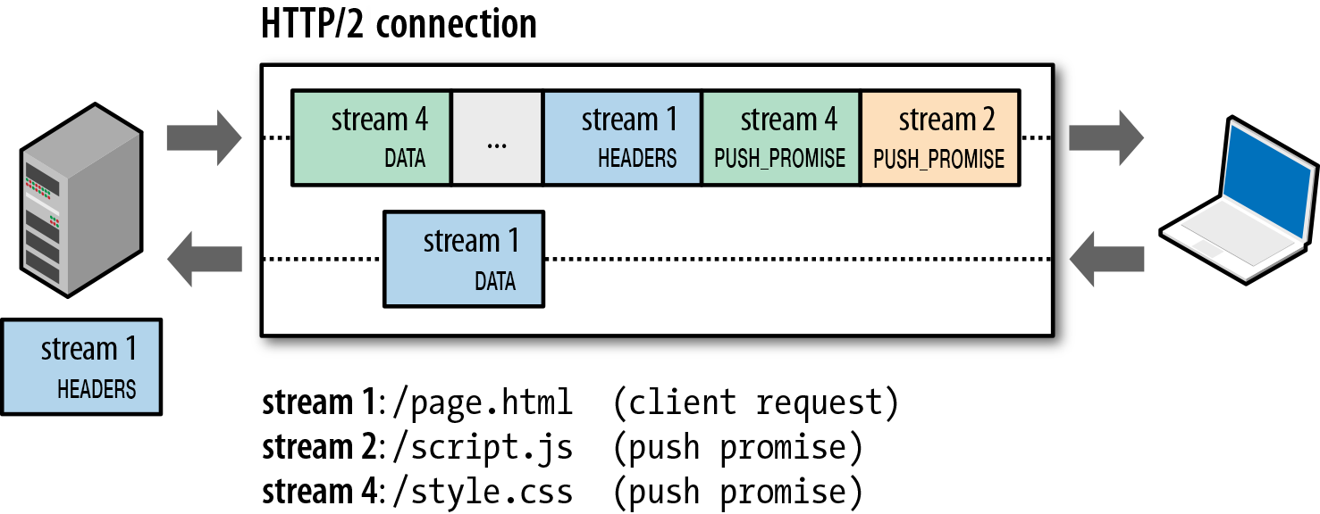
HTTP/2 Server Push

Slide 19
Outline
Admin and recap
HTTP
HTTP "acceleration"
Operational analysis

Slide 20
Goal: Best Server Design Limited Only by Resource Bottleneck
CPU
DISK
Before
NET
CPU
DISK
After
NET

Slide 21
Some Questions
When is CPU the bottleneck for scalability?
So that we need to add helper threads
How do we know that we are reaching the limit of scalability of a single machine?
These questions drive network server architecture design
Some basic performance analysis techniques are good to have

Slide 22

Background: Little’s Law (1961)
For any system with no or (low) loss.
Assume
mean arrival rate λ, mean time R at system, and mean number Q of requests at system
Then relationship between Q, λ, and R:
R, Q
λ
Example: XMU admits 3000 students each year, and mean time a student stays is 4 years, how many students are enrolled?
Notes:
Proof of Little’s Law:

Slide 23
Little’s Law: Proof
arrival
A
3
2
1
t
time

Slide 24
Operational Analysis
Relationships that do not require any assumptions about the distribution of service times or inter-arrival times
Hence focus on measurements
Identified originally by Buzen (1976) and later extended by Denning and Buzen (1978).
We touch only some techniques/results
In particular, bottleneck analysis
More details see linked reading

Slide 25
Under the Hood (An example FSM)
exit
(throughput λ until some
center saturates)
start (arrival rate λ)
CPU
I/O request
File I/O
network
Memory cache

Slide 26
Operational Analysis: Resource Demand of a Request
CPU
V_{CPU} visits for S_{CPU} units of resource time per visit
Network
V_{Net} visits for S_{Net} units of resource time per visit
Disk
V_{Disk} visits for S_{Disk} units of resource time per visit
Memory
V_{Mem} visits for S_{Mem} units of resource time per visit

Slide 27
Operational Quantities
T: observation interval Ai: # arrivals to device i
Bi: busy time of device i Ci: # completions at device i
i = 0 denotes system

Slide 28
Utilization Law
The law is independent of any assumption on arrival/service process
Example: Suppose NIC processes 125 pkts/sec, and each pkt takes 2 ms. What is utilization of the network NIC?

Slide 29
Deriving Relationship Between R, U, and S for one Device
Assume flow balanced (arrival=throughput), Little’s Law:
Assume PASTA (Poisson arrival--memory-less arrival--sees time average), a new request sees Q ahead of it, and FIFO
According to utilization law, U = XS

Slide 30
Forced Flow Law
Assume each request visits device i Vi times

Slide 31
Bottleneck Device
Define Di = Vi Si as the total demand of a request on device i
The device with the highest Di has the highest utilization, and thus is called the bottleneck

Slide 32
Bottleneck vs System Throughput

