Slide 1
Network Applications: Operational Analysis; Load Balancing among Homogeneous Servers
Qiao Xiang, Congming Gao, Qiang Su
https://sngroup.org.cn/courses/cnns-xmuf25/index.shtml
10/14/2025
This deck of slides are heavily based on CPSC 433/533 at Yale University, by courtesy of Dr. Y. Richard Yang.

Slide 2
Outline
Admin and recap
HTTP
HTTP “acceleration”
Operational analysis

Slide 3
Admin
Lab assignment 2 due today
Lab assignment 3 to be posted

Slide 4
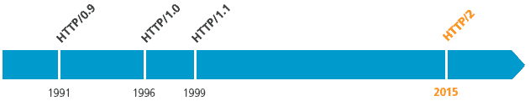
Recap: Substantial Efforts to Speedup Basic HTTP/1.0
Reduce the number of objects fetched [Browser cache]
Reduce data volume [Compression of data]
Header compression [HTTP/2]
Reduce the latency to the server to fetch the content [Proxy cache]
Remove the extra RTTs to fetch an object [Persistent HTTP, aka HTTP/1.1]
Increase concurrency [Multiple TCP connections]
Asynchronous fetch (multiple streams) using a single TCP [HTTP/2]
Server push [HTTP/2]

Slide 5
Outline
Admin and recap
HTTP
HTTP "acceleration"
Operational analysis

Slide 6
Goal: Best Server Design Limited Only by Resource Bottleneck
CPU
DISK
Before
NET
CPU
DISK
After
NET

Slide 7
Some Questions
When is CPU the bottleneck for scalability?
So that we need to add helper threads
How do we know that we are reaching the limit of scalability of a single machine?
These questions drive network server architecture design
Some basic performance analysis techniques are good to have

Slide 8

Background: Little’s Law (1961)
For any system with no or (low) loss.
Assume
mean arrival rate λ, mean time R at system, and mean number Q of requests at system
Then relationship between Q, λ, and R:
R, Q
λ
Example: XMU admits 5000 students each year, and mean time a student stays is 4 years, how many students are enrolled?
Notes:
Proof of Little’s Law:

Slide 9
Little’s Law: Proof
arrival
A
3
2
1
t
time

Slide 10
Operational Analysis: Resource Demand of a Request
CPU
V_{CPU} visits for S_{CPU} units of resource time per visit
Network
V_{Net} visits for S_{Net} units of resource time per visit
Disk
V_{Disk} visits for S_{Disk} units of resource time per visit
Memory
V_{Mem} visits for S_{Mem} units of resource time per visit

Slide 11
Operational Quantities
T: observation interval Ai: # arrivals to device i
Bi: busy time of device i Ci: # completions at device i
i = 0 denotes system

Slide 12
Utilization Law
The law is independent of any assumption on arrival/service process
Example: Suppose NIC processes 125 pkts/sec, and each pkt takes 2 ms. What is utilization of the network NIC?

Slide 13
Deriving Relationship Between R, U, and S for one Device
Assume flow balanced (arrival=throughput), Little’s Law:
Assume PASTA (Poisson arrival--memory-less arrival--sees time average), a new request sees Q ahead of it, and FIFO
According to utilization law, U = XS

Slide 14
Forced Flow Law
Assume each request visits device i Vi times

Slide 15
Bottleneck Device
Define Di = Vi Si as the total demand of a request on device i
The device with the highest Di has the highest utilization, and thus is called the bottleneck

Slide 16
Bottleneck vs System Throughput

Slide 17
Example 1
A request may need
10 ms CPU execution time
1 Mbytes network bw
1 Mbytes file access where
50% hit in memory cache
Suppose network bw is 100 Mbps, disk I/O rate is 1 ms per 8 Kbytes (assuming the program reads 8 KB each time)
Where is the bottleneck?

Slide 18
Example 1 (cont.)
CPU:
D_{CPU}=
Network:
D_{Net} =
Disk I/O:
Ddisk =
10 ms ( e.q. 100 requests/s)
1 Mbytes / 100 Mbps = 80 ms (e.q., 12.5 requests/s)
0.5 * 1 ms * 1M/8K = 62.5 ms (e.q. = 16 requests/s)

Slide 19
Example 2
A request may need
150 ms CPU execution time (e.g., dynamic content)
1 Mbytes network bw
1 Mbytes file access where
50% hit in memory cache
Suppose network bw is 100 Mbps, disk I/O rate is 1 ms per 8 Kbytes (assuming the program reads 8 KB each time)
Bottleneck: CPU -> use multiple threads to use more CPUs, if available, to avoid CPU as bottleneck

Slide 20
Interactive Response Time Law
System setup
Closed system with N users
Each user sends in a request, after response, think time, and then sends next request
Notation
Z = user think-time, R = Response time
The total cycle time of a user request is R+Z
In duration T, #requests generated by each user:
T/(R+Z) requests

Slide 21
Interactive Response Time Law
If N users and flow balanced:

Slide 22
Bottleneck Analysis
Here D is the sum of Di

Slide 23
Proof
We know
Using interactive response time law:

Slide 24
Summary: Operational Laws
Utilization law: U = XS
Forced flow law: Xi = Vi X
Bottleneck device: largest Di = Vi Si
Little’s Law: Qi = Xi Ri
Bottleneck bound of interactive response (for the given closed model):

Slide 25

In Practice: Common Bottlenecks
No more file descriptors
Sockets stuck in TIME_WAIT
High memory use (swapping)
CPU overload
Interrupt (IRQ) overload
[Aaron Bannert]

Slide 26
YouTube Design Alg.
http://video.google.com/videoplay?docid=-6304964351441328559#
while (true) { identify_and_fix_bottlenecks(); drink(); sleep(); notice_new_bottleneck(); }

Slide 27
Outline
Admin and recap
HTTP: single server
Multiple network servers
Why multiple network servers

Slide 28
Why Multiple Servers?
Scalability
Scaling beyond single server throughput
There is a fundamental limit on what a single server can
process (CPU/bw/disk throughput)
store (disk/memory)
Scaling beyond single geo location latency
There is a limit on the speed of light
Network detour and delay further increase the delay
Notes:
Facebook 12 M HTTP/sec
http://www.datadoghq.com/2013/07/the-best-of-velocity-and-devopsdays-2013-part-ii/

Slide 29
Why Multiple Servers?
Redundancy and fault tolerance
Administration/Maintenance (e.g., incremental upgrade)
Redundancy (e.g., to handle failures)

Slide 30
Why Multiple Servers?
System/software architecture
Resources may be naturally distributed at different machines (e.g., run a single copy of a database server due to single license; access to resource from third party)
Security (e.g., front end, business logic, and database)
Today we focus mostly on the first benefit, for homogeneous (replica) servers

Slide 31
Outline
Recap
Single network server
Multiple network servers
Why multiple servers
Multiple servers basic mechanism: request routing

Slide 32
Request Routing: Overview
Site A
Site B
?
- Global request routing: select a server site for each request
- Local request routing: select a specific server at the chosen site
Internet
Client

Slide 33

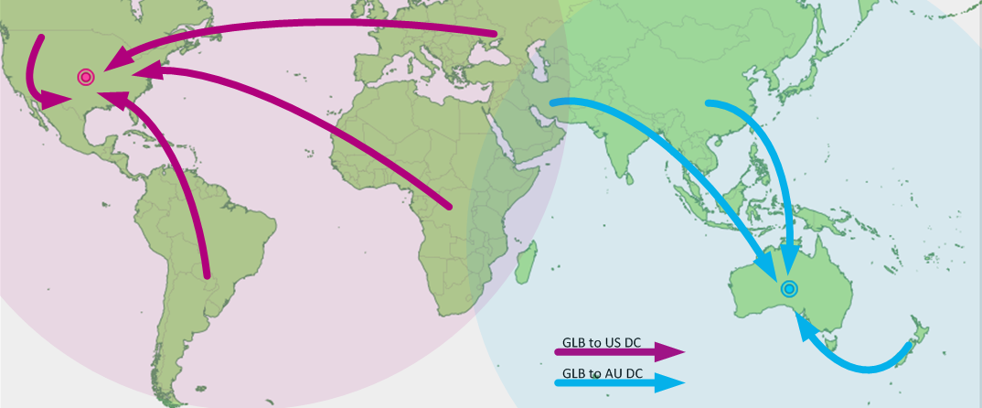
Request Routing: Overview
https://splash.riverbed.com/docs/DOC-1705

Slide 34
Request Routing: Basic Architecture
Site A
Site B
Major components
Server state monitoring
Load (incl. failed or not); what requests it can serve
Network path properties estimation
E.g., bw, delay, loss, network cost between clients and servers
Server assignment alg.
Request direction mechanism
?
Internet
Client
Notes:
What are challenges of each component?

Slide 35
Request Routing: Basic Architecture
server
state
net state: path property between servers/clients
server
selection algorithm
notify client
about selection (direction mech.)
requests

Slide 36
Network Path Properties
Why is the problem difficult?
Scalability: if do measurements, complete measurements grow with N * M, where
N is # of clients
M is # of servers
Complexity/feasibility in computing path metrics
M
N

Slide 37
Network Path Properties: Improve Scalability
Aggregation:
merge a set of IP addresses (reduce N and M)
E.g., when computing path properties, aggregates all clients sharing the same local DNS server
Sampling and prediction
Instead of measuring N*M entries, we measure a subset and predict the unmeasured paths
We will cover it later in the course
M servers
N’~100K local DNS servers
N~all Internet clients

Slide 38
Server Assignment
Why is the problem difficult?
What are potential problems of just sending each new client to the lightest load server?

Slide 39
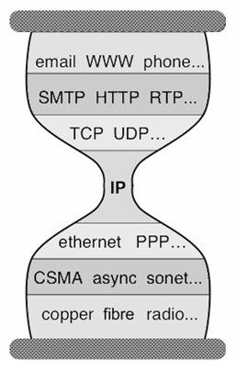
Client Direction Mechanisms
Key difficulty
May need to handle a large of clients
Basic types of mechanisms
Application layer, e.g.,
App/user is given a list of candidate server names
HTTP redirector
DNS: name resolution gives a list of server addresses
IP layer: Same IP address represents multiple physical servers
IP anycast: Same IP address shared by multiple servers and announced at different parts of the Internet. Network directs different clients to different servers
Smart-switch indirection: a server IP address may be a virtual IP address for a cluster of physical servers

Slide 40
Direction Mechanisms are Often Combined
App
DNS name1
DNS name2
IP1
IP2
IPn
Cluster1 in US East
Cluster2
in US West
Cluster2
in Europe
Load
balancer
Load
balancer
proxy
servers

Slide 41
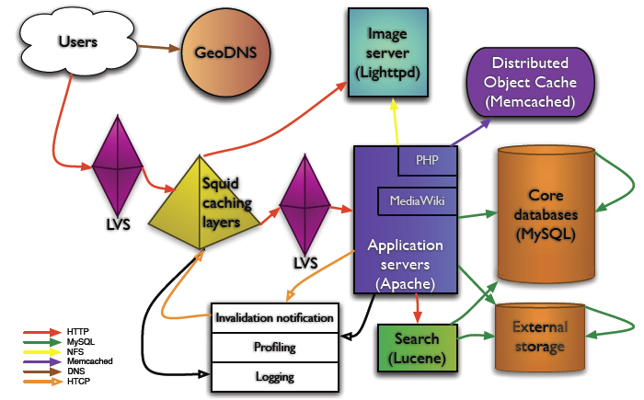
Example: Wikipedia Architecture
http://wikitech.wikimedia.org/images/8/81/Bergsma_-_Wikimedia_architecture_-_2007.pdf

Slide 42
Outline
Recap
Single, high-performance network server
Multiple network servers
Why multiple servers
Request routing mechanisms
Overview
Application-layer

Slide 43
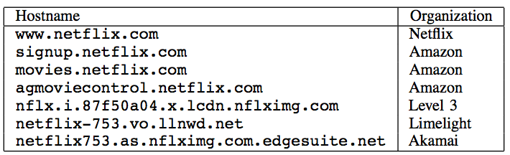
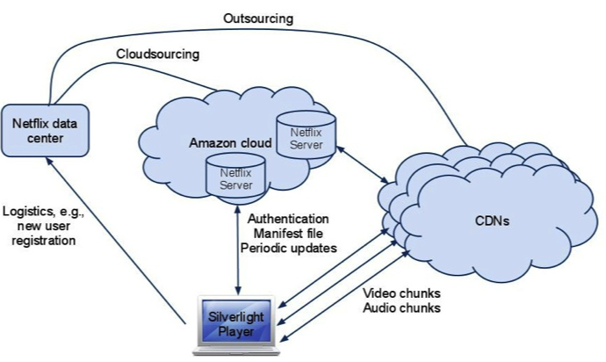
Example: Netflix

Slide 44
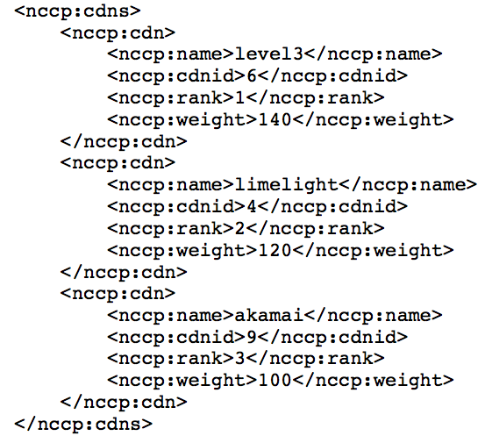
Example: Netflix Manifest File
Client player authenticates and then downloads manifest file from servers at Amazon Cloud

Slide 45
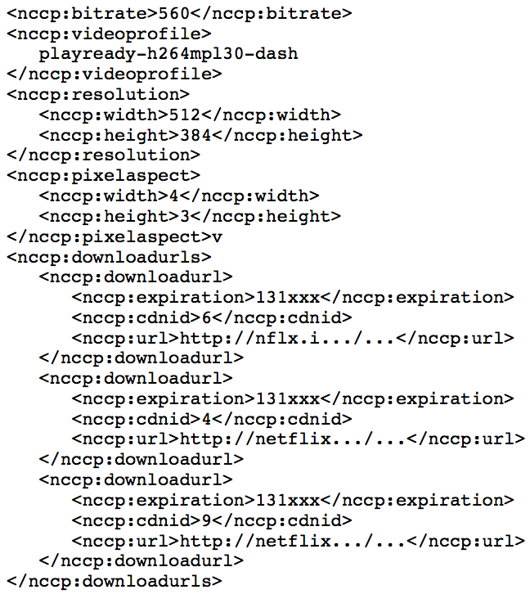
Example: Netflix Manifest File

Slide 46
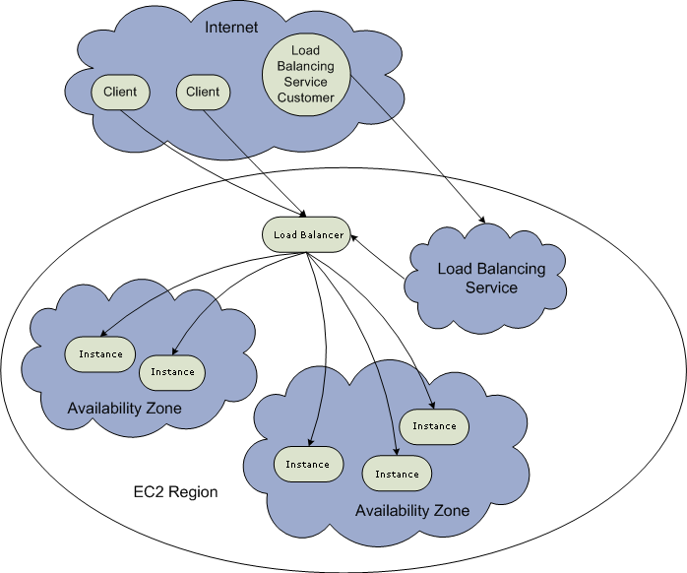
Example: Amazon Elastic Cloud 2 (EC2) Elastic Load Balancing
Use the create-load-balancer command to create an Elastic Load Balancer.
Use the register-instances -with-load-balancer command to register the Amazon EC2 instances that you want to load balance with the Elastic Load Balancer.
Elastic Load Balancing automatically checks the health of your load balancing Amazon EC2 instances. You can optionally customize the health checks by using the configure-healthcheck command.
Traffic to the DNS name provided by the Elastic Load Balancer is automatically distributed across healthy Amazon EC2 instances.
http://docs.aws.amazon.com/ElasticLoadBalancing/latest/DeveloperGuide/elastic-load-balancing.html

Slide 47
Details: Create Load Balancer
The operation returns the DNS name of your LoadBalancer. You can then map that to any other domain name (such as www.mywebsite.com) (how?) %aws elb create-load-balancer --load-balancer-name my-load-balancer --listeners "Protocol=HTTP,LoadBalancerPort=80,InstanceProtocol=HTTP,InstancePort=80" --availability-zones us-west-2a us-west-2b Result:
{ "DNSName": "my-load-balancer-123456789.us-west-2.elb.amazonaws.com”}
http://docs.aws.amazon.com/cli/latest/reference/elb/create-load-balancer.html

Slide 48
Details: Configure Health Check
The operation configures how instances are monitored, e.g., %aws elb configure-health-check --load-balancer-name my-load-balancer --health-check Target=HTTP:80/png,Interval=30,UnhealthyThreshold=2,HealthyThreshold=2,Timeout=3
Result:
{
"HealthCheck": {
"HealthyThreshold": 2,
"Interval": 30,
"Target": "HTTP:80/png",
"Timeout": 3,
"UnhealthyThreshold": 2
}
http://docs.aws.amazon.com/cli/latest/reference/elb/configure-health-check.html

Slide 49
Details: Register Instances
The operation registers instances that can receive traffic, %aws elb register-instances-with-load-balancer --load-balancer-name my-load-balancer --instances i-d6f6fae3
Result:
{ "Instances": [ {"InstanceId": "i-d6f6fae3“},
{"InstanceId": "i-207d9717“},
{"InstanceId": "i-afefb49b“}
]
}
http://docs.aws.amazon.com/cli/latest/reference/elb/register-instances-with-load-balancer.html

Slide 50
Outline
Recap
Single network server
Multiple network servers
Why multiple servers
Request routing mechanisms
Overview
Application-layer
DNS

Slide 51


Basic DNS Indirection and Rotation
%dig cnn.com
157.166.226.25
router
157.166.226.26
IP address
of cnn.com
157.166.255.18
157.166.226.25
157.166.226.26
IP address
of cnn.com
DNS server for cnn.com
157.166.226.26
157.166.226.25

Slide 52
CDN Using DNS (Akamai Architecture as an Example)
Content publisher (e.g., cnn)
provides base HTML documents
runs origin server(s); but delegates heavy-weight content (e.g., images) to CDN
Akamai runs
(~240,000) edge servers for hosting content
Deployment into 130 countries and 1600 networks
Claims 85% Internet users are within a single "network hop" of an Akamai CDN server.
customized DNS redirection servers to select edge servers based on
closeness to client browser, server load
Source: https://www.akamai.com/us/en/about/facts-figures.jsp

Slide 53
Linking to Akamai
Originally, URL Akamaization of embedded content: e.g.,
<IMG SRC= http://www.provider.com/image.gif > changed to
<IMG SRC = http://a661. g.akamai.net/hash/image.gif>
URL Akamaization is becoming obsolete and supported mostly for legacy reasons
Note that this DNS redirection unit is per customer, not individual files.

Slide 54
Exercise
https://cdn.nba.com/manage/2021/08/GettyImages-1234610091-scaled-e1665274852371-784x441.jpg
Check any web page of nba.com and find a page with an image
Find the URL
Use %dig [+trace] to see DNS load direction
https://www.nba.com/news/reports-lakers-extend-gm-rob-pelinka-through-2025-26-season
Notes:
https://media.cnn.com/api/v1/images/stellar/prod/221007114404-01-kogi-nigeria-floods.jpg?c=16x9&q=h_720,w_1280,c_fill

Slide 55
Recap: CNAME based DNS Name
Typical design
Use cname to create aliases, e.g., https://cdn.nba.com/manage/2021/08/GettyImages-1234610091-scaled-e1665274852371-1568x882.jpg
cname: e8017.dscb.akamaiedge.net
why two levels in the name?

Slide 56
https://cdn.nba.com/manage/2025/10/16x9-43.jpg?w=1568&h=882

