Slide 1
Network Applications: Load Balancing among Homogeneous Servers
Qiao Xiang, Congming Gao, Qiang Su
https://sngroup.org.cn/courses/cnns-xmuf25/index.shtml
10/16/2025
This deck of slides are heavily based on CPSC 433/533 at Yale University, by courtesy of Dr. Y. Richard Yang.

Slide 2
Outline
Admin and recap
Multiple network servers

Slide 3
Recap: Operational Laws
Utilization law: U = XS
Forced flow law: Xi = Vi X
Bottleneck device: largest Di = Vi Si
Little’s Law: Qi = Xi Ri
Bottleneck bound of interactive response (for the given closed model):

Slide 4
Recap: Why Multiple Servers?
Scalability
Scaling beyond single server throughput
There is a fundamental limit on what a single server can
process (CPU/bw/disk throughput)
store (disk/memory)
Scaling beyond single geo location latency
There is a limit on the speed of light
Network detour and delay further increase the delay
Notes:
Facebook 12 M HTTP/sec
http://www.datadoghq.com/2013/07/the-best-of-velocity-and-devopsdays-2013-part-ii/

Slide 5
Request Routing: Overview
Site A
Site B
?
- Global request routing: select a server site for each request
- Local request routing: select a specific server at the chosen site
Internet
Client

Slide 6
Request Routing: Basic Architecture
server
state
net state: path property between servers/clients
server
selection algorithm
notify client
about selection (direction mech.)
requests

Slide 7
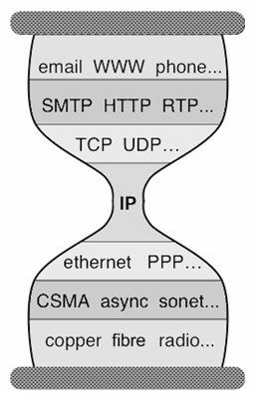
Client Direction Mechanisms
Key difficulty
May need to handle a large of clients
Basic types of mechanisms
Application layer, e.g.,
App/user is given a list of candidate server names
HTTP redirector
DNS: name resolution gives a list of server addresses
IP layer: Same IP address represents multiple physical servers
IP anycast: Same IP address shared by multiple servers and announced at different parts of the Internet. Network directs different clients to different servers
Smart-switch indirection: a server IP address may be a virtual IP address for a cluster of physical servers

Slide 8
Direction Mechanisms are Often Combined
App
DNS name1
DNS name2
IP1
IP2
IPn
Cluster1 in US East
Cluster2
in US West
Cluster2
in Europe
Load
balancer
Load
balancer
proxy
servers

Slide 9
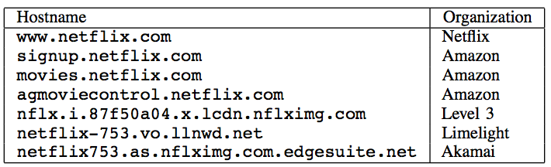
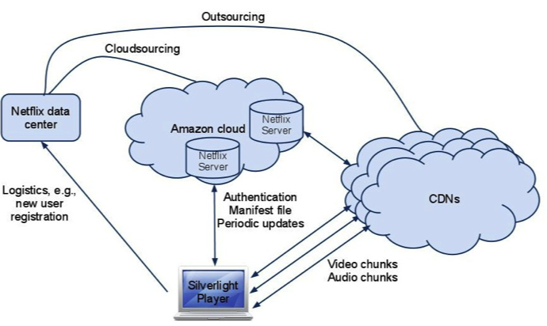
Example: Netflix

Slide 10
Outline
Recap
Single network server
Multiple network servers
Why multiple servers
Request routing mechanisms
Overview
Application-layer
DNS

Slide 11


Basic DNS Indirection and Rotation
%dig cnn.com
157.166.226.25
router
157.166.226.26
IP address
of cnn.com
157.166.255.18
157.166.226.25
157.166.226.26
IP address
of cnn.com
DNS server for cnn.com
157.166.226.26
157.166.226.25

Slide 12
CDN Using DNS (Akamai Architecture as an Example)
Content publisher (e.g., cnn)
provides base HTML documents
runs origin server(s); but delegates heavy-weight content (e.g., images) to CDN
Akamai runs
(~240,000) edge servers for hosting content
Deployment into 130 countries and 1600 networks
Claims 85% Internet users are within a single "network hop" of an Akamai CDN server.
customized DNS redirection servers to select edge servers based on
closeness to client browser, server load
Source: https://www.akamai.com/us/en/about/facts-figures.jsp

Slide 13
Linking to Akamai
Originally, URL Akamaization of embedded content: e.g.,
<IMG SRC= http://www.provider.com/image.gif > changed to
<IMG SRC = http://a661. g.akamai.net/hash/image.gif>
URL Akamaization is becoming obsolete and supported mostly for legacy reasons
Note that this DNS redirection unit is per customer, not individual files.

Slide 14
Exercise
https://cdn.nba.com/manage/2021/08/GettyImages-1234610091-scaled-e1665274852371-784x441.jpg
Check any web page of nba.com and find a page with an image
Find the URL
Use %dig [+trace] to see DNS load direction
https://www.nba.com/news/reports-lakers-extend-gm-rob-pelinka-through-2025-26-season
Notes:
https://media.cnn.com/api/v1/images/stellar/prod/221007114404-01-kogi-nigeria-floods.jpg?c=16x9&q=h_720,w_1280,c_fill

Slide 15
Exercise
https://cdn.nba.com/manage/2025/10/16x9-43.jpg?w=1568&h=882

Slide 16
Recap: CNAME based DNS Name
Typical design
Use cname to create aliases, e.g., https://cdn.nba.com/manage/2021/08/GettyImages-1234610091-scaled-e1665274852371-1568x882.jpg
cname: e8017.dscb.akamaiedge.net
why two levels in the name?

Slide 17
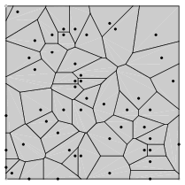
Two-Level Direction
high-level DNS determines proximity, directs to low-level DNS;
low-level DNS: who manages a close-by cluster of servers with different IP addresses
Input: dscb.akamaiedge.net & and client IP,
Output: region (low-level) DNS
Input: e8017.dscb.akamaiedge.net & and client IP
Output: specific servers

Slide 18
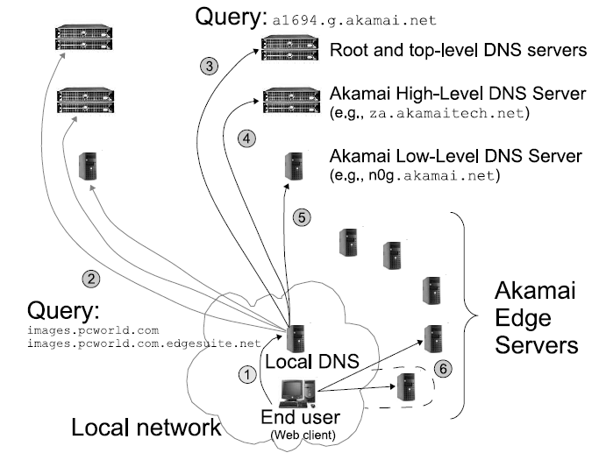
Akamai Load Direction
If the directed edge server does not have requested content,
it goes back to the original server (source) .
Notes:
High-level DNS determines client location and forward to the corresponding low level DNS

Slide 19
Two-Level DNS Mapping Alg
High-level
Typically geo-location matching from client to reg
Low-level
Typically secret, e.g., details of Akamai algorithms are proprietary
Typical goal: load balancing among servers

Slide 20
Akamai Local DNS LB Alg
A Bin-Packing algorithm (column 12 of Akamai Patent) every T second
Compute the load to each publisher k (called serial number)
Sort the publishers from increasing load
For each publisher, associate a list of random servers generated by a hash function
Hash range may be increasing, e.g., first hash [0,1], second [0, 3]
Assign the publisher to the first server that does not overload

Slide 21
Discussion
Advantages of using DNS for using multiple servers (LB)
Leveraging existing DNS features (e.g., cname, hierarchy name for natural hierarchical redirection)
Leveraging existing DNS deployment/optimization
Disadvantages of using DNS
Distributed caching may lead to slow response
Only in the unit of IP addresses

Slide 22
Outline
Recap
Multiple network servers
Basic issues
Load direction
DNS (IP level)
Load balancer/smart switch (sub-IP level)

Slide 23
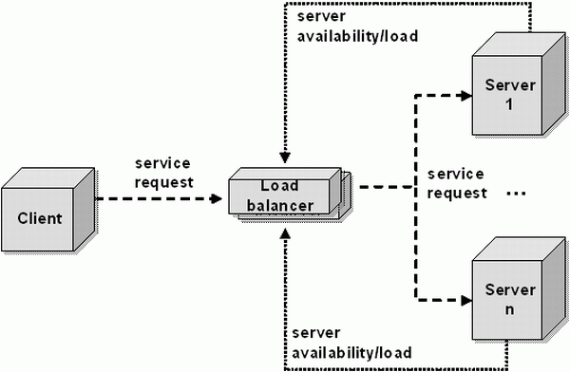
Smart Switch: Big Picture
smart switch

Slide 24
Load Balancer (LB): Basic Structure
RIP1
S=client
D=VIP
Server1
S=client
D=VIP
VIP
RIP2
Client
LB
Server2
RIP3
Server3
Problem of the basic structure?

Slide 25
Problem
S=client
D=VIP
Client to server packet has VIP as destination address, but real servers use RIPs
if LB just forwards the packet from client to a real server, the real server drops the packet
reply from real server to client has real server IP as source -> client will drop the packet
state: listening
address: {RealIP.6789, *:*}
completed connection queue: C1; C2 sendbuf:
recvbuf:
state:
address: {VIP:6789, 198.69.10.10.1500}
sendbuf:
recvbuf:
…
state:
address: {RealIP:6789, 198.69.10.10.1500}
sendbuf:
recvbuf:
…
server
client

Slide 26
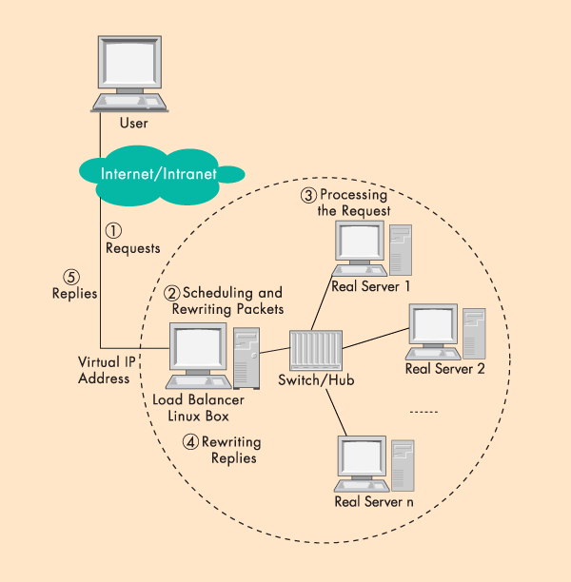
Solution 1: Network Address Translation (NAT)
LB does rewriting/ translation
Thus, the LB is similar to a typical NAT gateway with an additional scheduling function
Load Balancer

Slide 27
LB/NAT Advantages and Disadvantages
Advantages:
Only one public IP address is needed for the load balancer; real servers can use private IP addresses
Real servers need no change and are not aware of load balancing
Problem
The load balancer must be on the critical path and hence may become the bottleneck due to load to rewrite request and response packets
Typically, rewriting responses has more load because there are more response packets

Slide 28
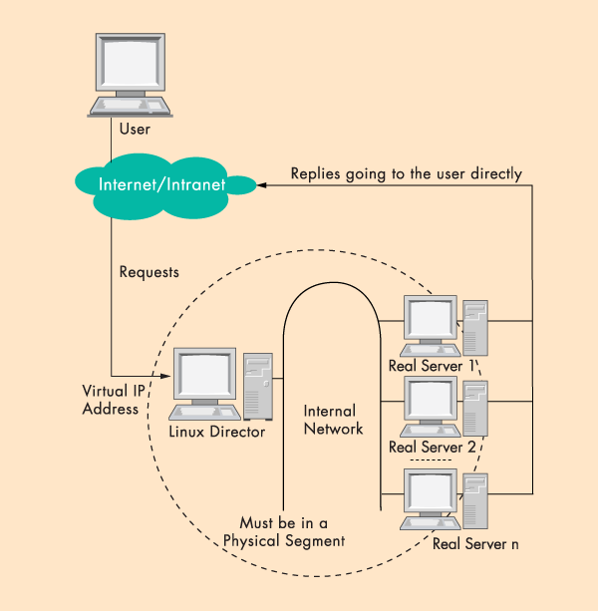
Goal: LB w/ Direct Reply
load
balancer
Connected
by a single switch

Slide 29
LB with Direct Reply: Implication
VIP
Server1
VIP
Client
LB
Server2
Server3
Direct reply
Each real server uses VIP as its IP address
Address conflict: multiple devices w/ the same IP addr

Slide 30
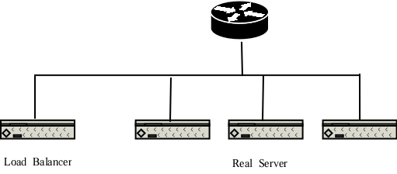
Why IP Address Matters?
VIP
Each network interface card listens to an assigned MAC address
A router is configured with the range of IP addresses connected to each interface (NIC)
To send to a device with a given IP, the router needs to translate IP to MAC (device) address
The translation is done by the Address Resolution Protocol (ARP)

Slide 31
ARP Protocol
ARP is “plug-and-play”:
nodes create their ARP tables without intervention from net administrator
A broadcast protocol:
Router broadcasts query frame, containing queried IP address
all machines on LAN receive ARP query
Node with queried IP receives ARP frame, replies its MAC address

Slide 32
ARP in Action
S=client
D=VIP
Router R
VIP
- Router broadcasts ARP broadcast query: who has VIP?
- ARP reply from LB: I have VIP; my MAC is MAC_{LB}
- Data packet from R to LB: destination MAC = MAC_{LB}

Slide 33
LB/DR Problem
Router R
VIP
VIP
VIP
VIP
ARP and race condition:
When router R gets a packet with dest. address VIP, it broadcasts an Address Resolution Protocol (ARP) request: who has VIP?
One of the real servers may reply before load balancer
Solution: configure real servers to not respond to ARP request

Slide 34
LB via Direct Routing
The virtual IP address is shared by real servers and the load balancer.
Each real server has a non-ARPing, loopback alias interface configured with the virtual IP address, and the load balancer has an interface configured with the virtual IP address to accept incoming packets.
The workflow of LB/DR is similar to that of LB/NAT:
the load balancer directly routes a packet to the selected server
the load balancer simply changes the MAC address of the data frame to that of the server and retransmits it on the LAN (how to know the real server’s MAC?)
When the server receives the forwarded packet, the server determines that the packet is for the address on its loopback alias interface, processes the request, and finally returns the result directly to the user

Slide 35
LB/DR Advantages and Disadvantages
Advantages:
Real servers send response packets to clients directly, avoiding LB as bottleneck
Disadvantages:
Servers must have non-arp alias interface
The load balancer and server must have one of their interfaces in the same LAN segment
Considered by some as a hack, not a clean architecture

Slide 36
Example Implementation of LB
An example open source implementation is Linux virtual server (linux-vs.org)
Used by
www.linux.com
sourceforge.net
wikipedia.org
More details on ARP problem: http://www.austintek.com/LVS/LVS-HOWTO/HOWTO/LVS-HOWTO.arp_problem.html
Many commercial LB servers from F5, Cisco, …
More details please read chapter 2 of Load Balancing Servers, Firewalls, and Caches

Slide 37
Problem of the Load Balancer Architecture
Server1
S=client
D=VIP
VIP
Client
LB
Server2
Server3
One major problem is that the LB becomes a single point of failure (SPOF).

Slide 38
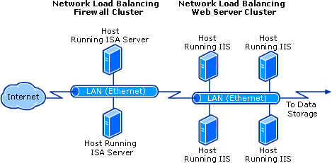
Solutions
Redundant load balancers
E.g., two load balancers (a good question to think offline)
Fully distributed load balancing
e.g., Microsoft Network Load Balancing (NLB)

Slide 39
Microsoft NLB
No dedicated load balancer
All servers in the cluster receive all packets
Key issue: one and only one server processes each packet
All servers within the cluster simultaneously run a mapping algorithm to determine which server should handle the packet. Those servers not required to service the packet simply discard it.
Mapping (ranking) algorithm: computing the “winning” server according to host priorities, multicast or unicast mode, port rules, affinity, load percentage distribution, client IP address, client port number, other internal load information
http://technet.microsoft.com/en-us/library/cc739506%28WS.10%29.aspx

Slide 40
Discussion
Compare the design of using Load Balancer vs Microsoft NLB

Slide 41
Recap: Direction Mechanisms
App
DNS name1
DNS name2
IP1
IP2
IPn
Cluster1 in US East
Cluster2
in US West
Cluster2
in Europe
Rewrite
Direct reply
Fault tolerance
Load
balancer
Load
balancer
proxy
servers

Slide 42
Scalability of Server-Only Approaches
origin
DNS
edge. servers
C₀
client 1
client 2
client n
client 3

