Slide 1
Network Transport Layer: Sliding Window, TCP
Qiao Xiang, Congming Gao, Qiang Su
https://sngroup.org.cn/courses/cnns-xmuf25/index.shtml
10/30/2025
This deck of slides are heavily based on CPSC 433/533 at Yale University, by courtesy of Dr. Y. Richard Yang.

Slide 2
Outline
Admin and recap
Reliable data transfer,
stop-and-wait
sliding window
TCP

Slide 3
Admin
Lab 4 to be posted this week

Slide 4
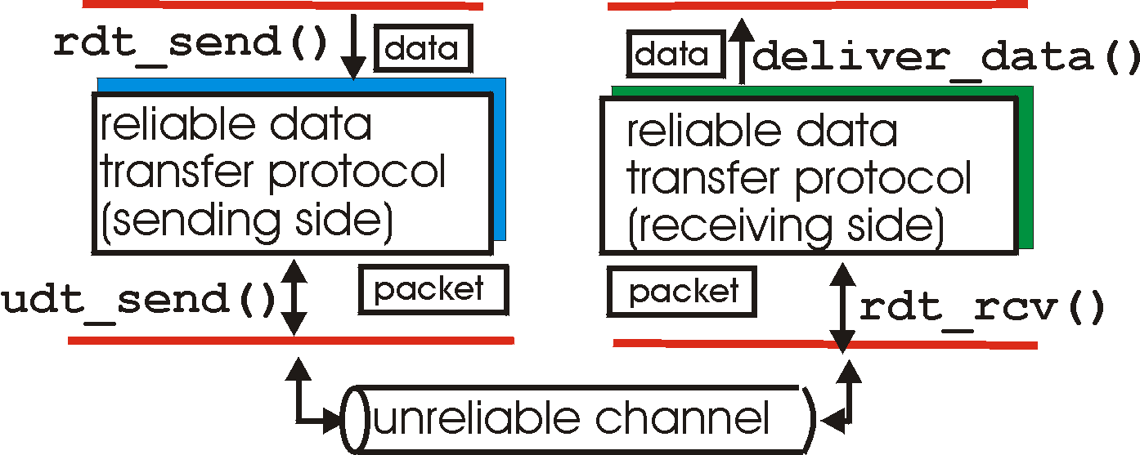
Recap: Reliable Data Transfer Context
rdt_send(): called from above, (e.g., by app.)
deliver_data(): called by rdt to deliver data to upper
send
side
receive
side
udt_send(): called by rdt,
to transfer packet over
unreliable channel to receiver
rdt_rcv(): called from below; when packet arrives on rcv-side of channel

Slide 5
Recap: Reliable Data Transfer Setting
We’ll:
incrementally develop sender, receiver sides of reliable data transfer protocol (rdt)
consider only unidirectional data transfer
but control info will flow on both directions !
use finite state machines (FSM) to specify sender, receiver
event causing state transition
actions taken on state transition
state: when in this “state” next state uniquely determined by next event
state
1
state
2
event
actions

Slide 6
rdt3.0: Channels with Errors and Loss
New assumption: underlying channel can also lose packets (data or ACKs)
checksum, seq. #, ACKs, retransmissions will be of help, but not enough
Q: Does rdt2.2 work under losses?
Approach: sender waits “reasonable” amount of time for ACK
requires countdown timer
retransmits if no ACK received in this time
if pkt (or ACK) just delayed (not lost):
retransmission will be duplicate, but use of seq. #’s already handles this
receiver must specify seq # of pkt being ACKed

Slide 7
rdt3.0 Sender
rdt_send(data)
rdt_rcv(rcvpkt) &&
( corrupt(rcvpkt) ||
isACK(rcvpkt,1) )
sndpkt = make_pkt(0, data, checksum)
udt_send(sndpkt)
start_timer
udt_send(sndpkt)
rdt_rcv(rcvpkt)
Λ
Λ
Wait for
call 0 from above
Wait for ACK0
timeout
udt_send(sndpkt)
start_timer
rdt_rcv(rcvpkt)
&& notcorrupt(rcvpkt)
&& isACK(rcvpkt,1)
rdt_rcv(rcvpkt)
&& notcorrupt(rcvpkt)
&& isACK(rcvpkt,0)
stop_timer
stop_timer
Wait for ACK1
Wait for
call 1 from above
timeout
udt_send(sndpkt)
start_timer
rdt_rcv(rcvpkt)
rdt_send(data)
Λ
rdt_rcv(rcvpkt) &&
( corrupt(rcvpkt) ||
isACK(rcvpkt,0) )
sndpkt = make_pkt(1, data, checksum)
udt_send(sndpkt)
start_timer
Λ

Slide 8
rdt3.0: Stop-and-Wait Performance
sender
receiver
first packet bit transmitted, t = 0
last packet bit transmitted, t = L / R
first packet bit arrives
RTT
last packet bit arrives, send ACK
ACK arrives, send next
packet, t = RTT + L / R
What is U_{sender}: utilization – fraction of time link busy sending?
Assume: 1 Gbps link, 15 ms e-e prop. delay, 1KB packet
8

Slide 9
Performance of rdt3.0
rdt3.0 works, but performance stinks
Example: 1 Gbps link, 15 ms e-e prop. delay, 1KB packet:
T
=
L (packet length in bits)
8kb/pkt
transmit
=
= 8 microsec
R (transmission rate, bps)
10**9 b/sec
1KB pkt every 30 msec -> 33kB/sec throughput over 1 Gbps link
network protocol limits use of physical resources !

Slide 10
A Summary of Questions
How to improve the performance of rdt3.0?
What if there are reordering and duplication?
How to determine the “right” timeout value?
10

Slide 11
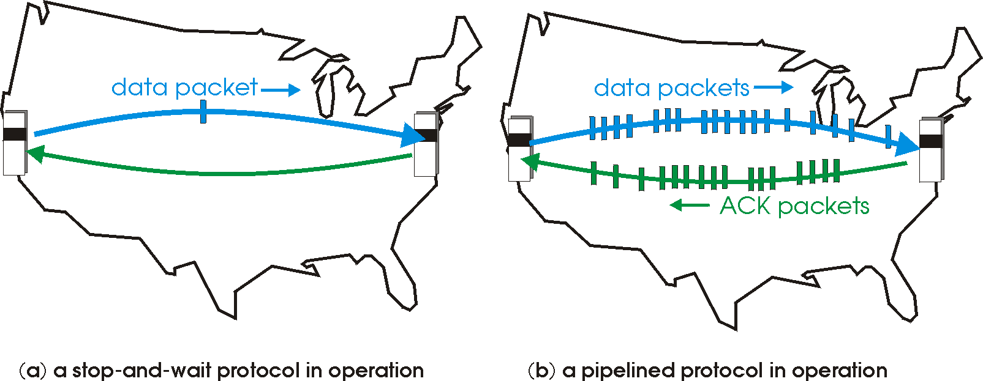
Sliding Window Protocols: Pipelining
Pipelining: sender allows multiple, “in-flight”, yet-to-be-acknowledged pkts
range of sequence numbers must be increased
buffering at sender and/or receiver
11
Notes:
Two generic forms of pipelined protocols: go-Back-N, selective repeat

Slide 12
Pipelining: Increased Utilization
sender
receiver
first packet bit transmitted, t = 0
last bit transmitted, t = L / R
first packet bit arrives
RTT
last packet bit arrives, send ACK
last bit of 2nd packet arrives, send ACK
last bit of 3rd packet arrives, send ACK
ACK arrives, send next
packet, t = RTT + L / R
increase utilization
by a factor of 3!
Question: a rule-of-thumb window size?
12

Slide 13
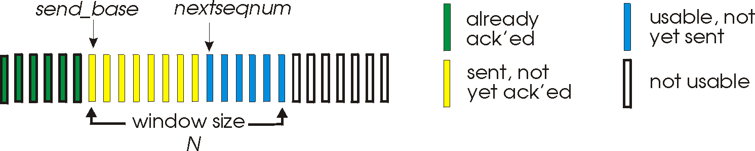
Realizing Sliding Window: Go-Back-n
Sender:
k-bit seq # in pkt header
“window” of up to W, consecutive unack’ed pkts allowed
W
ACK(n): ACKs all pkts up to, including seq # n - “cumulative ACK”
note: ACK(n) could mean two things: I have received upto and include n, or I am waiting for n
timer for the packet at base
timeout(n): retransmit pkt n and all higher seq # pkts in window
13

Slide 14
GBN: Sender FSM
rdt_send(data)
if (nextseqnum < base+W) {
sndpkt[nextseqnum] = make_pkt(nextseqnum,data,chksum)
udt_send(sndpkt[nextseqnum])
if (base == nextseqnum) start_timer
nextseqnum++
} else
block sender
Λ
base=1
nextseqnum=1
timeout
start_timer
udt_send(sndpkt[base])
udt_send(sndpkt[base+1])
…
udt_send(sndpkt[nextseqnum-1])
Wait
rdt_rcv(rcvpkt)
&& corrupt(rcvpkt)
rdt_rcv(rcvpkt) &&
notcorrupt(rcvpkt)
if (new packets ACKed) {
advance base;
if (more packets waiting) send more packets
}
if (base == nextseqnum)
stop_timer
else
start_timer for the packet at new base
14

Slide 15
GBN: Receiver FSM
default
udt_send(sndpkt)
rdt_rcv(rcvpkt)
&& notcurrupt(rcvpkt)
&& hasseqnum(rcvpkt,expectedseqnum)
Λ
Wait
extract(rcvpkt,data)
deliver_data(data)
sndpkt = make_pkt(expectedseqnum,ACK,chksum)
udt_send(sndpkt)
expectedseqnum++
expectedseqnum=1
sndpkt =
make_pkt(expectedseqnum,ACK,chksum)
Only state: expectedseqnum
out-of-order pkt:
discard (don’t buffer) -> no receiver buffering!
re-ACK pkt with highest in-order seq #
may generate duplicate ACKs
15

Slide 16
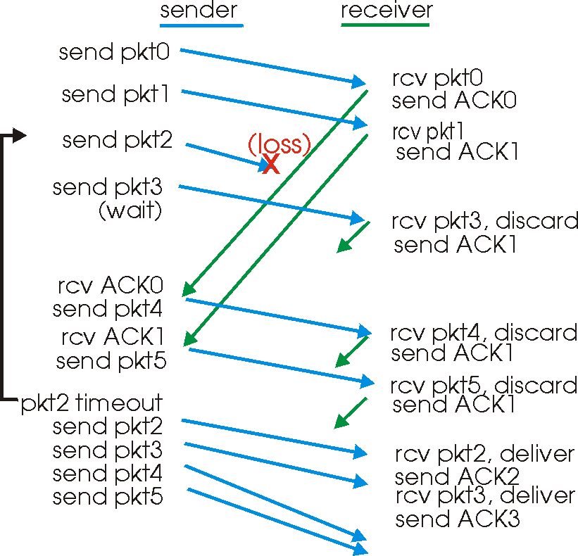
GBN in Action
window
size = 4
16

Slide 17
Analysis: Efficiency of Go-Back-n
Assume window size W
Assume each packet is lost with probability p
On average, how many packets do we send for each data packet received?
17

Slide 18
Selective Repeat
Sender window
Window size W: W consecutive unACKed seq #’s
Receiver individually acknowledges correctly received pkts
buffers out-of-order pkts, for eventual in-order delivery to upper layer
ACK(n) means received packet with seq# n only
buffer size at receiver: window size
Sender only resends pkts for which ACK not received
sender timer for each unACKed pkt
18

Slide 19
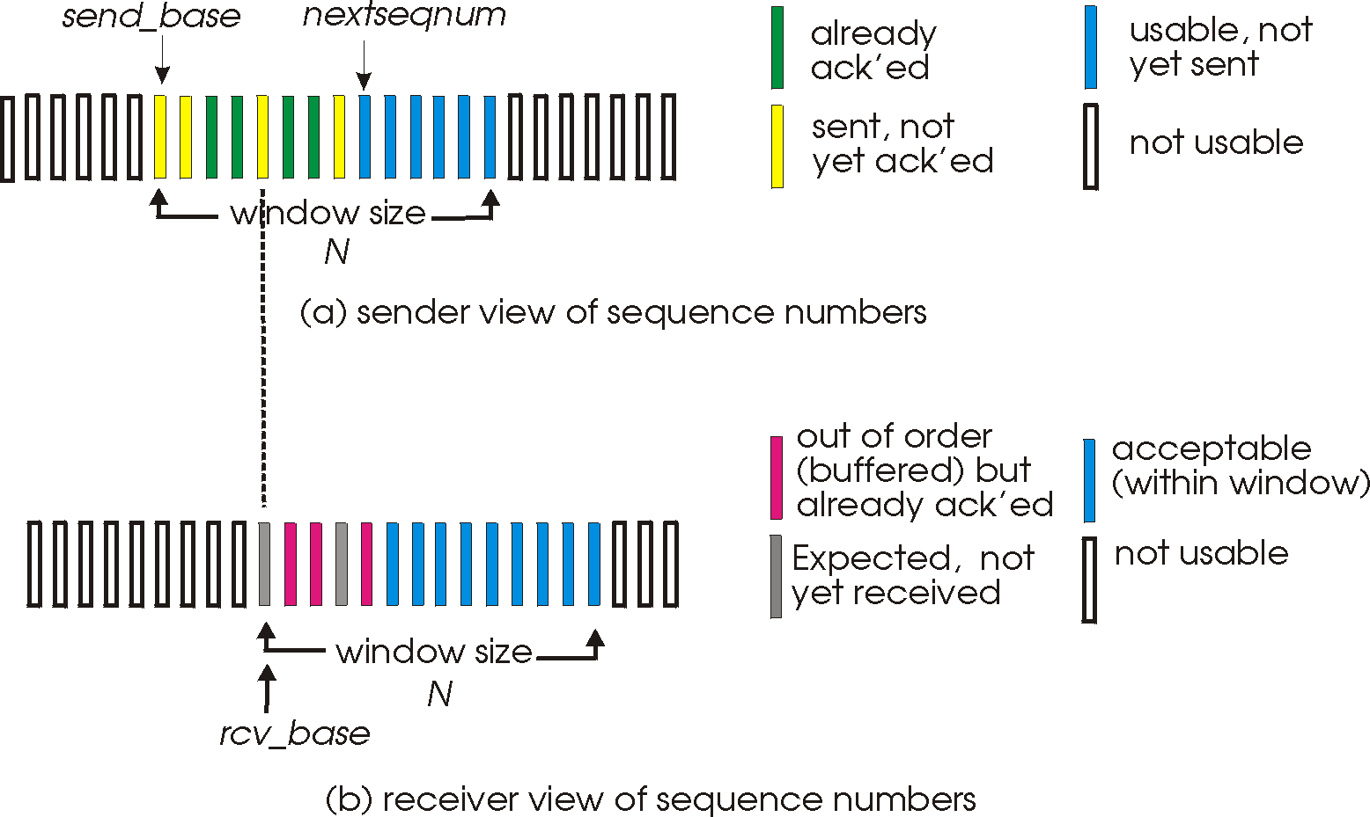
Selective Repeat: Sender, Receiver Windows
W
W
19

Slide 20
Selective Repeat
sender
receiver
data from above :
unACKed packets is less than window size W, send; otherwise block app.
timeout(n):
resend pkt n, restart timer
ACK(n) in [sendbase,sendbase+W-1]:
mark pkt n as received
update sendbase to the first packet unACKed
pkt n in [rcvbase, rcvbase+W-1]
send ACK(n)
if (out-of-order) mark and buffer pkt n else /*in-order*/
deliver any in-order packets
otherwise:
ignore
20

Slide 21
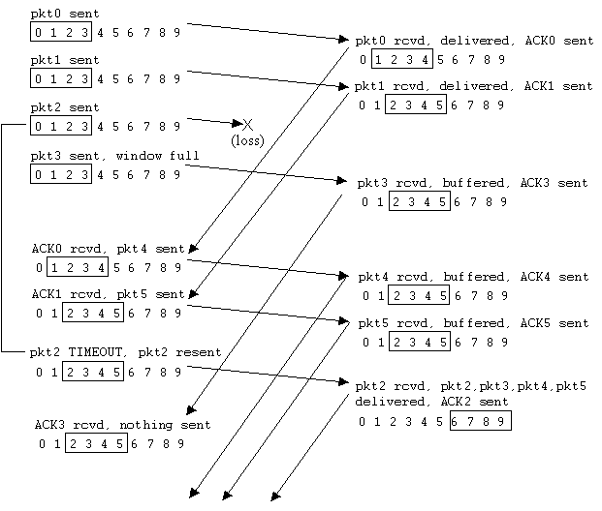
Selective Repeat in Action
21

Slide 22
Discussion: Efficiency of Selective Repeat
Assume window size W
Assume each packet is lost with probability p
On average, how many packets do we send for each data packet received?
22

Slide 23
Selective Repeat: Seq# Ambiguity
Example:
seq #’s: 0, 1, 2, 3
window size=3
Error: incorrectly passes duplicate data as new.
23

Slide 24
State Invariant: Window Location
Go-back-n (GBN)
Selective repeat (SR)
sender window
receiver window
sender window
receiver window
24

Slide 25
Q: what relationship between seq # size and window size?
Window Location
Go-back-n (GBN)
Selective repeat (SR)
sender window
receiver window
sender window
receiver window
25

Slide 26
Selective Repeat
sender
receiver
data from above :
unACKed packets is less than window size W, send; otherwise block app.
timeout(n):
resend pkt n, restart timer
ACK(n) in [sendbase,sendbase+W-1]:
mark pkt n as received
update sendbase to the first packet unACKed
pkt n in [rcvbase, rcvbase+W-1]
send ACK(n)
if (out-of-order) mark and buffer pkt n else /*in-order*/
deliver any in-order packets
pkt n in [rcvbase-W, rcvbase-1]
send ACK(n)
otherwise:
ignore
26

Slide 27
Sliding Window Protocols: Go-back-n and Selective Repeat
 | Go-back-n | Selective Repeat
data bandwidth: sender to receiver (avg. number of times a pkt is transmitted)
ACK bandwidth (receiver to sender)
Relationship between M (the number of seq#) and W (window size)
Buffer size at receiver
Complexity
Less efficient
More efficient
More efficient
Less efficient
M > W
M ≥ 2W
1
W
Simpler
More complex
p: the loss rate of a packet; M: number of seq# (e.g., 3 bit M = 8); W: window size
27

Slide 28
rdt3.0: Protocol Analysis using State Invariants
sender
receiver
data 0 (n-1)
waiting for 0 (n-1)
State consistency:
When receiver’s state is waiting n, the state of the sender is either sending for n-1 or sending for n
When sender’s state is sending for n, receiver’s state is waiting for n or n + 1
ACK for 0 (n-1)
sending 0 (n-1)
data 0 (n-1)
waiting for 1
(n)
ACK for 0 (n-1)
data 1 (n)
sending 1 (n)
waiting for 0 (n+1)

Slide 29
Outline
Admin and Recap
Reliable data transfer
perfect channel
channel with bit errors
channel with bit errors and losses
sliding window: reliability with throughput
TCP reliability

Slide 30
TCP: Overview RFCs: 793, 1122, 1323, 2018, 2581
Point-to-point reliability: one sender, one receiver
Flow controlled and congestion controlled

Slide 31
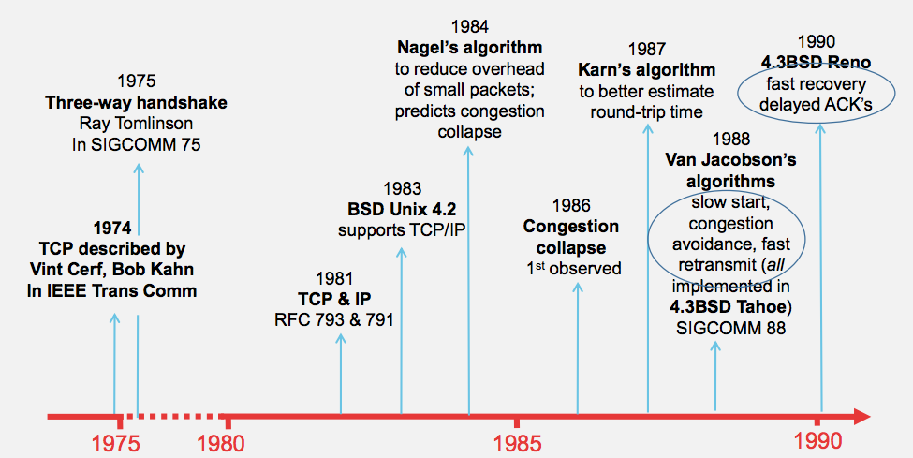
Evolution of TCP
Source: http://webcourse.cs.technion.ac.il/236341/Winter2015-2016/ho/WCFiles/Tutorial10.pdf

Slide 32
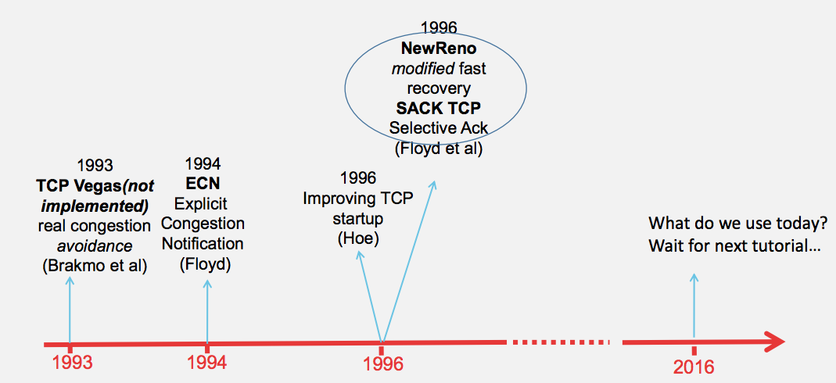
Evolution of TCP
multiple versions
Source: http://webcourse.cs.technion.ac.il/236341/Winter2015-2016/ho/WCFiles/Tutorial10.pdf

Slide 33
TCP Reliable Data Transfer
Connection-oriented:
connection management
setup (exchange of control msgs) init’s sender, receiver state before data exchange
close
Full duplex data:
bi-directional data flow in same connection
A sliding window protocol
a combination of go-back-n and selective repeat:
send & receive buffers
cumulative acks
TCP uses a single retransmission timer
do not retransmit all packets upon timeout

Slide 34
TCP Segment Structure
32 bits
URG: urgent data
(generally not used)
counting
by bytes
of data
(not segments!)
source port #
dest port #
sequence number
ACK: ACK #
valid
acknowledgement number
head
len
not
used
U
rcvr window size
A
P
R
S
PSH: push data now
(generally not used)
F
flow control
checksum
ptr urgent data
RST, SYN, FIN:
connection management
(reset, setup teardown
commands)
Options (variable length)
application
data
(variable length)
Also in UDP

Slide 35
Outline
Admin and Recap
Reliable data transfer
perfect channel
channel with bit errors
channel with bit errors and losses
sliding window: reliability with throughput
TCP reliability
data seq#, ack, buffering

Slide 36
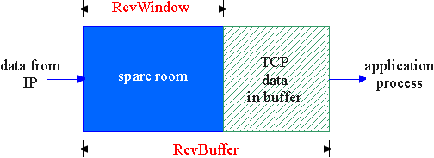
Flow Control
flow control
sender won’t overflow
receiver’s buffer by
transmitting too much,
too fast
receive side of a connection has a receive buffer:
speed-matching service: matching the send rate to the receiving app’s drain rate
app process may be slow at reading from buffer

Slide 37
TCP Flow Control: How it Works
source port #
dest port #
sequence number
acknowledgement number
head
len
not
used
U
A
rcvr window size
P
R
S
F
checksum
ptr urgent data
spare room in buffer
= RcvWindow
Options (variable length)
application
data
(variable length)

Slide 38
TCP Seq. #’s and ACKs
Seq. #’s:
byte stream “number” of first byte in segment’s data
ACKs:
seq # of next byte expected from other side
cumulative ACK in standard header
selective ACK in options
Host A
Host B
User
types
‘C’
Seq=42, ACK=79, data = ‘C’
host ACKs
receipt of
‘C’, echoes
back ‘C’
Seq=79, ACK=43, data = ‘C’
host ACKs
receipt
of echoed
‘C’
Seq=43, ACK=80
time
simple telnet scenario

Slide 39
TCP Send/Ack Optimizations
TCP includes many tune/optimizations, e.g.,
the “small-packet problem”: sender sends a lot of small packets (e.g., telnet one char at a time)
Nagle’s algorithm: do not send data if there is small amount of data in send buffer and there is an unack’d segment
the ”ack inefficiency” problem: receiver sends too many ACKs, no chance of combing ACK with data
Delayed ack to reduce # of ACKs/combine ACK with reply

Slide 40
TCP Receiver ACK Generation [RFC 1122, RFC 2581]
Event at Receiver
Arrival of in-order segment with
expected seq #. All data up to
expected seq # already ACKed
Arrival of in-order segment with
expected seq #. One other
segment has ACK pending
Arrival of out-of-order segment
higher-than-expect seq. # .
Gap detected
Arrival of segment that
partially or completely fills gap
TCP Receiver Action
Delayed ACK. Wait up to 500ms
for next segment. If no next segment,
send ACK
Immediately send single cumulative
ACK, ACKing both in-order segments
Immediately send duplicate ACK,
indicating seq. # of next expected byte
Immediate send ACK, provided that
segment starts at lower end of gap

Slide 41
Outline
Admin and Recap
Reliable data transfer
perfect channel
channel with bit errors
channel with bit errors and losses
sliding window: reliability with throughput
TCP reliability
data seq#, ack, buffering
timeout realization

Slide 42
TCP Reliable Data Transfer
Basic structure: sliding window protocol
Remaining issue: How to determine the “right” parameters?
timeout value?
sliding window size?

Slide 43
History
Key parameters for TCP in mid-1980s
fixed window size W
timeout value = 2 RTT
Network collapse in the mid-1980s
UCB ←→ LBL throughput dropped by 1000X !
The intuition was that the collapse was caused by wrong parameters…

Slide 44
Timeout: Cost of Timeout Param
Why is good timeout value important?
too short
premature timeout
unnecessary retransmissions; many duplicates
too long
slow reaction to segment loss
Q: Is it possible to set Timeout as a constant?
Q: Any problem w/ the early approach: Timeout = 2 RTT

Slide 45
Setting Timeout
Problem:
Ideally, we set timeout = RTT, but RTT is not a fixed value => using the average of RTT will generate many timeouts due to network variations
Possibility: using the average/median of RTT
Issue: this will generate many timeouts due to network variations
Solution:
Set Timeout RTO = avg + “safety margin” based on variation
freq.
RTT
TCP approach:
Timeout = EstRTT + 4 * DevRTT

Slide 46
Compute EstRTT and DevRTT
Exponential weighted moving average (EWMA)
influence of past sample decreases exponentially fast
EstRTT = (1-alpha)*EstRTT + alpha*SampleRTT
- SampleRTT: measured time from segment transmission until ACK receipt
- typical value: alpha = 0.125
DevRTT = (1-beta)*DevRTT + beta|SampleRTT-EstRTT|
(typically, beta = 0.25)

Slide 47
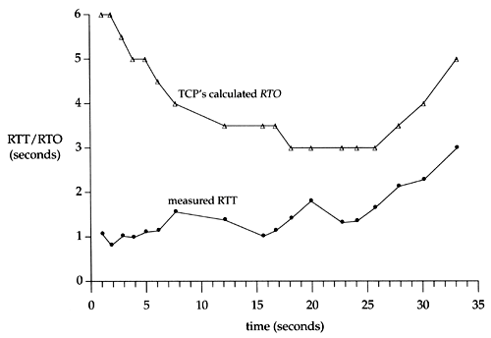
An Example TCP Session

Slide 48
Fast Retransmit
Issue: Timeout period often relatively long:
long delay before resending lost packet
Question: Can we detect loss faster than RTT?
Detect lost segments via duplicate ACKs
sender often sends many segments back-to-back
if segment is lost, there will likely be many duplicate ACKs
If sender receives 3 ACKs for the same data, it supposes that segment after ACKed data was lost:
resend segment before timer expires

Slide 49
Triple Duplicate Ack
Packets
1
2
3
4
5
6
7
Acknowledgements (waiting seq#)
2
3
4
4
4
4

Slide 50
Fast Retransmit:
event: ACK received, with ACK field value of y
if (y > SendBase) {
…
SendBase = y
if (there are currently not-yet-acknowledged segments)
start timer
…
}
else {
increment count of dup ACKs received for y
if (count of dup ACKs received for y = 3) {
resend segment with sequence number y
…
a duplicate ACK for
already ACKed segment
fast retransmit

Slide 51
TCP: reliable data transfer
00 sendbase = initial_sequence number agreed by TWH
01 nextseqnum = initial_sequence number by TWH
02 loop (forever) {
03 switch(event)
04 event: data received from application above
05 if (window allows send)
06 create TCP segment with sequence number nextseqnum
06 if (no timer) start timer
07 pass segment to IP
08 nextseqnum = nextseqnum + length(data) else put packet in buffer
09 event: timer timeout for sendbase
10 retransmit segment
11 compute new timeout interval
12 restart timer
13 event: ACK received, with ACK field value of y
14 if (y > sendbase) { /* cumulative ACK of all data up to y */
15 cancel the timer for sendbase
sendbase = y
if (no timer and packet pending) start timer for new sendbase
while (there are segments and window allow)
sent a segment;
18 }
19 else { /* y==sendbase, duplicate ACK for already ACKed segment */
20 increment number of duplicate ACKs received for y
21 if (number of duplicate ACKS received for y == 3) {
22 /* TCP fast retransmit */
23 resend segment with sequence number y
24 restart timer for segment y
25 }
26 } /* end of loop forever */
Simplified
TCP
sender

Slide 52
Outline
Admin and Recap
Reliable data transfer
perfect channel
channel with bit errors
channel with bit errors and losses
sliding window: reliability with throughput
TCP reliability
data seq#, ack, buffering
timeout realization
connection management

Slide 53
Why Connection Setup/When to Accept (Safely Deliver) First Packet?
sender
receiver
data 0
accept
ACK for 0

Slide 54
Why Connection Setup/When to Accept (Safely Deliver) First Packet?
sender
receiver
data 0 (transfer $1000 to B)
accept
ACK for 0 (n)
data 0 (transfer $1000 to B)
accept?
54
Notes:
a sender should not reuse a seq# before it is sure the packet has left the network

Slide 55
Transport “Safe-Setup” Principle
A general safety principle for a receiver R to accept a message from a sender S is the general “authentication” principle, which consists of two conditions:
Transport authentication principle:
[p1] Receiver can be sure that what Sender says is fresh
[p2] Receiver receives something that only Sender can say
We first assume a secure setting: no malicious attacks.
Exercise: Techniques to allow a receiver to check for freshness (e.g., add a time stamp)?

Slide 56
Generic Challenge-Response Structure Checking Freshness
sender
receiver
I have data to send
deliver
Challenge (nonce)
Demonstrate knowing nonce; data

Slide 57
Three Way Handshake (TWH) [Tomlinson 1975]
Host A
Host B
SYN(seq=x)
notify initial seq#. Accept?
ACK(seq=x), SYN(seq=y)
think of y as a challenge
ACK(seq=y)
accept data only after
verified y is bounced back
x is the init. seq
DATA(seq=x+1)
SYN: indicates connection setup
Notes:
Syn(seq=x) could be duplicate or malicious

Slide 58
Scenarios with Duplicate Request/SYN Attack
Host A
Host B
SYN(seq=x)
accept?
ACK(seq=x), SYN(seq=y)
no such request
REJECT(seq=y)
reject

Slide 59
Scenarios with Duplicate Request/SYN Attack
Host A
Host B
SYN(seq=x)
accept?
ACK(seq=x), SYN(seq=y)
no such request
ACK(seq=z)
reject
REJECT(seq=y)

Slide 60
Make “Challenge y” Robust
To avoid that “SYNC ACK y” comes from reordering and duplication
for each connection (sender-receiver pair), ensuring that two identically numbered packets are never outstanding at the same time
network bounds the life time of each packet
a sender will not reuse a seq# before it is sure that all packets with the seq# are purged from the network
seq. number space should be large enough to not limit transmission rate
Increasingly move to cryptographic challenge and response
Notes:
Add QUIC design: QUIC uses a cryptographic handshake
Servers
front-end servers, which collectively handle billions of requests a day from web browsers and mobile apps across a wide range of services.
On the client side, we have deployed QUIC in
Chrome,
our mobile video streaming YouTube app, and in the
Google Search app on Android
TCP connections commonly incur at least one round-trip delay of connection setup time before any application data can be sent, and TLS adds two round trips to this delay

Slide 61
Connection Close
Why connection close?
so that each side can release resource and remove state about the connection (do not want dangling socket)
client
server
init. close
release
resource?
I am done. Are you done too?
close
I am done too. Goodbye!
release
resource?
close
release
resource?

Slide 62
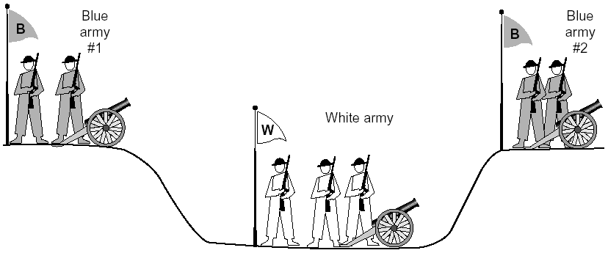
General Case: The Two-Army Problem
The gray (blue) armies need to agree on whether or not they will attack the white army. They achieve agreement by sending messengers to the other side. If they both agree, attack; otherwise, no. Note that a messenger can be captured!

Slide 63
Time_Wait
Generic technique: Timeout to “solve” infeasible problem
Instead of message-driven state transition, use a timeout based transition; use timeout to handle error cases
client
server
init. close
release
resource?
I am done. Are you done too?
Working
Closed
close
I am done too. Goodbye!
release
resource?
close
Working
Time_Waiit
Closed
release
resource?

Slide 64
Time_Wait Design Options
Design 1 (initiator time wait)
Design 2 (receiver time wait)
Host A
Host B
Host A
Host B
close
FIN
close
FIN
Time = n x timeout
Time to retry FIN after each timeout
Close after receive FIN
All states removed
ACK
Time to retransmit ACK
Close after first ACK
All states removed
ACK
All states removed
All states removed

Slide 65
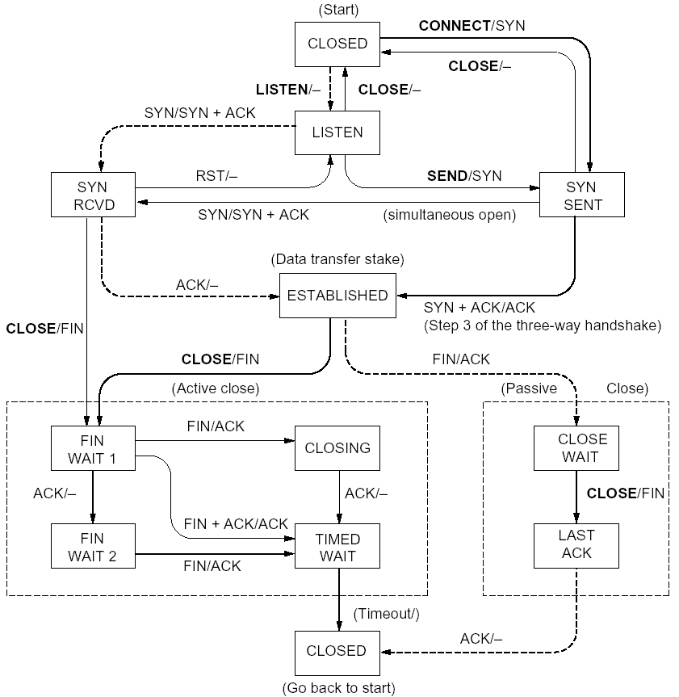
%netstat -t -a
CLOSED
SYN SENT
CLOSED
SYN
LISTEN
SYN RCVD
SYN/ACK
ESTABLSIHED
ACK
ESTABLSIHED
ESTABLSIHED
ESTABLSIHED
FIN WAIT 1
FIN
CLOSE WAIT
ACK
LAST ACK
FIN WAIT 2
FIN
TIME WAIT
ACK

Slide 66
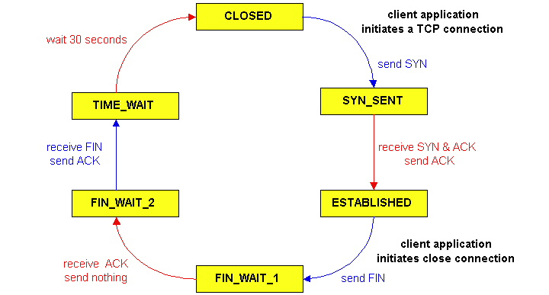
TCP Connection Management
CLOSED
SYN SENT
CLOSED
TCP lifecycle: init SYN/FIN
SYN
SYN RCVD
SYN/ACK
ESTABLSIHED
ACK
ESTABLSIHED
ESTABLSIHED
FIN WAIT 1
FIN
CLOSE WAIT
ACK
LAST ACK
FIN WAIT 2
FIN
TIME WAIT
ACK
http://dsd.lbl.gov/TCP-tuning/ip-sysctl-2.6.txt

Slide 67
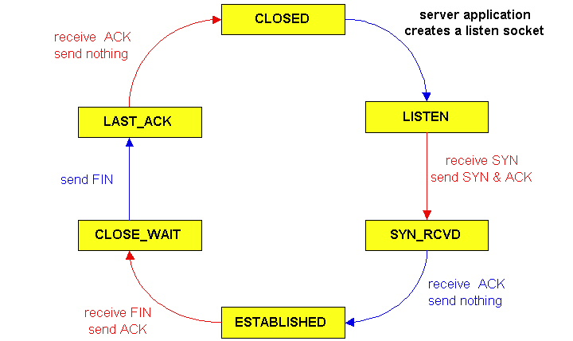
TCP Connection Management
CLOSED
SYN SENT
CLOSED
SYN
TCP lifecycle: wait for SYN/FIN
SYN RCVD
SYN/ACK
ESTABLSIHED
ACK
ESTABLSIHED
ESTABLSIHED
FIN WAIT 1
FIN
CLOSE WAIT
ACK
LAST ACK
FIN WAIT 2
FIN
TIME WAIT
ACK

Slide 68
A Summary of Questions
Basic structure: sliding window protocols
How to determine the “right” parameters?
timeout: mean + variation
sliding window size?

