Slide 1
Introduction to Computational Thinking
Lecture #7 Offline:
Strings Processing
Qiao Xiang, Qingyu Song
https://sngroup.org.cn/courses/ct-xmuf25/index.shtml
11/16/2025
This deck of slides are heavily based on cs112 at Yale University and cs101 at UCAS, respectively,
by courtesy of Dr. Y. Richard Yang and Dr. Zhiwei Xu.

Slide 2
Outline
Admin and recap
Conditionals
Strings

Slide 3
Discussion
Functions (methods) that one may need to process text (Strings)?
Notes:
处理文本（字符串）可能需要哪些函数（方法）？
列子：
数一下有多少个字符？
刚刚学过的：
输出特定格式？

Slide 4
Roadmap: String Processing
Access methods, e.g.,
length, substring, charAt, indexOf
String generator methods (string->string), e.g.
toLowerCase, toUpperCase, replace, split (string->strings)
Conversion from String, e.g.,
Integer.parseInt, Double.parseDouble
Input processing, e.g.,
Scanner.next, Scanner.nextLine
Output formatting: format string
System.out.printf, String.format
Boolean methods, e.g.,
equals, equalsIgnoreCase, startsWith, endsWith, contains, matches

Slide 5
Strings
string: An object storing a sequence of text characters.
Unlike most other objects, a String is so common that Java introduces a short cut and you do not need to create String with new—to make Strings more similar to native primitive data types
String name = "text";
String name = expression; int x = 3; int y = 5; String point = "(" + x + ", " + y + ")";

Slide 6
String Internal: Indexes
index | 0 | 1 | 2 | 3 | 4 | 5 | 6 | 7
character | R | . |  | K | e | l | l | y
A string is a sequence of characters numbered with 0-based indexes:
String name = "R. Kelly";
First character's index : 0
Last character's index : 1 less than the string's length
The individual characters are values of type char

Slide 7
String Access Methods
Method name | Description
length() | number of characters in this string
charAt(index) | character at index
indexOf(str) | index where the start of the given string appears in this string (-1 if not found)
These methods are called using the dot notation:
String name = "Dr. Dre";
System.out.println( name.length() ); // 7

Slide 8
String Method Examples
// index 01234567890123456
String s1 = “Xiamen University";
String s2 = “CT 2025, Fall";
System.out.println( s1.length() );
System.out.println( s1.indexOf("e") );
// 17
// 4
Notes:
这里为了对齐，省略了1，后面的0代表10,11,12…

Slide 9
String Generation Methods
Method name | Description
substring(index1, index2) or substring(index1) | A new string with characters in this string from index1 (inclusive) to index2 (exclusive); if index2 is omitted, grabs till end of string
toLowerCase() | A new string with all lowercase letters
toUpperCase() | A new string with all uppercase letters
replace(str1, str2) | A new string replacing occurrences of str1 with str2
Java strings are immutable. Hence, each of the above will return a new string. With the current string not modified.
Notes:
Exclusive: 不包括最后一个index2位置的字符
Grab：抓
Immutable：不可更改的

Slide 10
String Method Examples
// index 01234567890123456
String s1 = “Xiamen University";
String s2 = “CT 2025, Fall";
System.out.println( s1.length() );
System.out.println( s1.indexOf("e") );
System.out.println( s1.substring(7, 17) );
String s3 = s2.substring(9, 13);
System.out.println( s3.toLowerCase() );
// 17
// 4
// “University"
// “fall"

Slide 11
String as Immutable Data Type
Methods like substring and toLowerCase build and return a new string, rather than modifying the current string.
String s = "lil bow wow";
s.toUpperCase();
System.out.println(s); // lil bow wow
To modify a variable's value, you must reassign it:
String s = "lil bow wow";
s = s.toUpperCase();
System.out.println(s); // LIL BOW WOW

Slide 12
Parsing a String
Instead of substring, indexOf, you can also use scanner to parse a string (in units of tokens only).
String s = “Year 2025 is great!”;
Scanner scan = new Scanner( s );
String word = scan.next(); // skip Year
int year = scan.nextInt();
Notes:
之前： s 是System.in 好，我们发现scanner 方法没法直接输入string

Slide 13
Exercise
Given the following string:
// index 0123456789012345678901
String book = "Building Java Programs";
How would you extract the word "Building" from book?
More generally, how to extract the first word of a string?
One solution: substring(0, indexOf(“ ”))
Notes:
用我们学过的知识
其他自己查文档，探索一下

Slide 14
Split a String
Some common approaches
Use indexOf to find the location and then substring to extract a sub string
Use scanner to extract tokens
String s = “Years 2017 2018 will be great!”;
Scanner scan = new Scanner( s );
String word = scan.next(); // skip Year
int year1 = scan.nextInt(); // 2017
word = scan.next();
int year2 = Integer.parseInt( word ); // 2018
Use split to split a string into multiple strings (more later)
Notes:
那么实现这样一个流程所需要的知识呢就是字符串分割

Slide 15

Exercise
Write a program to convert your “boring” name to a more exciting "gangsta name."
last initial
Diddy
first name (all caps)
-izzle
Example Output:
Type your name, playa: Marge Simpson
Your gangsta name is "S. Diddy MARGE-izzle"
(stage name of Sean Combs[吹牛老爹, 美国说唱歌手] )
(Hip-Pop Ending押韵的韵脚)
Notes:
Gangsta：黑帮

Slide 16
Strings Answer
// This program prints your "gangsta" name.
import java.util.*;
public class GangstaName {
public static void main(String[] args) {
Scanner console = new Scanner(System.in);
System.out.print("Type your name, playa: ");
String name = console.nextLine();
// split name into first/last name and initials
String first = name.substring(0, name.indexOf(" "));
first = first.toUpperCase();
String last = name.substring(name.indexOf(" ") + 1);
String lInitial = last.substring(0, 1);
System.out.println("Your gangsta name is \"" + lInitial + ". Diddy " + first + "-izzle\"");
}
}

Slide 17
String Boolean (Pattern-Matching) Methods
Method | Description
equals(str) | whether two strings contain the same characters
equalsIgnoreCase(str) | whether two strings contain the same characters, ignoring upper vs. lower case
startsWith(str) | whether one contains other's characters at start
endsWith(str) | whether one contains other's characters at end
contains(str) | whether the given string is found within this one
matches(regExp) | whether the string matches a regular expression
Scanner console = new Scanner(System.in);
System.out.print("Type your name: ");
String name = console.nextLine();
if (name.startsWith(”Prof. Dr.")) {
System.out.println(”Are you from Germany?");
} else if (name.endsWith("SquarePants")) {
System.out.println("And I am Patrick Star!");
}

Slide 18
Exercise: Word Rhyme
Prompt the user for two words and report whether they:
"rhyme" (end with the same last two letters尾部押韵)
alliterate (begin with the same letter头部押韵)
Example output: (run #1)
Type two words: car STAR
They rhyme!
(run #2)
Type two words: bare bear
They alliterate!
(run #3)
Type two words: sell shell
They rhyme and alliterate!
(run #4)
Type two words: extra strawberry
Notes:
Word Rhyme 押韵词

Slide 19
Boolean Answer
public static void main(String[] args) {
Scanner console = new Scanner(System.in);
System.out.print("Type two words: ");
String word1 = console.next().toLowerCase();
String word2 = console.next().toLowerCase();
boolean isR = rhyme(word1, word2));
boolean isA = alliterate(word1, word2));
// output
}
// Returns true if s1 and s2 end with the same two letters.
public static boolean rhyme(String s1, String s2) {
return s2.length() >= 2 && s1.endsWith(s2.substring(s2.length() - 2));
}
// Returns true if s1 and s2 start with the same letter.
public static boolean alliterate(String s1, String s2) {
return s2.length() >= 1 && s1.startsWith(s2.substring(0, 1));
}

Slide 20
Offline Exercise/Read: Regular Expression Match (See Backup Slides)

Slide 21
Outline
Strings
String access, modify, parse, format
String boolean methods
String vs char

Slide 22
String charAt method
The chars in a String can be accessed using the charAt method.
String food = "cookie";
char firstLetter = food.charAt(0); // 'c'
System.out.println(firstLetter + " is for " + food);
System.out.println("That's good enough for me!");
You can use a for loop to print or examine each character.
String major = "CS";
for (int i = 0; i < major.length(); i++) {
char c = major.charAt(i);
System.out.println(c);
}
Output:
C
S
StringExamples.java stringChars

Slide 23
char vs. int
https://en.wikipedia.org/wiki/List_of_Unicode_characters
Char internal stores the index of a char
Using char in arithmetic expressions will cause char to be converted to an int
To convert an int into the equivalent char, type-cast it.
(char) ('a' + 2) is 'c'
for (char c = 'a'; c <= 'z'; c = (char)(c+1) ) {
System.out.print(c);
}
for (char c = 'a'; c <= 'z'; c ++ ) {
System.out.print(c);
}
StringExamples.java charInt method

Slide 24
char vs. String
"h" is a String 'h' is a char (the two behave differently)
String is an object; it contains methods
String s = "h";
s = s.toUpperCase(); // 'H'
int len = s.length(); // 1
char first = s.charAt(0); // 'H'
char is primitive; you can't call methods on it
char c = 'h';
c = c.toUpperCase(); // ERROR
Notes:
24

Slide 25
char vs. String (char Comparison)
Consistent with primitive numerical types, you can compare char values using relational operators (ordering is alphabetical order):
'a' < 'b' and 'X' == 'X' and 'Q' != 'q’
String word = console.next();
char ch = word.charAt(word.length() - 1) ;
if ( ch == 's') {
System.out.println(word + " is plural.");
}
ch = word.charAt(0) ;
if ( ‘a’ <= ch && ch <= ‘z’) {
System.out.println(word + ”starts w/ a letter”);
}
StringExamples.java charCompare method

Slide 26
char vs. String (Comparison)
<, <=, >, >= are not defined on objects and hence you cannot write str1 <= str2
!= and == are defined on all objects, but they compare references (seen later), not values. So == often gives false even when two Strings have the same letters.
Scanner console = new Scanner( System.in );
String name = console.next(); // user input Barney
if (name == "Barney") {
System.out.println("I love you, you love me,");
System.out.println("We're a happy family!");
}

Slide 27
char vs. String (Comparison)
String comparisons based on content use the method equals.
Scanner console = new Scanner(System.in);
System.out.print("What is your name? ");
String name = console.next();
if (name.equals("Barney")) {
System.out.println("I love you, you love me,");
System.out.println("We're a happy family!");
}
String defines compareTo(anotherString) to compare the lexicographic order of two strings.
StringExamples.java stringCompare method
Notes:
Lexicographic: 字典顺序

Slide 28
char vs. String
 | String | char
Store | An object w/ a sequence of chars | A primitive value storing a unicode index
Methods | .length, .toUpperCase, … | No methods
==, != | Compare reference, not value | Compare value
<, <=, >, >= | No defined. Use compareTo(anotherString) method | Lexicographic order
.equals method | Compare content | Not defined
https://symbl.cc/en/unicode-table/
Notes:
28
Lexicographic：词典

Slide 29
Caesar Cipher
If he had anything confidential to say, he wrote it in cipher, that is, by so changing the order of the letters of the alphabet, that not a word could be made out. If anyone wishes to decipher these, and get at their meaning, he must substitute the fourth letter of the alphabet, namely D, for A, and so with the others.
—Suetonius, Life of Julius Caesar 56
Notes:
Confidential：机密的 cipher：密码

Slide 30

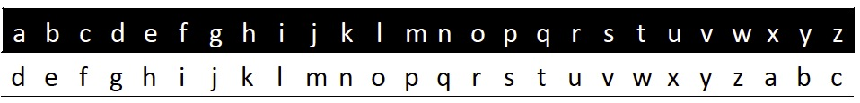
(Offline) Caesar Cipher
Plaintext
Ciphertext
attack said zeus προσβάλλω
dwwdfn vdlg chxv
στςφείξξό

Slide 31
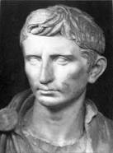
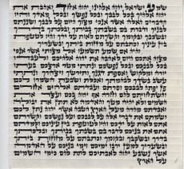

(Offline) Additional Caesar-Style Cipher
Augustus
Right shift 1 without rotate, with AA for Z
Mezuzah
Shift of one to encrypt the names of God
Vigenere (a variant) was used by the Confederacy during Civil War
Mafia boss Provenzano (2006): A (4), …

Slide 32
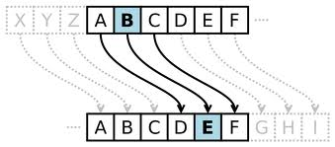
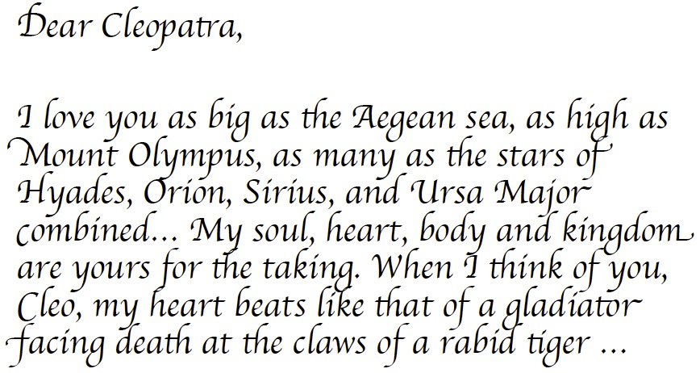
(Offline) Why Programming?

Slide 33
(Offline) Caesar Cipher Encoding (Design 1)
Letter | a | b | c | d | ... | … | w | x | y | z
Orig | 97 | 98 | 99 | 100 | ... | … | 119 | 120 | 121 | 122
Shift (+3) | 100 | 101 | 102 | 103 |  |  | 122 | 123 | 124 | 125
Cipher | 100 | 101 | 102 | 103 |  |  | 122 | 97 | 98 | 99
int cipher = ch + key;
if (cipher > ‘z’) cipher -= 26;
ch = (char)cipher;
Q: What if key is 100?

Slide 34
(Offline) Caesar Cipher: Encoding(Design 2)
Letter | a | b | c | d | ... | … | w | x | y | z
Orig | 0 | 1 | 2 | 3 | ... | … | 22 | 23 | 24 | 25
Shift (+3) | 3 | 4 | 5 | 6 |  |  | 25 | 26 | 27 | 28
Cipher (% 26) | 3 | 4 | 5 | 6 |  |  | 25 | 0 | 1 | 2
int cipherInt = (origInt + key) % 26
Assumption: a-z mapped to 0 to 25.
How to map a char in a-z to 0 to 25?
char – ‘a’

Slide 35
(Offline) Caesar Cipher Encoding
Letter | a | b | c | d | ... | … | w | x | y | z
Orig | 0 | 1 | 2 | 3 | ... | … | 22 | 23 | 24 | 25
Shift (+3) | 3 | 4 | 5 | 6 |  |  | 25 | 26 | 27 | 28
Cipher (% 26) | 3 | 4 | 5 | 6 |  |  | 25 | 0 | 1 | 2
int chRelativeIndex = ch – ‘a’;
int cipherRelInd = (chRelativeIndex + key) % 26;
ch = (char)(cipherRelInd + ‘a’);

Slide 36
Offline Exercise/Think: How to Decode? (See Backup Slides)

Slide 37
(Offline) Extension: Encrypt a Text File
Goal: Instead of reading text from terminal, user specifies a file name, which gives the content to be encrypted.

Slide 38
(Offline Read) More File Details
Create a File object to get info about a file on your drive.
You can use File’s exists method to test existence:
File file = new File(“data.txt");
if ( !file.exists() ) {
// try a second input file as a backup
System.out.print(“data file not found!");
file = new File(“data2.txt");
}
Method name | Description
canRead() | returns whether file is able to be read
delete() | removes file from disk
exists() | whether this file exists on disk
getName() | returns file's name
length() | returns number of bytes in file

Slide 39
(Offline) CaesarFile using a for Loop
public class ReadFile {
public static void main(String[] args) {
try {
Scanner input = new Scanner(new File(”data.txt"));
encode(input, 3); } catch (FileNotFoundException e) {
// print an error message
System.out.println(“File not found exception”);
} // end of catch
} // end of main
}
public static void encode(Scanner scan, int key) {
for (int line = 0; line < NLINES; line ++ ) { String text = scan.nextLine();
String result = Caesar.encode(text, key);
System.out.println( result );
}
}

Slide 40

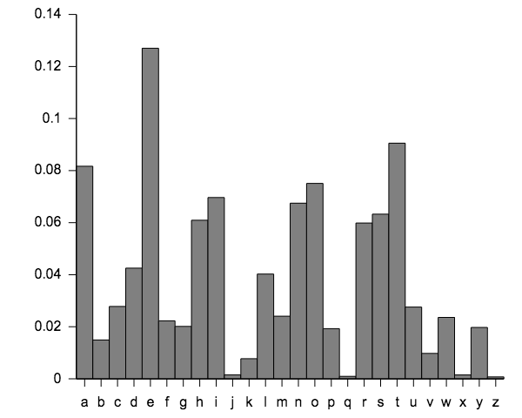
(Offline) Exercise: Breaking Caesar Encryption
Caesar encryption (or permutation ciphers in general) is easy to break because it does not change the frequency of letters.

Slide 41
Backup Slides

Slide 42
Regular Expression
A regular expression defines a search pattern for strings.
Regular expressions can be used to search, edit and manipulate text.
The pattern defined by the regular expression may match one or several times or not at all for a given string.
http://www.vogella.com/tutorials/JavaRegularExpressions/article.html

Slide 43
Regular Expression
RegEx | Description
. | Matches any character
^regex | Finds regex that must match at the beginning of the line.
regex$ | Must match at the end of the line.
[abc] | Set definition, can match the letter a, b or c.
[abc][vz] | Set definition, can match a or b or c followed by either v or z.
[^abc] | When a caret appears as the first character inside square brackets, it negates the pattern. This can match any character except a or b or c.
[a-d1-7] | Ranges: matches a letter between a and d and figures from 1 to 7, but not d1.
X|Z | Finds X or Z.
XZ | Finds X directly followed by Z.
$ | Checks if a line end follows.
(Yale)|(MIT) | Yale or MIT; () is the grouping operator

Slide 44
Examples
Scanner console = new Scanner(System.in);
System.out.print("Type your name: ");
String name = console.nextLine();
..
name.startsWith(”Prof. Dr.”)
name.matches(“^Prof\. Dr\.”)
name.endsWith("Esq.”)
name.matches(“Esq\.$”)

Slide 45
Meta Chars
Regex | Description
\d | Any digit, short for [0-9]
\D | A non-digit, short for [^0-9]
\s | A whitespace character, short for [ \t\n\x0b\r\f]
\S | A non-whitespace character, short for [^\s]
\w | A word character, short for [a-zA-Z_0-9]
\W | A non-word character [^\w]
\b | Matches a word boundary where a word character is [a-zA-Z0-9_].

Slide 46
Quantifiers
Regular Expression | Description | Examples
* | Occurs zero or more times, is short for {0,} | X* finds no or several letter X,
 |  | .* finds any character sequence
+ | Occurs one or more times, is short for {1,} | X+ - Finds one or several letter X
? | Occurs no or one times, ? is short for {0,1}. | X? finds no or exactly one letter X
{X} | Occurs X number of times, {} describes the order of the preceding liberal | \d{3} searches for three digits, .{10} for any character sequence of length 10.
{X,Y} | Occurs between X and Y times, | \d{1,4} means \d must occur at least once and at a maximum of four.
*? | ? after a quantifier makes it a reluctant quantifier. It tries to find the smallest match.

Slide 47
Example
Scanner console = new Scanner(System.in);
System.out.print("Type your name: ");
String name = console.nextLine();
..
name.contains(“Yale”)
name.matches(“.*Yale.*”);
String ssn = console.nextLine();
// how to validate it is correct ssn: 123-45-6789
ssn.matches(“\\d{3}-\\d{2}-\\d{4}”)
String ph = console.nextLine();
// how to validate right ph# format: 432-6400 or 432 6400
ph.matches(“\\d{3}[- ]\\d{4}”)

Slide 48
Practice: Detect Email Address

Slide 49
(Offline) Caesar Cipher: Decoding
Letter | a | b | c | d | ... | … | w | x | y | z
Orig | 0 | 1 | 2 | 3 | ... | … | 22 | 23 | 24 | 25
Shift (+3) | 3 | 4 | 5 | 6 |  |  | 25 | 26 | 27 | 28
Cipher (% 26) | 3 | 4 | 5 | 6 |  |  | 25 | 0 | 1 | 2
Back (-3) | 0 | 1 | 2 | 3 |  |  | 22 | -3 | -2 | -1
Range (+26%26) | 0 | 1 | 2 | 3 |  |  | 22 | 23 | 24 | 25

Slide 50
(Offline) Unifying Design
int cipherInt = (origInt + key) % 26
int origInt = (cipherInt – key + 26) % 26
A single encode method with parameter key
To encode
encode(key)
To decode
encode(26 – key)
Caesar.java

