Slide 1
Introduction to Computational Thinking
Lecture #7:
Boolean Expressions; Nested if/else; Switch and Conditional Operator Shortcuts; Strings Processing
Qiao Xiang, Qingyu Song
https://sngroup.org.cn/courses/ct-xmuf25/index.shtml
11/12/2025
This deck of slides are heavily based on cs112 at Yale University and cs101 at UCAS, respectively,
by courtesy of Dr. Y. Richard Yang and Dr. Zhiwei Xu.

Slide 2
Outline
Admin and recap
Text I/O
Input: basic Scanner input
Output: basic printf and String.format
Notes:
方法结束 -> 文本输入输出

Slide 3
Recap: Input using Scanner
Java uses an object to remember the state (e.g., source) of a scanner
Input can be read as tokens or a line (nextLine)
Scanner console = new Scanner(System.in);
console.nextInt();

Slide 4
Input from File
There are two approaches
Create a scanner with src as a file (more shortly)
Redirect: a concept in computer science, which allows the operating system to send a file’s content as if it is typed in by keyboard: (Use command line: Terminal -> to working directory) %java Plot < USA.txt
Plot.java USA.txt

Slide 5


Token and Exception
When a token is not the type that the scanner expects, since no reasonable (non-ambiguous) return value, Scanner throws an exception (panic)
System.out.print("Which year will you graduate? ");
int year = console.nextInt();
Output:
Which year will you graduate? Timmy
java.util.InputMismatchException
at java.util.Scanner.next(Unknown Source)
at java.util.Scanner.nextInt(Unknown Source)
...

Slide 6

Exceptions
Exception: a programming language mechanism to represent a runtime error, e.g.,
dividing an integer by 0
trying to read the wrong type of value from a Scanner
trying to read a file that does not exist
Java has defined a set of exceptions, each with a name, e.g., ArithmeticException, InputMisMatchException, FileNotFoundException

Slide 7
Design Methodology: How to Handle Potential Exceptions?
Two basic approaches
Test before proceed
Proceed and clean up (try/catch)

Slide 8
Robust Input Approach 1: Test Before Proceed
Design pattern
if ( <ExceptionConditionFalse> ) {
proceed;
}
else {
System.out.println(“Error message.”);
}
return type of hasNextInt() is boolean, indicating a logical condition.
System.out.print("Which year will you graduate? ");
if ( console.hasNextInt() ) {
year = console.nextInt();
}
else {
System.out.println(“Wrong type; please give int.”);
}

Slide 9
Robust Input Approach 2: try and catch
try/catch: if an exception happens, program execution jumps to the catch statement, skipping the rest in the try block.
try {
potentially dangerous statements
} catch (ExceptionName e) {
handle exception, such as print an error message
} // end of catch

Slide 10
Robust Input Approach 2: Example
import java.util.Scanner; // for Scanner
public class ScannerInputExampleTry {
public static void main(String[] args) {
Scanner console = new Scanner( System.in );
try {
System.out.print("Which year will you graduate? ");
int year = console.nextInt();
System.out.println(“Your give “ + year); } catch (InputMisMatchException e) {
// print an error message
System.out.println(“You give a wrong input type.”);
} // end of catch
} // end of main
}

Slide 11
What Happened: the throws Clause
throws clause: Keyword on a method's header to state that it may generate an exception (and will not handle it) and those using it must handle it (called a checked exception; nextInt does not declare it).
Syntax:
public static <type> <name>(...) throws <type> {
Example: http://docs.oracle.com/javase/7/docs/api/java/util/Scanner.html#Scanner(java.io.File)
Notes:
analogy: A throws clause is like the legal waiver you sign before you go bungee jumping. "I understand that I am taking a risk, and I promise not to sue!”
Throws：可能跑出异常，调用时候必须处理
Clause：条款

Slide 12
A Tiny Bit History of Java Text Formatting
Before Java 1.5, Java provides formatting classes such as NumberFormat and DecimalFormat classes as part of the java.text package
But many programmers like the more flexible method signature of printf() starting from the C programming language
Starting from Java 1.5, printf/formatr is added and typically preferred by many programmers

Slide 13
Outline
Admin and recap
Text I/O
Input: basic Scanner input
Output: basic printf and String.format
Notes:
方法结束 -> 文本输入输出

Slide 14
Printf/Format Design
System.out.printf("format string", parameters);
Output with placeholders to insert parameters, e.g.,
%d integer
%f real number
%s string
these placeholders are used instead of + concatenation
Example:
int x = 3;
int y = -17;
System.out.printf("x is %d and y is %d!\n", x, y);
printf does not drop to the next line unless you write \n
// x is 3 and y is -17!
https://docs.oracle.com/javase/8/docs/api/java/util/Formatter.html

Slide 15
Printf/Format Design and Language Support
System.out.printf("format string", parameters);
In the most general case, Java allows flexible (variable) method signature, e.g.,
Number and type of parameters determined by the first parameter. We will not learn how to define such methods, but will use some: printf() and format()
public static type name( <type1> param1, <type2>… param2)

Slide 16
printf Width
%Wd integer, W characters wide, right-aligned
%-Wd integer, W characters wide, left-aligned
%Wf real number, W characters wide, right-aligned
...
for (int i = 1; i <= 3; i++) {
for (int j = 1; j <= 10; j++) {
System.out.printf("%4d", (i * j));
}
System.out.println(); // to end the line
}
Output:
1 2 3 4 5 6 7 8 9 10
2 4 6 8 10 12 14 16 18 20
3 6 9 12 15 18 21 24 27 30

Slide 17
printf Precision
%.Df real number, rounded to D digits after decimal
%W.Df real number, W chars wide, D digits after decimal
%-W.Df real number, W wide (left-align), D after decimal
double gpa = 3.253764;
System.out.printf("your GPA is %.1f\n", gpa);
System.out.printf("more precisely: %8.3f\n", gpa);
Output:
your GPA is 3.3
more precisely: 3.254
3
8

Slide 18
printf Formatting
Many more formatting control options supported by printf, e.g., using the comma (,) to display numbers with thousands separator
System.out.printf("%,d\n", 58625);
System.out.printf("%,.2f\n", 12345678.9);
Output:
58,625
12,345,678.90

Slide 19
System.out.printf and String.format
String.format has the same formatting capability as printf, except that printf outputs and String.format returns:
System.out.printf("%,.2f\n", 12345678.9);
String s = String.format("%,.2f\n", 12345678.9);
System.out.print( s );
Output:
12,345,678.90
12,345,678.90

Slide 20
Foundational Programming Concepts
any program you might want to write
objects
methods and classes
graphics, sound, and image I/O
arrays
conditionals and loops
math
text I/O
primitive data types
assignment statements

Slide 21
Program Flow of Control
Java provides conditional and loop statements as program flow of control statements:
decision statements, or conditional statements: decide whether or not to execute a particular statement
repetition statements, or loop statements: perform a statement over and over repetitively
The foundation of program flow of control is the logical condition, which should be a boolean expression, e.g., if ( <boolean expression> ) { do something } [else { so something else }]

Slide 22

Basic Boolean Expression: Relational Tests
A basic Boolean expression is a relational test of two values using a relational operator :
Note the difference between the equality operator (==) and the assignment operator (=)
Operator | Meaning | Example | Value
== | equals | 1 + 1 == 2 | true
!= | does not equal | 3.2 != 2.5 | true
< | less than | 10 < 5 | false
> | greater than | 10 > 5 | true
<= | less than or equal to | 126 <= 100 | false
>= | greater than or equal to | 5.0 >= 5.0 | true
Notes:
关系运算符 对两个值 进行关系测试：

Slide 23
More Complex Relational Test: Testing Containment
(x,y)
H
W
(0,0)
Test if point (x, y) is in the rectangle?
(0 <= x <= W) and (0 <= y <= H)
SYNTAX ERROR
(0 <= x) && ( x <= W) && (0 <= y) && (y <= H)
Notes:
And不是Java中的定义的操作符

Slide 24
Logical Operators
Tests can be combined using logical operators:
"Truth tables" for each, used with logical values p and q:
Operator | Description | Example | Result
&& | and | (2 == 3) && (-1 < 5) | false
|| | or | (2 == 3) || (-1 < 5) | true
! | not | !(2 == 3) | true
p | q | p && q | p || q
true | true | true | true
true | false | false | true
false | true | false | true
false | false | false | false
p | !p
true | false
false | true
Notes:
离散学过，快讲

Slide 25
Exercise: Testing Containment
h
H
(x,y)
W
w
(0,0)
Test if dark rectangle is in the bigger rectangle?

Slide 26
(Offline) Exercise
Write a method to return the number of days in a month
public static int daysInMonth( )
int year, int month

Slide 27
Applying Logical Operators
Implement leap year condition: “… most years that are evenly divisible by 4 are leap years; However, there are some exceptions to this rule: Years that are evenly divisible by 100 are not leap years, unless they are also evenly divisible by 400”
leap year
4
or
100
year % 400 == 0
and
400
year % 4 == 0
year % 100 != 0
Notes:
leap year: 闰年

Slide 28
Testing Leap Year
leap year
4
or
100
year % 400 == 0
and
400
year % 4 == 0
year % 100 != 0
y % 400 == 0 || (y % 100 != 0 && y % 4 == 0)

Slide 29
Applying Logical Operators
Use a logical OR to combine the cases
if (m == 1 || m == 3 || m == 5 || m == 7 || m == 8 || m == 10 || m == 12) numDays = 31;

Slide 30
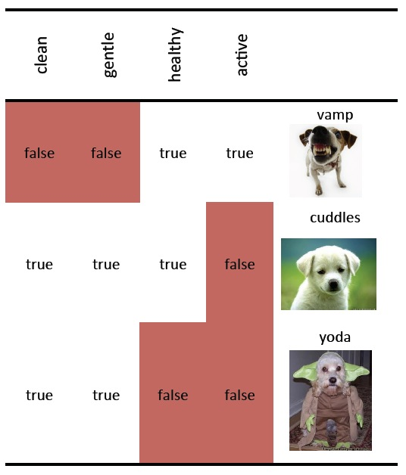
(Offline) Exercise: Basic Boolean Expressions
gentle || active
all
!active && healthy
cuddles
!(clean && healthy)
vamp, yoda
!clean || !healthy
vamp, yoda
!(clean || gentle)
vamp
!clean &&!gentle
vamp

Slide 31
Reuse Testing for Leap Year
How do we define a method to reuse the ability to test if a year is a leap year?
? isLeapYear(int year);

Slide 32
Outline
Admin and recap
Conditionals
Logical conditions (Boolean expressions)
Basic relational tests
Tests using logical operators
Boolean type

Slide 33
boolean Type
boolean: A primitive type whose values are true or false.
Like other types, it is legal to:
create a boolean variable and assign it values
pass a boolean value as a parameter
return boolean value as a method
call a method that returns a boolean and use it as a test
You can use Boolean variables in Boolean expressions

Slide 34
boolean Expressions: What
Similar to arithmetic expressions, except that
the operands are Boolean values, Boolean variables, or relational tests.
the operators are logical operators || && !
Example boolean lovesCS = true;
boolean student = age < 21;
// allow only CS-loving students over 21
if (student && lovesCS)
System.out.println(“Pass");
// an alternative if (age < 21 && lovesCS)
System.out.println(“Pass");
Notes:
arithmetic expressions 算术表达式

Slide 35
boolean Expressions: Why
Why is the type boolean useful?
Can capture a complex logical test result and use it later
Can write a method that does a complex test and returns it
boolean goodAge = age >= 18 && age < 29;
boolean goodHeight = height >= 78 && height < 84;
boolean rich = salary >= 100000.0 || hasStock;
boolean perfect = school == YALE;
if ((goodAge && goodHeight) || rich || perfect) {
System.out.println("Okay, let's go out!");
} else {
System.out.println("It's not you, it's me...");
}
Notes:
两个场景

Slide 36
English vs Programming
OR vs Exclusive OR
I’ll either watch TV or go to gym: Exclusive OR
watchTV || gotoGym can be both true
x is either 1 or 2 or 3
x == 1 || 2 || 3
x ==1 || x == 2 || x == 3
Notes:
逻辑或：只要 A、B 中至少有一个为真 (1)，A ∨ B 就为真 (1)
异或：当且仅当 A 与 B 不同（一真一假），A ⊕ B 为真 (1)；否则为假 (0)。

Slide 37
Logical AND/OR Evaluation
Java uses shortcircuit when evaluating && and ||
a && b shortcircuit:
if a is false, b is not evaluated
if ((count != 0) && (total / count > AVG_THRESHOLD)){
// …
}
a || b shortcircuit:
if a is true, b is not evaluated
Notes:
Shortcircuit：短路

Slide 38
Mixed Arithmetic, Relation, Logical, and Assignment Expression
Example:
boolean mystery = 5 * 7 >= 3 + 5 * (7 – 1) && 7 <= 11;
Precedence ordering of boolean expression
Arithmetic operators
Relations operators (==, !=, <, >, <=, >=)
Note that equality and relational operators cannot be chained (e.g., 1 < x < 3 is invalid)
NOT (!)
AND (&&)
OR (||)
Assignment operators (=)
Notes:
Precedence ordering ：优先顺序

Slide 39
Example
boolean mystery = 5 * 7 >= 3 + 5 * (7 – 1) && 7 <= 11;
5 * 7 >= 3 + 5 * 6 && 7 <= 11
35 >= 3 + 30 && 7 <= 11
35 >= 33 && 7 <= 11
true && true
true

Slide 40
Define and Use boolean Methods
Define a boolean method
public static boolean isOdd(int n) {
if (n % 2 == 1) {
return true;
} else {
return false;
} // see a shorter version shortly
}
Calls to a boolean test method:
if ( isOdd(57) ) {
...
}

Slide 41
Exercise: Implement and Use isLeapYear

Slide 42
"Boolean Zen", part 1 (Use)
// reads redundant
Programmers new to boolean often test if a result is true:
if ( isOdd(57) == true ) {
...
}
Simplify to:
if ( isOdd(57) ) { // concise
...
}
A similar pattern can be used for a false test:
if ( isOdd(57) == false ) { // does not read well
if ( !isOdd(57) ) { // concise

Slide 43
"Boolean Zen", part 2 (Define)
Programmers new to boolean often have an if/else to return true or false:
public static boolean isOdd(int n) {
if (n % 2 == 1) {
return true;
} else {
return false;
}
}
public static boolean isOdd(int n) {
return (n % 2 == 1);
}

Slide 44
"Boolean Zen" template
Replace
public static boolean <name>(<parameters>) {
if (<test>) {
return true;
} else {
return false;
}
}
with
public static boolean <name>(<parameters>) {
return <test>;
}

Slide 45
Exercise: Apply Boolean Zen
public static boolean isPrime(int n) {
int factors = 0;
for (int i = 1; i <= n; i++) {
if (n % i == 0) { // cumulative sum
factors++;
}
}
if (factors == 2) {
return true;
} else {
return false;
}
}

Slide 46
(Offline) Exercise
Students new to boolean often have an if/else to return true or false:
public static boolean bothOdd(int n1, int n2) {
if (n1 % 2 == 1 && n2 % 2 == 1) {
return true;
} else {
return false;
}
}

Slide 47
(Offline) Exercise
Students new to boolean often have an if/else to return true or false:
public static boolean bothOdd(int n1, int n2) {
if (n1 % 2 == 1 && n2 % 2 == 1) {
return true;
} else {
return false;
}
}
public static boolean bothOdd(int n1, int n2) {
return (n1 % 2 == 1 && n2 % 2 == 1);
}

Slide 48
Outline
Admin and recap
Conditionals
Logical conditions (Boolean expressions)
Basic relational tests
Tests using logical operators
Boolean type
Nested if/else conditional statements

Slide 49
Motivation: Chaos Game
public static void main (String[] args) {
for (int i = 0; i < 10000; i++) {
int rand = (int) (Math.random() * 3);
if (rand == 0) {
//
}
if (rand == 1) {
// …
}
if (rand == 2) {
// …
}
}
}
Q: How many comparisons in each round (iteration)?

Slide 50
Revision: Nested Comparison (else if)
public static void main (String[] args) { …
for (int i = 0; i < 1000; i++) {
int rand = (int) (Math.random() * 3);
if (rand == 0) {
//
}
else if (rand == 1) {
// …
}
else if (rand == 2) {
// …
}
}
}
Add else to skip tests if already matched. This is called nested comparison (else if)
Q: Average # of comparisons per iteration?
Benefit of nested comparison: reduce # comparisons

Slide 51
Example: Grading Curve
if (percent >= 90) {
grade = A;
}
A
90
if (percent >= 80) {
grade = B;
}
B
80
if (percent >= 70) {
grade = C;
}
C
70
if (percent >= 60) {
grade = D;
}
D
60
F
if (percent < 60) {
grade = F;
}

Slide 52
Example: Grading Curve (Design 1)
if (percent >= 90) {
grade = A;
}
A
90
if (percent >= 80 && percent < 90) {
grade = B;
}
B
80
if (percent >= 70 && percent < 80) {
grade = C;
}
C
70
if (percent >= 60 && percent < 70) {
grade = D;
}
D
60
F
if (percent < 60) {
grade = F;
}
Exclusive if conditions

Slide 53
Example: Grading Curve (Design 2)
if (percent >= 90) {
grade = A;
}
A
90
else
if (percent >= 80) {
grade = B;
}
B
80
else
if (percent >= 70) {
grade = C;
}
C
70
else
if (percent >= 60) {
grade = D;
}
D
60
F
else
if (percent < 60) {
grade = F;
}
Nested comparison to achieve mutual exclusion; high-to-low.

Slide 54
Nested if/else as Set Refinement
P >= 60
if (percent >= 90) {
// assigns A
}
else
if (percent >= 80) {
// assigns B
}
P >= 70
else
if (percent >= 70) {
// assigns C
}
P >= 80
else
if (percent >= 60) {
// D
}
P >=90
else {
// F
}

Slide 55
Example: Grading Curve (Design 3: Low to High)
if (percent < 60) {
grade = F;
}
A
90
else
if (percent < 70) {
grade = D;
}
B
80
else
if (percent < 80) {
grade = C;
}
C
70
else
if (percent < 90) {
grade = B;
}
D
60
F
else
{
grade = A;
}

Slide 56
Example: Grading Curve using nested else/if
if (percent >= 90) {
grade = A;
} else if (percent >= 80) {
grade = B;
}
else if (percent >= 70) {
grade = C;
}
else if (percent >= 60) {
grade = D;
}
else {
grade = F;
}
if (percent < 60) {
grade = F;
} else if (percent < 70)
{
grade = D;
}
else if (percent < 80)
{
grade = C;
}
else if (percent < 90)
{
grade = B;
}
else {
grade = A;
}
A
90
B
80
C
70
D
60
F
High-to-low or Low-to-high is a personal programming style.

Slide 57
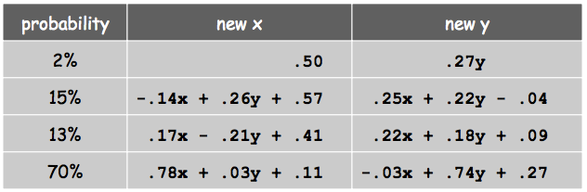
Exercise: Chaos Game2
Draw points with these rules
Basic idea
Generate random numbers in [0, 1.0]
Divide 0-1.0 into 4 areas for the 4 cases
Check which area each number falls in

Slide 58
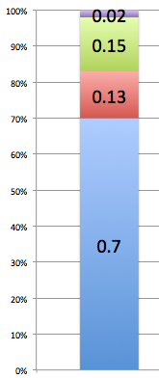
Exercise: Chaos Game2
Draw points with these rules
Basic idea
Generate random numbers in [0, 1.0]
Divide 0-1.0 into 4 areas for the 4 cases
Check which area each number falls in
Notes:
思考：如何用if else来表示这个条件

Slide 59
Exercise: Barnsley Game
public static void main(String[] args) {
StdDraw.setPenRadius(0.002);
StdDraw.setPenColor(Color.GREEN);
final int T = 40000;
double x = 0.0, y = 0.0;
for (int t = 0; t < T; t++) {
double rand = Math.random(); // 0 - 1.0
if (rand <= 0.7) { // 0 - 0.7: 70%
x = .78 * x + .03 * y + .11;
y = -.03 * x + .74 * y + .27;
} else if (rand <= 0.7 + 0.15) { // 0.7 - 0.7+0.15: 15%
x = -.14 * x + .26 * y + .57;
y = .25 * x + .22 * y - .04;
} else if (rand < 0.7 + 0.15 + 0.13) { // 0.7+0.15 – 0.7+0.15+0.13: %13
x = .17 * x - .21 * y + .41;
y = .22 * x + .18 * y + .09;
} else { // 2%
x = 0.5;
y = .27 * y;
}
StdDraw.point(x, y);
} // end of for
} // end of main

Slide 60

Barnsley Game
Questions to think about
What does computation tell us about nature?
What may nature tell us about computation?
Notes:
两个很令人深思的问题：
计算能告诉我们关于自然的什么信息？计算可以仿真
自然又能告诉我们关于计算的什么信息？引领方向？

Slide 61
Summary: nested if/else
Nested if/else is a common structure
Mutually exclusive test conditions => Reduces # of comparisons
Non-mutual exclusive test conditions => Achieves mutual exclusion
a > b
a < b
a == b

Slide 62
Outline
Admin and recap
Conditionals
Logical conditions (Boolean expressions)
Basic relational tests
Tests using logical operators
Boolean type
Nested if/else conditional statements
Benefits of nested if/else
Complexities of nested if/else
mismatched else
all path must return

Slide 63
(Offline Read) Matching Nested if Statements
Nested if statements may have a matching problem
if (temperature < 50)
if (temperature < 100)
System.out.println(“Cool!”);
else
System.out.println(“Hot!”);

Slide 64
(Offline Read) Nested if w/ Ambiguity
if (temperature < 50)
if (temperature < 100)
System.out.println(“Cool!”);
else
System.out.println(“Hot!”);
if (temperature < 50)
if (temperature < 100)
System.out.println(“Cool!”);
else
System.out.println(“Hot!”);
t < 50
t < 50
Yes
No
Yes
t < 100
Hot!
t < 100
No
Yes
Yes
Hot!
Cool!
Cool!
50
100
50
100
Give a value of temperature to produce differentt results

Slide 65
(Offline Read) Nested if Statements
if (temperature < 50)
if (temperature < 100)
System.out.println(“Cool!”);
else
System.out.println(“Hot!”);
if (temperature < 50)
if (temperature < 100)
System.out.println(“Cool!”);
else
System.out.println(“Hot!”);
Rule: an else clause is matched to the last unmatched if (no matter what the indentation implies)
If you find such statements confusing, avoid writing such structures and always use block statements ({}) to make the structure clear.

Slide 66
if/else with return
A method with a return requires that all paths through the code must reach a return statement.
The compiler analyzes this by considering the syntax only!
Notes:
只根据语法：即使你的语义是正确的，如果语法不符合规则，也过编译出错。

Slide 67
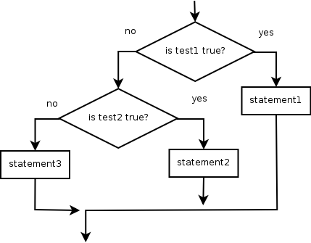
if/else with return
static int myMethod() {
if (test1) {
statement(s);
return x;
} else if (test2) {
statement(s);
return y;
} else {
statement(s);
return z;
}
} // end of method
if
else if
return
else
return
return

Slide 68
if/else with return
static int myMethod() {
if (test1) {
statement(s);
return x;
} else if (test2) {
statement(s);
return y;
} else {
statement(s);
return z;
}
} // end of method
// ERROR: missing return in a path
if
else if
return
return
return

Slide 69
if/else with return
public static int max(int a, int b) {
if (a > b) {
return a;
}
}
public static int max(int a, int b)
{
int myMax = a; // default
if (b > a) {
myMax = b;
}
return myMax;
}
// Error: not all paths return a value
public static int max(int a, int b) {
if (a > b) {
return a;
} else if (a <= b) {
return b;
}
}
// OK
// Error: syntax analysis missing a path
public static int max(int a, int b)
{
if (b > a) {
return b;
}
return a;
}
public static int max(int a, int b) {
if (a > b) {
return a;
} else if (a <= b) {
return b;
}
}
// OK
// OK
Notes:
错误：语法分析缺少路径

Slide 70
Outline
Admin and recap
Conditionals
Logical conditions (Boolean expressions)
Basic relational tests
Tests using logical operators
Boolean type
Nested if/else conditional statements
Benefits of nested if/else
Complexities of nested if/else
mismatched else
all path must return
Conditional shortcuts

Slide 71
Alternative Testing using switch
Java switch statement is a shortcut allowing clear listing of multiple choices in some settings
expression must result in an integral data type, like an integer or char
switch ( expression )
{
case value1 :
statement-list1
case value2 :
statement-list2
case value3 :
statement-list3
case ...
}
switch
and
case
are
keywords
If expression
first matches value2,
control jumps
to here
Notes:
char 在 Java 中是整型的一种，它存储的是一个 16 位的无符号整数。由于底层存储的是整数，因此 char 类型可以参与算术运算。

Slide 72
The switch Statement: default
A switch statement can have an optional default case as the last case in the statement
The default case has no associated value and simply uses the reserved word default
If the default case is present, control will transfer to it if no other case value matches
If there is no default case, and no other value matches, control falls through to the statement after the switch
Notes:
两种情况：
有default，没有匹配
无default，没有匹配

Slide 73
The switch Statement Design Decision
Flow of control jumps to the first matching case and execution, ignoring the case statements.
Often a break statement is used at the end of each case's statement list
A break statement causes control to transfer to the end of the switch statement
If a break statement is not used, the flow of control will continue into the next case
Notes:
如果使用break，会跳出switch的控制流

Slide 74
Exercises
(Offline) Implement DaysInMonth.java using switch (DaysInMonthSwitch.java)
(Offline) Implement a method to convert a number between 1 and 10 to its English word

Slide 75
Limitation of the switch Statement
The result of the expression must be an integral type, e.g,
case x < 1: // ERROR
The value for each case must be a constant expression
switch ( expression ) {
case value1 :
statement-list1
case value2 :
statement-list2
case value3 :
statement-list3
default: ...
}
Notes:
强调constant

Slide 76
Shortcut: The Conditional Operator
Java has a conditional operator that evaluates a boolean expression to determine which one of the two expressions should be evaluated:
condition ? expression1 : expression2
If the condition is true, expression1 is evaluated; if it is false, expression2 is evaluated; the value of the evaluated expression becomes available
For example:
larger = (num1 > num2) ? num1 : num2;
if num1 is greater that num2, then num1 is assigned to larger; otherwise, num2 is assigned to larger
Notes:
我们能不能进一步缩短

Slide 77
Examples
Example 1: Scanner scan = new Scanner( System.in );
double val = scan.nextDouble();
val = (val < 0) ? –val : val;
Offline exercise: Use operator on Feb (daysInMonth)
Exercise (use right plural):
Scanner scan = new Scanner( System.in );
int dollar = scan.nextInt();
System.out.println ("Your amount is " + dollar +
_________ ? “ Dollar." : “ Dollars.");
dollar <= 1
Notes:
Plural：复数

Slide 78

Foundational Programming Concepts
any program you might want to write
objects
methods
classes
graphics
sound
image
arrays
conditionals
loops
math
text
primitive data types
assignment statements

Slide 79
Outline
Admin and recap
Conditionals
Strings

Slide 80
Discussion
Functions (methods) that one may need to process text (Strings)?
Notes:
处理文本（字符串）可能需要哪些函数（方法）？
列子：
数一下有多少个字符？
刚刚学过的：
输出特定格式？

Slide 81
Roadmap: String Processing
Access methods, e.g.,
length, substring, charAt, indexOf
String generator methods (string->string), e.g.
toLowerCase, toUpperCase, replace, split (string->strings)
Conversion from String, e.g.,
Integer.parseInt, Double.parseDouble
Input processing, e.g.,
Scanner.next, Scanner.nextLine
Output formatting: format string
System.out.printf, String.format
Boolean methods, e.g.,
equals, equalsIgnoreCase, startsWith, endsWith, contains, matches

Slide 82
Strings
string: An object storing a sequence of text characters.
Unlike most other objects, a String is so common that Java introduces a short cut and you do not need to create String with new—to make Strings more similar to native primitive data types
String name = "text";
String name = expression; int x = 3; int y = 5; String point = "(" + x + ", " + y + ")";

Slide 83
String Internal: Indexes
index | 0 | 1 | 2 | 3 | 4 | 5 | 6 | 7
character | R | . |  | K | e | l | l | y
A string is a sequence of characters numbered with 0-based indexes:
String name = "R. Kelly";
First character's index : 0
Last character's index : 1 less than the string's length
The individual characters are values of type char

Slide 84
String Access Methods
Method name | Description
length() | number of characters in this string
charAt(index) | character at index
indexOf(str) | index where the start of the given string appears in this string (-1 if not found)
These methods are called using the dot notation:
String name = "Dr. Dre";
System.out.println( name.length() ); // 7

Slide 85
String Method Examples
// index 01234567890123456
String s1 = “Xiamen University";
String s2 = “CT 2025, Fall";
System.out.println( s1.length() );
System.out.println( s1.indexOf("e") );
// 17
// 4
Notes:
这里为了对齐，省略了1，后面的0代表10,11,12…

Slide 86
String Generation Methods
Method name | Description
substring(index1, index2) or substring(index1) | A new string with characters in this string from index1 (inclusive) to index2 (exclusive); if index2 is omitted, grabs till end of string
toLowerCase() | A new string with all lowercase letters
toUpperCase() | A new string with all uppercase letters
replace(str1, str2) | A new string replacing occurrences of str1 with str2
Java strings are immutable. Hence, each of the above will return a new string. With the current string not modified.
Notes:
Exclusive: 不包括最后一个index2位置的字符
Grab：抓
Immutable：不可更改的

Slide 87
String Method Examples
// index 01234567890123456
String s1 = “Xiamen University";
String s2 = “CT 2025, Fall";
System.out.println( s1.length() );
System.out.println( s1.indexOf("e") );
System.out.println( s1.substring(7, 17) );
String s3 = s2.substring(9, 13);
System.out.println( s3.toLowerCase() );
// 17
// 4
// “University"
// “fall"

Slide 88
String as Immutable Data Type
Methods like substring and toLowerCase build and return a new string, rather than modifying the current string.
String s = "lil bow wow";
s.toUpperCase();
System.out.println(s); // lil bow wow
To modify a variable's value, you must reassign it:
String s = "lil bow wow";
s = s.toUpperCase();
System.out.println(s); // LIL BOW WOW

Slide 89
Parsing a String
Instead of substring, indexOf, you can also use scanner to parse a string (in units of tokens only).
String s = “Year 2025 is great!”;
Scanner scan = new Scanner( s );
String word = scan.next(); // skip Year
int year = scan.nextInt();
Notes:
之前： s 是System.in 好，我们发现scanner 方法没法直接输入string

Slide 90
Exercise
Given the following string:
// index 0123456789012345678901
String book = "Building Java Programs";
How would you extract the word "Building" from book?
More generally, how to extract the first word of a string?
One solution: substring(0, indexOf(“ ”))
Notes:
用我们学过的知识
其他自己查文档，探索一下

Slide 91
Split a String
Some common approaches
Use indexOf to find the location and then substring to extract a sub string
Use scanner to extract tokens
String s = “Years 2017 2018 will be great!”;
Scanner scan = new Scanner( s );
String word = scan.next(); // skip Year
int year1 = scan.nextInt(); // 2017
word = scan.next();
int year2 = Integer.parseInt( word ); // 2018
Use split to split a string into multiple strings (more later)
Notes:
那么实现这样一个流程所需要的知识呢就是字符串分割

Slide 92

Exercise
Write a program to convert your “boring” name to a more exciting "gangsta name."
last initial
Diddy
first name (all caps)
-izzle
Example Output:
Type your name, playa: Marge Simpson
Your gangsta name is "S. Diddy MARGE-izzle"
(stage name of Sean Combs[吹牛老爹, 美国说唱歌手] )
(Hip-Pop Ending押韵的韵脚)
Notes:
Gangsta：黑帮

Slide 93
Strings Answer
// This program prints your "gangsta" name.
import java.util.*;
public class GangstaName {
public static void main(String[] args) {
Scanner console = new Scanner(System.in);
System.out.print("Type your name, playa: ");
String name = console.nextLine();
// split name into first/last name and initials
String first = name.substring(0, name.indexOf(" "));
first = first.toUpperCase();
String last = name.substring(name.indexOf(" ") + 1);
String lInitial = last.substring(0, 1);
System.out.println("Your gangsta name is \"" + lInitial + ". Diddy " + first + "-izzle\"");
}
}

Slide 94
String Boolean (Pattern-Matching) Methods
Method | Description
equals(str) | whether two strings contain the same characters
equalsIgnoreCase(str) | whether two strings contain the same characters, ignoring upper vs. lower case
startsWith(str) | whether one contains other's characters at start
endsWith(str) | whether one contains other's characters at end
contains(str) | whether the given string is found within this one
matches(regExp) | whether the string matches a regular expression
Scanner console = new Scanner(System.in);
System.out.print("Type your name: ");
String name = console.nextLine();
if (name.startsWith(”Prof. Dr.")) {
System.out.println(”Are you from Germany?");
} else if (name.endsWith("SquarePants")) {
System.out.println("And I am Patrick Star!");
}

Slide 95
Exercise: Word Rhyme
Prompt the user for two words and report whether they:
"rhyme" (end with the same last two letters尾部押韵)
alliterate (begin with the same letter头部押韵)
Example output: (run #1)
Type two words: car STAR
They rhyme!
(run #2)
Type two words: bare bear
They alliterate!
(run #3)
Type two words: sell shell
They rhyme and alliterate!
(run #4)
Type two words: extra strawberry
Notes:
Word Rhyme 押韵词

Slide 96
Boolean Answer
public static void main(String[] args) {
Scanner console = new Scanner(System.in);
System.out.print("Type two words: ");
String word1 = console.next().toLowerCase();
String word2 = console.next().toLowerCase();
boolean isR = rhyme(word1, word2));
boolean isA = alliterate(word1, word2));
// output
}
// Returns true if s1 and s2 end with the same two letters.
public static boolean rhyme(String s1, String s2) {
return s2.length() >= 2 && s1.endsWith(s2.substring(s2.length() - 2));
}
// Returns true if s1 and s2 start with the same letter.
public static boolean alliterate(String s1, String s2) {
return s2.length() >= 1 && s1.startsWith(s2.substring(0, 1));
}

Slide 97
Offline Exercise/Read: Regular Expression Match (See Backup Slides)

Slide 98
Outline
Strings
String access, modify, parse, format
String boolean methods
String vs char

Slide 99
String charAt method
The chars in a String can be accessed using the charAt method.
String food = "cookie";
char firstLetter = food.charAt(0); // 'c'
System.out.println(firstLetter + " is for " + food);
System.out.println("That's good enough for me!");
You can use a for loop to print or examine each character.
String major = "CS";
for (int i = 0; i < major.length(); i++) {
char c = major.charAt(i);
System.out.println(c);
}
Output:
C
S
StringExamples.java stringChars

Slide 100
char vs. int
https://en.wikipedia.org/wiki/List_of_Unicode_characters
Char internal stores the index of a char
Using char in arithmetic expressions will cause char to be converted to an int
To convert an int into the equivalent char, type-cast it.
(char) ('a' + 2) is 'c'
for (char c = 'a'; c <= 'z'; c = (char)(c+1) ) {
System.out.print(c);
}
for (char c = 'a'; c <= 'z'; c ++ ) {
System.out.print(c);
}
StringExamples.java charInt method

Slide 101
char vs. String
"h" is a String 'h' is a char (the two behave differently)
String is an object; it contains methods
String s = "h";
s = s.toUpperCase(); // 'H'
int len = s.length(); // 1
char first = s.charAt(0); // 'H'
char is primitive; you can't call methods on it
char c = 'h';
c = c.toUpperCase(); // ERROR
Notes:
101

Slide 102
char vs. String (char Comparison)
Consistent with primitive numerical types, you can compare char values using relational operators (ordering is alphabetical order):
'a' < 'b' and 'X' == 'X' and 'Q' != 'q’
String word = console.next();
char ch = word.charAt(word.length() - 1) ;
if ( ch == 's') {
System.out.println(word + " is plural.");
}
ch = word.charAt(0) ;
if ( ‘a’ <= ch && ch <= ‘z’) {
System.out.println(word + ”starts w/ a letter”);
}
StringExamples.java charCompare method

Slide 103
char vs. String (Comparison)
<, <=, >, >= are not defined on objects and hence you cannot write str1 <= str2
!= and == are defined on all objects, but they compare references (seen later), not values. So == often gives false even when two Strings have the same letters.
Scanner console = new Scanner( System.in );
String name = console.next(); // user input Barney
if (name == "Barney") {
System.out.println("I love you, you love me,");
System.out.println("We're a happy family!");
}

Slide 104
char vs. String (Comparison)
String comparisons based on content use the method equals.
Scanner console = new Scanner(System.in);
System.out.print("What is your name? ");
String name = console.next();
if (name.equals("Barney")) {
System.out.println("I love you, you love me,");
System.out.println("We're a happy family!");
}
String defines compareTo(anotherString) to compare the lexicographic order of two strings.
StringExamples.java stringCompare method
Notes:
Lexicographic: 字典顺序

Slide 105
char vs. String
 | String | char
Store | An object w/ a sequence of chars | A primitive value storing a unicode index
Methods | .length, .toUpperCase, … | No methods
==, != | Compare reference, not value | Compare value
<, <=, >, >= | No defined. Use compareTo(anotherString) method | Lexicographic order
.equals method | Compare content | Not defined
https://symbl.cc/en/unicode-table/
Notes:
105

Slide 106
Caesar Cipher
If he had anything confidential to say, he wrote it in cipher, that is, by so changing the order of the letters of the alphabet, that not a word could be made out. If anyone wishes to decipher these, and get at their meaning, he must substitute the fourth letter of the alphabet, namely D, for A, and so with the others.
—Suetonius, Life of Julius Caesar 56
Notes:
Confidential：机密的 cipher：密码

Slide 107

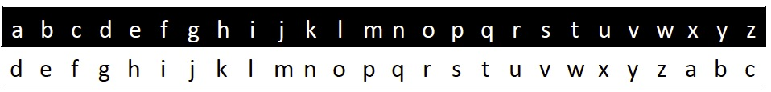
Caesar Cipher
Plaintext
Ciphertext
attack said zeus προσβάλλω
dwwdfn vdlg chxv
στςφείξξό

Slide 108
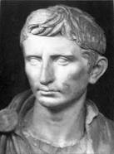
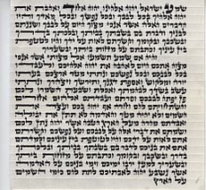

Additional Caesar-Style Cipher
Augustus
Right shift 1 without rotate, with AA for Z
Mezuzah
Shift of one to encrypt the names of God
Vigenere (a variant) was used by the Confederacy during Civil War
Mafia boss Provenzano (2006): A (4), …

Slide 109
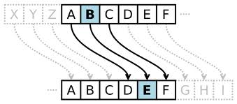
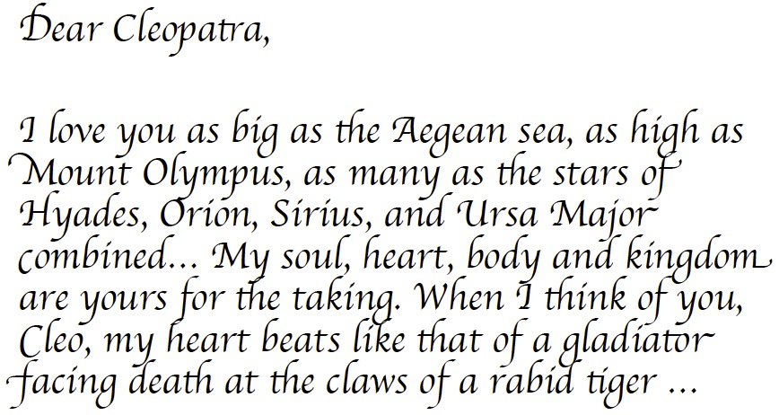
Why Programming?

Slide 110
Caesar Cipher Encoding (Design 1)
Letter | a | b | c | d | ... | … | w | x | y | z
Orig | 97 | 98 | 99 | 100 | ... | … | 119 | 120 | 121 | 122
Shift (+3) | 100 | 101 | 102 | 103 |  |  | 122 | 123 | 124 | 125
Cipher | 100 | 101 | 102 | 103 |  |  | 122 | 97 | 98 | 99
int cipher = ch + key;
if (cipher > ‘z’) cipher -= 26;
ch = (char)cipher;
Q: What if key is 100?

Slide 111
Caesar Cipher: Encoding (Design 2)
Letter | a | b | c | d | ... | … | w | x | y | z
Orig | 0 | 1 | 2 | 3 | ... | … | 22 | 23 | 24 | 25
Shift (+3) | 3 | 4 | 5 | 6 |  |  | 25 | 26 | 27 | 28
Cipher (% 26) | 3 | 4 | 5 | 6 |  |  | 25 | 0 | 1 | 2
int cipherInt = (origInt + key) % 26
Assumption: a-z mapped to 0 to 25.
How to map a char in a-z to 0 to 25?
char – ‘a’

Slide 112
Caesar Cipher Encoding
Letter | a | b | c | d | ... | … | w | x | y | z
Orig | 0 | 1 | 2 | 3 | ... | … | 22 | 23 | 24 | 25
Shift (+3) | 3 | 4 | 5 | 6 |  |  | 25 | 26 | 27 | 28
Cipher (% 26) | 3 | 4 | 5 | 6 |  |  | 25 | 0 | 1 | 2
int chRelativeIndex = ch – ‘a’;
int cipherRelInd = (chRelativeIndex + key) % 26;
ch = (char)(cipherRelInd + ‘a’);

Slide 113
Offline Exercise/Think: How to Decode? (See Backup Slides)

Slide 114
Extension: Encrypt a Text File
Goal: Instead of reading text from terminal, user specifies a file name, which gives the content to be encrypted.

Slide 115
(Offline Read) More File Details
Create a File object to get info about a file on your drive.
You can use File’s exists method to test existence:
File file = new File(“data.txt");
if ( !file.exists() ) {
// try a second input file as a backup
System.out.print(“data file not found!");
file = new File(“data2.txt");
}
Method name | Description
canRead() | returns whether file is able to be read
delete() | removes file from disk
exists() | whether this file exists on disk
getName() | returns file's name
length() | returns number of bytes in file

Slide 116
CaesarFile using a for Loop
public class ReadFile {
public static void main(String[] args) {
try {
Scanner input = new Scanner(new File(”data.txt"));
encode(input, 3); } catch (FileNotFoundException e) {
// print an error message
System.out.println(“File not found exception”);
} // end of catch
} // end of main
}
public static void encode(Scanner scan, int key) {
for (int line = 0; line < NLINES; line ++ ) { String text = scan.nextLine();
String result = Caesar.encode(text, key);
System.out.println( result );
}
}

Slide 117

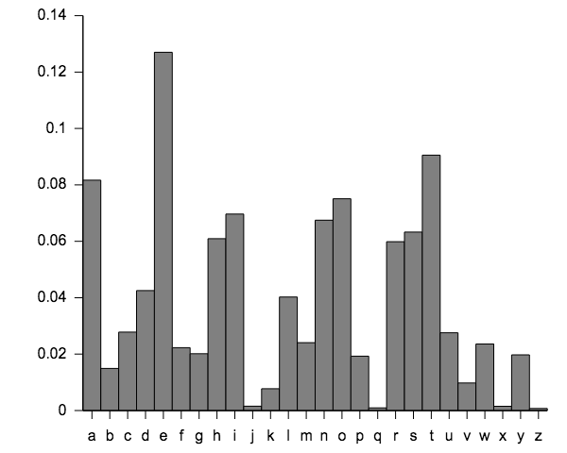
Exercise: Breaking Caesar Encryption
Caesar encryption (or permutation ciphers in general) is easy to break because it does not change the frequency of letters.

Slide 118
Backup Slides

Slide 119
Regular Expression
A regular expression defines a search pattern for strings.
Regular expressions can be used to search, edit and manipulate text.
The pattern defined by the regular expression may match one or several times or not at all for a given string.
http://www.vogella.com/tutorials/JavaRegularExpressions/article.html

Slide 120
Regular Expression
RegEx | Description
. | Matches any character
^regex | Finds regex that must match at the beginning of the line.
regex$ | Must match at the end of the line.
[abc] | Set definition, can match the letter a, b or c.
[abc][vz] | Set definition, can match a or b or c followed by either v or z.
[^abc] | When a caret appears as the first character inside square brackets, it negates the pattern. This can match any character except a or b or c.
[a-d1-7] | Ranges: matches a letter between a and d and figures from 1 to 7, but not d1.
X|Z | Finds X or Z.
XZ | Finds X directly followed by Z.
$ | Checks if a line end follows.
(Yale)|(MIT) | Yale or MIT; () is the grouping operator

Slide 121
Examples
Scanner console = new Scanner(System.in);
System.out.print("Type your name: ");
String name = console.nextLine();
..
name.startsWith(”Prof. Dr.”)
name.matches(“^Prof\. Dr\.”)
name.endsWith("Esq.”)
name.matches(“Esq\.$”)

Slide 122
Meta Chars
Regex | Description
\d | Any digit, short for [0-9]
\D | A non-digit, short for [^0-9]
\s | A whitespace character, short for [ \t\n\x0b\r\f]
\S | A non-whitespace character, short for [^\s]
\w | A word character, short for [a-zA-Z_0-9]
\W | A non-word character [^\w]
\b | Matches a word boundary where a word character is [a-zA-Z0-9_].

Slide 123
Quantifiers
Regular Expression | Description | Examples
* | Occurs zero or more times, is short for {0,} | X* finds no or several letter X,
 |  | .* finds any character sequence
+ | Occurs one or more times, is short for {1,} | X+ - Finds one or several letter X
? | Occurs no or one times, ? is short for {0,1}. | X? finds no or exactly one letter X
{X} | Occurs X number of times, {} describes the order of the preceding liberal | \d{3} searches for three digits, .{10} for any character sequence of length 10.
{X,Y} | Occurs between X and Y times, | \d{1,4} means \d must occur at least once and at a maximum of four.
*? | ? after a quantifier makes it a reluctant quantifier. It tries to find the smallest match.

Slide 124
Example
Scanner console = new Scanner(System.in);
System.out.print("Type your name: ");
String name = console.nextLine();
..
name.contains(“Yale”)
name.matches(“.*Yale.*”);
String ssn = console.nextLine();
// how to validate it is correct ssn: 123-45-6789
ssn.matches(“\\d{3}-\\d{2}-\\d{4}”)
String ph = console.nextLine();
// how to validate right ph# format: 432-6400 or 432 6400
ph.matches(“\\d{3}[- ]\\d{4}”)

Slide 125
Practice: Detect Email Address

Slide 126
Caesar Cipher: Decoding
Letter | a | b | c | d | ... | … | w | x | y | z
Orig | 0 | 1 | 2 | 3 | ... | … | 22 | 23 | 24 | 25
Shift (+3) | 3 | 4 | 5 | 6 |  |  | 25 | 26 | 27 | 28
Cipher (% 26) | 3 | 4 | 5 | 6 |  |  | 25 | 0 | 1 | 2
Back (-3) | 0 | 1 | 2 | 3 |  |  | 22 | -3 | -2 | -1
Range (+26%26) | 0 | 1 | 2 | 3 |  |  | 22 | 23 | 24 | 25

Slide 127
Unifying Design
int cipherInt = (origInt + key) % 26
int origInt = (cipherInt – key + 26) % 26
A single encode method with parameter key
To encode
encode(key)
To decode
encode(26 – key)
Caesar.java

