Slide 1
Computer Networks and Network Security
Qiao Xiang, Congming Gao, Qiang Su
https://sngroup.org.cn/courses/cnns-xmuf25/index.shtml
9/2/2025
This deck of slides are heavily based on CPSC 433/533 at Yale University, by courtesy of Dr. Y. Richard Yang.

Slide 2
Outline
Administrative trivia’s
What is a network protocol?
A brief introduction to the Internet: past and present
Summary

Slide 3
Personnel
Instructor
  Qiao Xiang, qiaoxiang@xmu.edu.cn
    office hours： by appointment
  Congming Gao, gaocm@xmu.edu.cn
  Qiang Su, qiangsu@xmu.edu.cn
Teaching assistant
  Yining Jiang, yining.jiang.xmu@outlook.com
  Wenyun Xu, wenyun.xu.xmu@outlook.com

Slide 4

Instructor: Qiao Xiang
Joined XMU as a professor in January 2021
Research: Computer Networks and Systems
Previously,
  Research assistant professor, Yale University, US., 2019-2020
  Postdoctoral fellow, Yale University, US. 2016-2018
  Postdoctoral fellow, McGill University, Canada, 2014-2015
  Ph.D. in Computer Science, Wayne State University, US, 2014
  B.E. in Information Security and B.Econ., NKU, 2007

Slide 5

Instructor: Congming Gao
Joined XMU as an associate professor September 2022
Research: Computer System and Architecture
Previously,
  Postdoctoral fellow, Tsinghua University, 2020-2022
  Ph.D. in Computer Science, Chongqing University, 2020
  Visiting scholar, University of Pittsburgh, US. 2018-2019
  Research Assistant, City University of Hongkong, 2015
  B.E. in Information Security, Chongqing University, 2014

Slide 6

Instructor: Qiang Su
Joined XMU as an assistant professor in May 2025
Research: Computer Networks and Systems
Previously,
  Research Associate, CUHK, HK, 2024
  Visiting Researcher, MBZUAI, UAE, 2024
  Ph.D. in Computer Science, CityU HK, HK, 2024
  Visiting Researcher, Boston University, US. 2023
  B.E. in Computer Science and Technology, NEU, 2018

Slide 7

Textbook
Textbook
  Computer Networking: A Top-Down Approach, 7/e
  by Jim Kurose and Keith Ross
Reference books
  Computer Networks
  by Tanenbaum and Wetherall
  Computer Networks, A Systems Approach
  by Larry Peterson and Bruce Davie
  TCP/IP Illustrated, Volume 1: The Protocols
  by W. Richard Stevens
  Java Network Programming,
  by Elliotte Harold
Resources
  https://sngroup.org.cn/courses/cnns-xmuf25/index.shtml
on

Slide 8
What are the Goals of this Course?
Learn design principles and techniques of:
  the Internet infrastructure (Internet service provider, data center, cloud)
  large-scale Internet applications
Focus on how the principles and techniques apply and adapt in real world:
  real examples from the Internet

Slide 9
Computer Networks and Network Security vs. Computer Networks and Communication
CNNS:
Bilingual:
  English in slides / homework / exams
  Chinese in lecture / lab classes / discussions
More emphasis on design principles, theories and programming
More emphasis on security issues
Less emphasis on communication (e.g., physical layer and wireless networks)
A top-down roadmap

Slide 10
Why Study Computer Networks?
Looking for a job
Domestic | International
Huawei | Amazon
Alibaba | Google
Tencent | Microsoft
Xiaomi | Facebook
JD | Uber
… | …

Slide 11


Why Study Computer Networks?
Be an entrepreneur

Slide 12




Why Study Computer Networks?
Pursue graduate degrees overseas

Slide 13





Why Study Computer Networks?
Pursue graduate degrees domestically
Xin Jin
PKU
Tong Yang
PKU
Chenren Xu
PKU
Linghe Kong
SJTU
If you are interested in working with me on research projects, please send me an email at qiaoxiang@xmu.edu.cn
Chen Tian
NJU
Peng Zhang
XJTU
Qiao Xiang
XMU
Qiang Su
XMU

Slide 14

What Do You Need To Do?
Please go to the class website to fill out the class background survey
  help us determine your background
  help us determine the depth, topics, and the details of assignments
  suggest topics that you want to be covered (if you think of a topic later, please send me email)

Slide 15
What Do You Need To Do?
Your workload
  5-6 lab assignments
    2-3 written assignments
    3-4 programming assignments
      one HTTP 1.0 server, one TCP, one routing protocol
  1 class project （2-3 persons a team)
    List of potential topics to be posted before midterm
  2 exams
You will have the opportunity to use Large Language Model (e.g., ChatGPT) in 1-2 designated programming assignments

Slide 16
How to Succeed in this Class?
Engage in lectures
  Questions are highly encouraged
Read textbooks / references / online materials
Apply the principles / techniques you learned in lectures to assignments and the project
Do not procrastinate assignments and the project
  For programming assignments and projects, follow the timeline of checkpoints to avoid the deadline panic

Slide 17
Class Project
Research or engineering project related to computer networks and network security
Grading criteria:
  Innovation 25%, Practicality 25%, Completeness 25%, Presentation 25%
Suggestions
  Identify teams and talk to the instructor to decide on the topic as early as possible
  Read latest papers/technical documents to get inspiration
  If possible, target research papers / patents

Slide 18
Grading
Class Participation | 10%
Lab Assignments | 40%
Class Project | 15%
Exams | 15%+20%
Grades are important, but you do not need worry too much about them
More important is what you realize/learn than the grades !!

Slide 19
Questions?

Slide 20
Outline
Administrative trivia’s
What is a network protocol?

Slide 21
What is a Network Protocol?
A network protocol defines the format and the order of messages exchanged between two or more communicating entities, as well as the actions taken on the transmission and/or receipt of a message or other events.

Slide 22

Example Protocol: Simple Mail
Transfer Protocol (SMTP)
Messages from a client to a mail server
  HELO
  MAIL FROM: <address>
  RCPT TO: <address>
  DATA
  <This is the text end with a line with a single .>
  QUIT
Messages from a mail server to a client
  status code
    The first digit of the response broadly indicates the success, failure, or progress of the previous command.
      1xx - Informative message
      2xx - Command ok
      3xx - Command ok so far, send the rest of it.
      4xx - Command was correct, but couldn't be performed for some reason.
      5xx - Command unimplemented, or incorrect, or a serious program error occurred.
  content
outgoing
message queue
user mailbox
user
agent
mail
server
user
agent
SMTP
mail
server
user
agent
SMTP
SMTP
mail
server
user
agent
POP3,
IMAP
SMTP
user
agent
user
agent
Command: %telnet smtp.xmu.edu.cn 25
Notes:
RCPT TO: <> notify=success,failure

Slide 23
Demo: SMTP
C: auth login
S: 334 VXNlcm5hbWU6
C: eG11Y25ucw==
S: 334 UGFzc3dvcmQ6
C: MzM0ZjU2MDVkZjE1MDRmOQ==
S: 235 OK Authenticated
C: mail from:xmucnns@sina.com
S: 250 ok
C: rcpt to:qiaoxiang@xmu.edu.cn
S: 250 ok
C: data
S: 354 End data with <CR><LF>.<CR><LF>
C: Date:2025-9-2 11:15
C: From:xmucnns@sina.com
C: To:qiaoxiang@xmu.edu.cn
C: Subject:test smtp
C:
C: Hello, Qiao.
C:
C: .
S: 250 ok queue id 11479549283321
C: quit
S: 221 smtp-97-27.smtpsmail.fmail.bx.sinanode.com
S: Connection closed by foreign host.

Slide 24
Example Protocol: TCP Connection Close Protocol
Why connection close?
  so that each side can release resource and remove state about the communication
client
server
init. close
release
resource?
I am done. Are you done too?
close
I am done too. Goodbye!
release
resource?
close
release
resource?

Slide 25
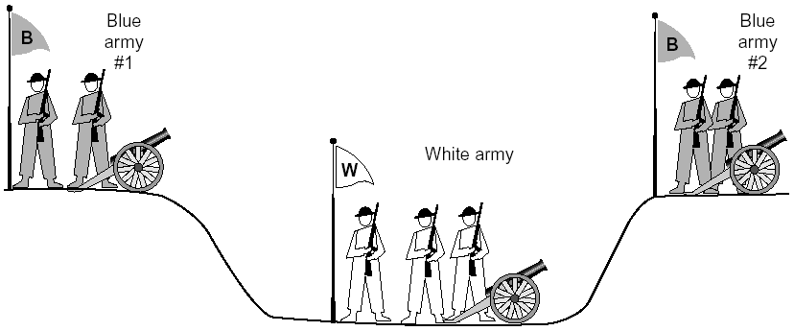
General Case: The Two-Army Problem
The gray (blue) armies need to agree on whether or not they will attack the white army. They achieve agreement by sending messengers to the other side. If they both agree, attack; otherwise, no. Note that a messenger can be captured!

Slide 26
Example: TCP Protocol Handshakes
Host A
SYN(seq=x)
Host B
ACK(seq=x), SYN(seq=y)
ACK(seq=y)
DATA(seq=x+1)
ACK
FIN
ACK
FIN
ACK

Slide 27
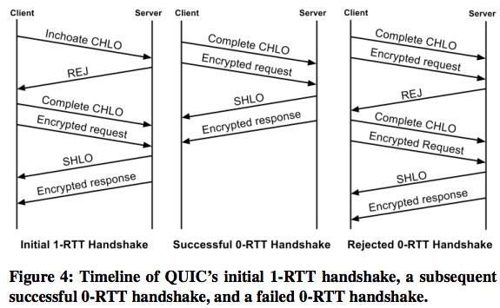
Example: Google’ new QUIC
http://conferences.sigcomm.org/sigcomm/2017/files/program/ts-5-1-QUIC.pdf

Slide 28
Protocol Standardization
Most widely used protocols are defined in standards
Why standard?

Slide 29
Internet Standardization Process
All standards of the Internet are published as RFC (Request for Comments)
  e.g., the SMTP protocol is specified in RFC821
  but not all RFCs are Internet Standards: http://qiaoxiang.me/courses/cnns-xmuf21/readings/interestingrfcs.html

Slide 30
Internet Standardization Process
All standards of the Internet are published as RFC (Request for Comments)
  e.g., the SMTP protocol is specified in RFC821
  but not all RFCs are Internet Standards: https://sngroup.org.cn/courses/cnns-xmuf23/readings/interestingrfcs.html
A typical (but not the only) way of standardization:
  Internet draft
  RFC
  proposed standard
  draft standard (requires 2 working implementations)
  Internet standard (declared by Internet Architecture Board)
David Clark, 1992:
  We reject: kings, presidents, and voting. We believe in: rough consensus and running code.

Slide 31

Outline
Administrative trivia’s
What is a network protocol?
A brief introduction to the Internet
  past (a brief history)
  present

Slide 32
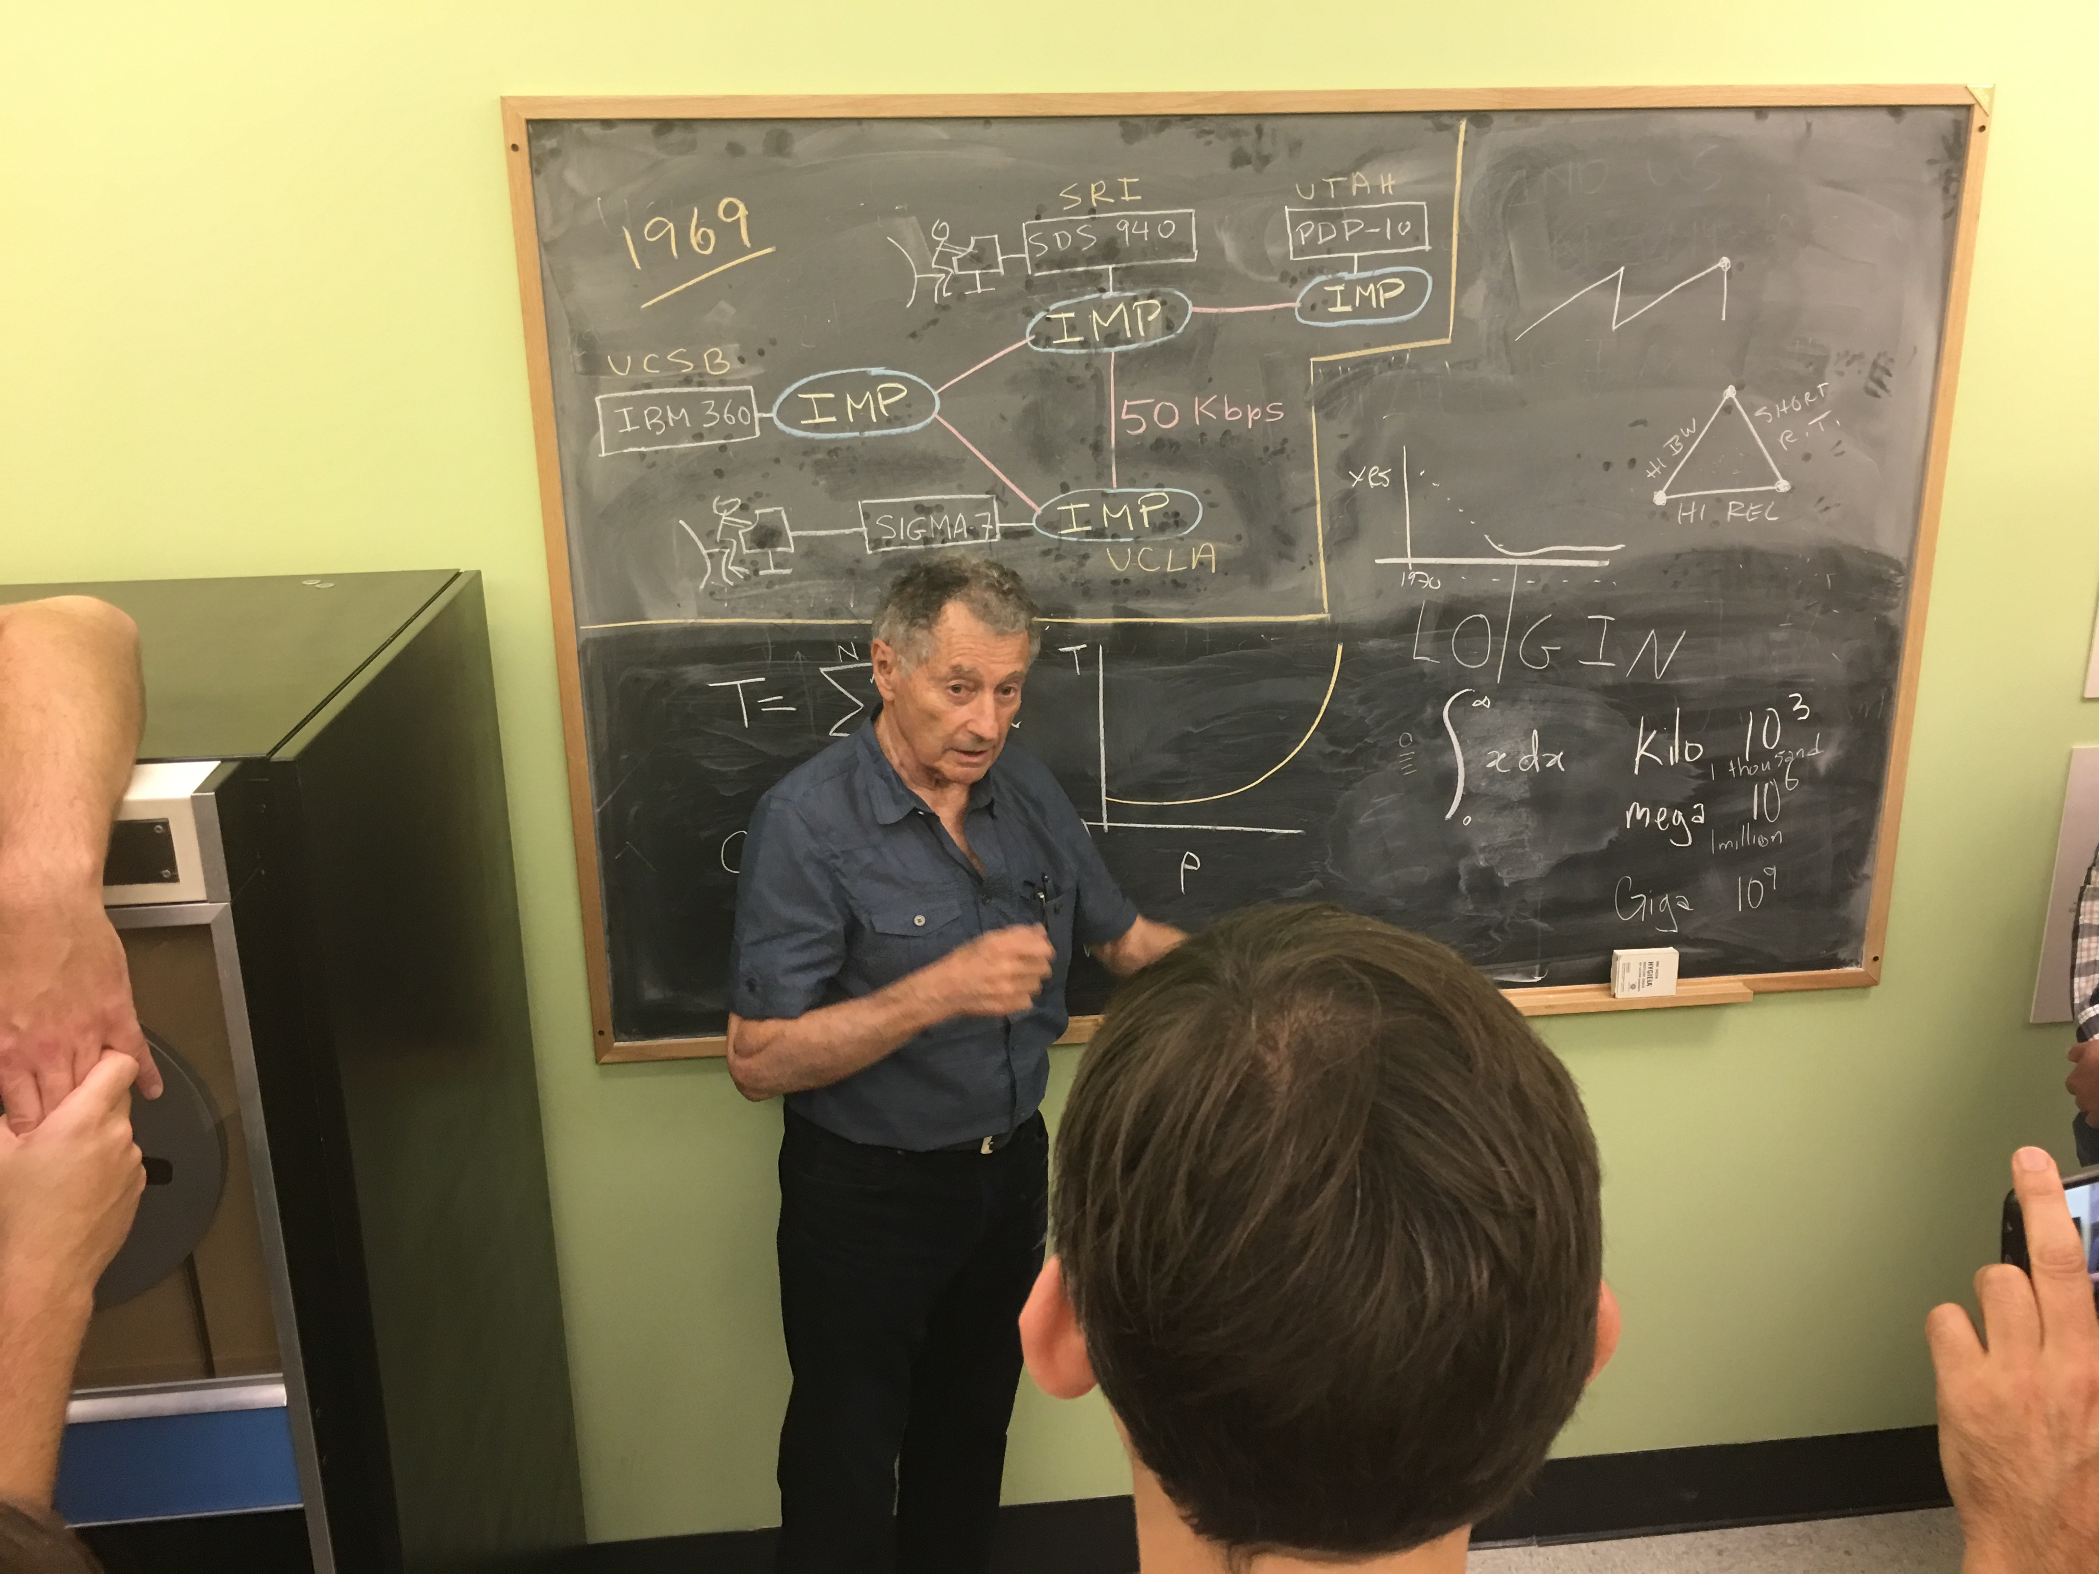
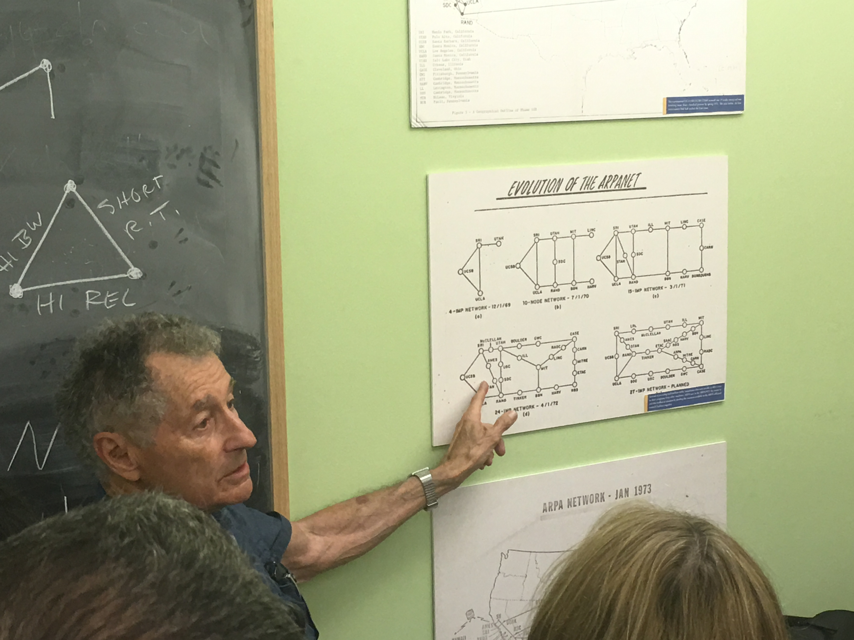
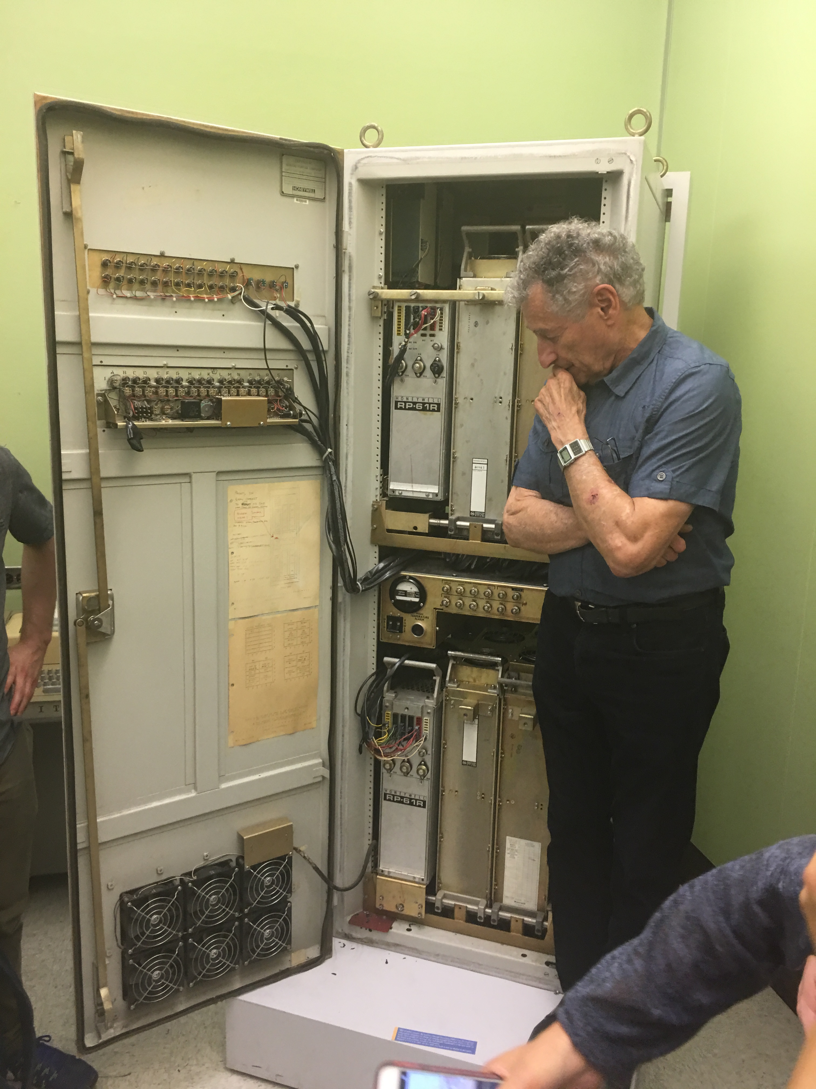
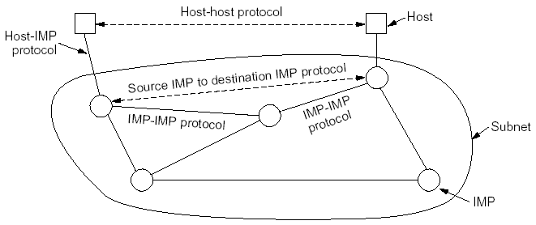
Prelude:
Packet Switching and ARPANET
1957
  USSR launched Sputnik; US DoD formed Advanced Research Projects Agency (ARPA)
1961
  First paper by Len Kleinrock on packet switching theory
1964
  Paul Baran from RAND on design of packet switching networks
1965-1968
  ARPANET plan
  Bolt Beranek and Newman,
  Inc. (BBN), a small company,
  was awarded Packet Switch
  contract to build Interface
  Message Processors (IMPs)

Slide 33
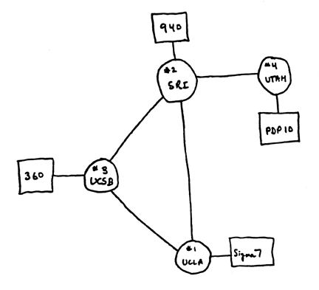
Internet 1.0: Initial ARPANET
1969
  ARPANET commissioned: 4 nodes, 50kbps

Slide 34
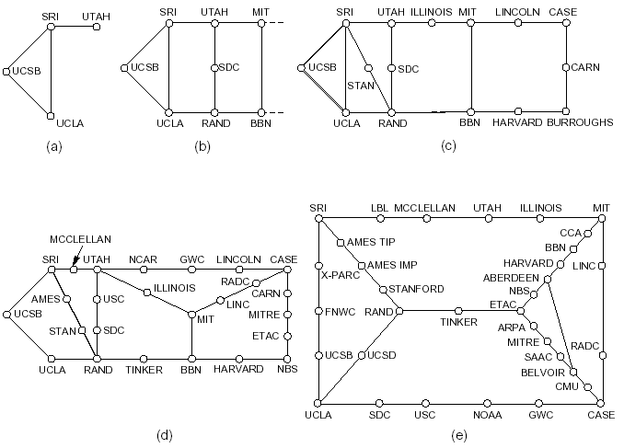
Initial Expansion of the ARPANET
Dec. 1969
July 1970
Mar. 1971
Apr. 1972
Sept. 1972
RFC 527: ARPAWOCKY; RFC 602: The Stockings Were Hung by the Chimney with Care

Slide 35
The Internet Becomes a Network of Networks
1970: ALOHAnet, the first packet radio network, developed by Norman Abramson, Univ of Hawaii, becomed operational
1973: Bob Kahn posed the Internet problem---how to connect ARPANET, packet radio network, and satellite network
1974: Vint Cerf, Bob Kahn published initial design of TCP (NCP) to connect multiple networks
  - 1978: TCP (NCP) split to TCP/IP
  - 1983: TCP (NCP) converted to TCP/IP (Jan. 1)

Slide 36
Growth of the Internet
1981: BITNET (Because It’s Time NETwork) between CUNY and Yale
1986: NSF builds NSFNET as backbone, links 6 supercomputer centers, 56 kbps; this allows an explosion of connections, especially from universities
1987: 10,000 hosts
1987： China's first email "Across the Great Wall we can reach every corner in the world" sent to Germany
1988: Internet congestion collapse; TCP congestion control
1989: 100,000 hosts
RFC 1121: Act One – The Poem
WELCOME by Leonard Kleinrock
We've gathered here for two days to examine and debate
And reflect on data networks and as well to celebrate.
To recognize the leaders and recount the path we took.
We'll begin with how it happened; for it's time to take a look.
Yes, the history is legend and the pioneers are here.
Listen to the story - it's our job to make it clear.
We'll tell you where we are now and where we'll likely go.
So welcome to ACT ONE, folks.
Sit back - enjoy the show!!

Slide 37
Internet 2.0: Web, Commercialization, Social Networking of the Internet
1990: ARPANET ceases to exist
1991: NSF lifts restrictions on the commercial use of the Net; Berners-Lee of European Organization for Nuclear Research (CERN) released World Wide Web
1992: 1 million hosts (RFC 1300: Remembrances of Things Past)
1994: China's first 64K dedicated circuit to the Internet
1998: Google was founded
2004: Facebook was founded
2006: Amazon AWS cloud computing
For a link of interesting RFCs, please see
http://qiaoxiang.me/courses/cnns-xmuf21/readings/interestingrfcs.html
For more on Internet history, please see http://www.zakon.org/robert/internet/timeline/

Slide 38
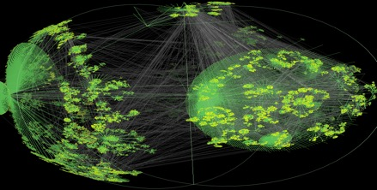
Growth of the Internet in Terms of Number of Hosts
Number of Hosts on the Internet:
Aug. 1981 213
Oct. 1984 1,024
Dec. 1987 28,174
Oct. 1990 313,000
Jan. 1993 1,313,000
Jan. 1996 9,472,000
Jan. 1999 43,218,000
Jan. 2002 147,344,723
Jan. 2005 317,646,084
Jan. 2007 433,193,199
Jan. 2010 732,740,444
Jan. 2013 963,518,598
Jan. 2016 1,048,766,623
Jan. 2017 1,062,660,523
CAIDA router
level view
http://ftp.isc.org/www/survey/reports/current/

