Slide 1
Network Applications: Email, DNS
Qiao Xiang, Congming Gao, Qiang Su
https://sngroup.org.cn/courses/cnns-xmuf25/index.shtml
09/11/2025
This deck of slides are heavily based on CPSC 433/533 at Yale University, by courtesy of Dr. Y. Richard Yang.

Slide 2
Outline
Admin. and recap
Layered architecture
Internet layering
Application layer overview
Network applications
Email
DNS

Slide 3
Recap: Summary of the Taxonomy of Communication Networks
communication network
switched network
broadcast communication
packet-switched network
circuit-switched network
datagram network
virtual circuit network

Slide 4
Recap: Circuit Switching vs. Packet Switching
 | circuit switching | packet switching
resource usage | use a single partition bandwidth | use whole link bandwidth
reservation/setup | need reservation (setup delay) | no reservation
resource contention | busy signal (session loss) | congestion (long delay and packet losses)
charging | time | packet
header | no per-pkt header | per packet header
fast path processing | fast | per packet processing

Slide 5
Recap: Queueing Theory
Model system state
Introduce state transition diagram
Focus on equilibrium: state trend neither growing nor shrinking

Slide 6
Recap: Queueing Theory Analysis of Circuit-Switching
system state: # of busy lines
0
1
k
k+1
N
p0
p1
pk
pk+1
pN

Slide 7
Recap: Queueing Theory Analysis of Circuit-Switching
system state: # of busy lines
λ
0
1
k
k+1
N
(k+1)μ
p0
p1
pk
pk+1
pN
at equilibrium (time reversibility) in one unit time: #(transitions k → k+1) = #(transitions k+1 → k)

Slide 8
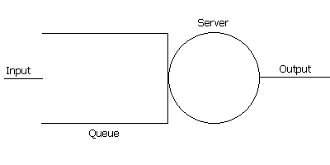
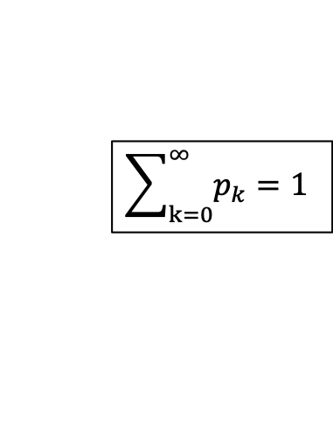
Recap: Queueing Theory Analysis of Packet Switching
system state: #packets in queue
λ
0
1
k
k+1
N
μ
p0
p1
pk
pk+1
at equilibrium (time reversibility) in one unit time: #(transitions k → k+1) = #(transitions k+1 → k)
$$\sum_{k=0}^{∞}{p_{k}}=1$$

Slide 9
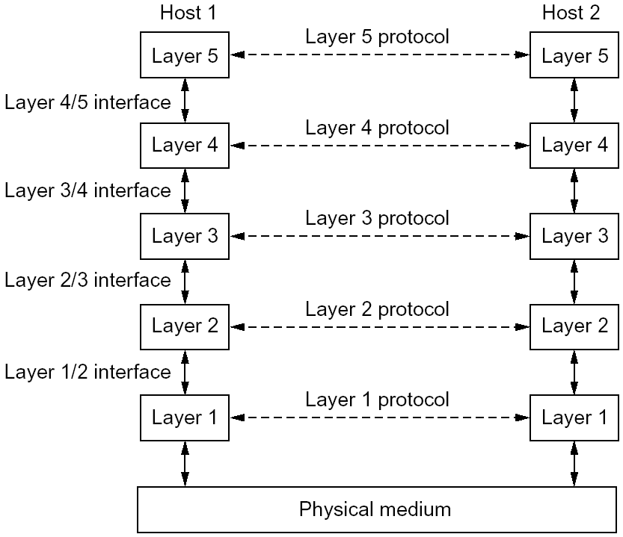
Recap: Layering
Why layering
reference model
modularization
Concepts
service, interface, and protocol
physical vs logical communication
Key design decision
end-to-end arguments to place functions in layers

Slide 10
Some Implications of Layered Architecture
A packet as a stack container
Each layer needs multiplexing and demultiplexing to serve layer above
…
Hn-1
Hn
Ln
Has a field to indicate which higher layer requires the service
Ln-1

Slide 11
The Hourglass Architecture of the Internet
Email
WWW
FTP
Telnet
TCP
UDP
end users
IP4
network
infrastructure
Ethernet
Wireless
Cable/DSL
Notes:
How about move the line to on top of TCP/UDP?

Slide 12
Link Layer (Ethernet)
Services (to network layer)
multiplexing/demultiplexing
- from/to the network layer
error detection
multiple access control
arbitrate access to shared medium
Interface
send frames to a directly reachable peer
Email
WWW
FTP
Telnet
TCP
UDP
IP4/6
Ethernet
Wireless
Cable/DSL

Slide 13

Link Layer: Protocol Header (Ethernet)
Email
WWW
FTP
Telnet
Email
WWW
FTP
Telnet
multiplexing
/demultiplexing
error
detection
TCP
UDP
TCP
UDP
IP4/6
IP4/6
access control
Ethernet
Wireless
Cable/DSL
Ethernet
Wireless
Cable/DSL
IP4
IP6
IP4
IP6
link
link

Slide 14
Network Layer: IP
Services (to transport layer)
multiplexing/demultiplexing from/to the transport
fragmentation and reassembling: partition a fragment into smaller packets
- removed in IPv6
error detection
routing: best-effort to send packets from source to destination
certain QoS/CoS
does not provide reliability or reservation
Interface:
send a packet to a (transport-layer) peer at a specified global destination, with certain QoS/CoS
Email
WWW
FTP
Telnet
SSL
TCP
UDP
IP
Ethernet
Wireless
Cable/DSL

Slide 15
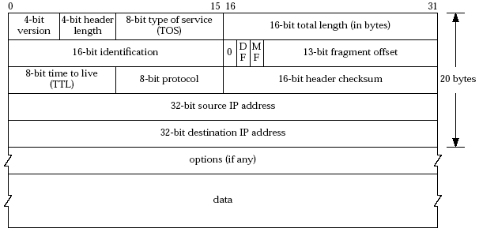
Network Layer: IPv4 Header
QoS/CoS
fragmentation / reassembling
error
detection
routing
Email
WWW
FTP
Telnet
Email
WWW
FTP
Telnet
SSL
SSL
TCP
UDP
TCP
UDP
IP
multiplexing
/demultiplexing
IP
Ethernet
Wireless
Cable/DSL
Ethernet
Wireless
Cable/DSL

Slide 16
Transport Layer: UDP
A connectionless service
Does not provide: connection setup, reliability, flow control, congestion control, timing, or bandwidth guarantee
why is there a UDP?
Email
WWW
FTP
Telnet
TCP
UDP
IP
Ethernet
Wireless
Cable/DSL

Slide 17
Transport Services and APIs
Multiple services and APIs proposed in history
XTI (X/Open Transport Interface), a slight modification of the Transport Layer Interface (TLI) developed by AT&T.
Commonly used transport-layer service model and API: Socket
sometimes called "Berkeley sockets" acknowledging their heritage from Berkeley Unix
a socket has a transport-layer local port number
e.g., email (SMTP) port number 25, web port number 80
Application can send data into socket, read data out of socket
an application process binds to a socket (-a all; -u udp; -n number)
%netstat -aun
Notes:
http://www.techrepublic.com/blog/security/list-open-ports-and-listening-services/
lsof –i -n

Slide 18
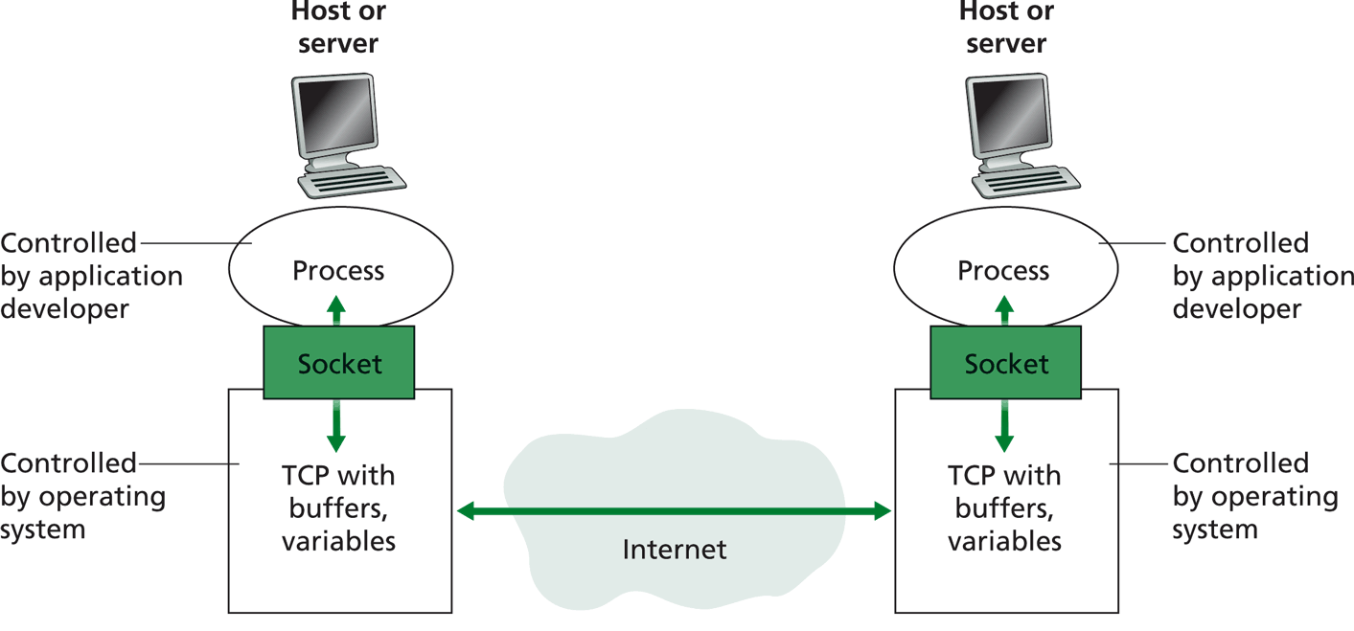
Socket Service Model and API
transport
protocol
buffers,
states
buffers,
states

Slide 19
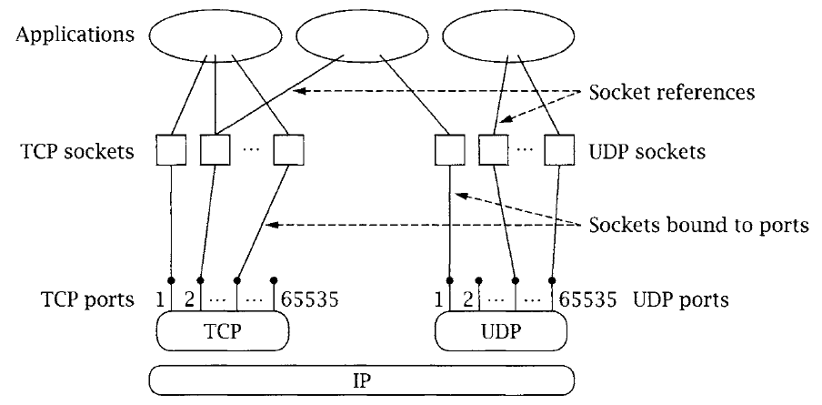
Multiplexing/Demultiplexing

Slide 20
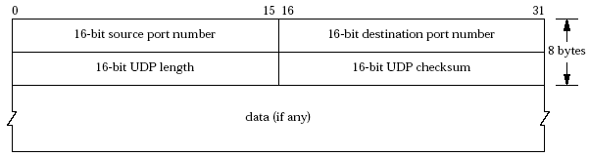
Transport Layer: UDP Header
multiplexing
/demultiplexing
error
detection
Email
WWW
FTP
Telnet
Email
WWW
FTP
Telnet
TCP
UDP
UDP
TCP
IP
IP
Ethernet
Wireless
FDDI
Ethernet
Wireless
Cable/DSL

Slide 21
Transport Layer: TCP
Services
multiplexing/demultiplexing
reliable transport
between sending and receiving processes
setup required between sender and receiver: a connection-oriented service
flow control: sender won’t overwhelm receiver
congestion control: throttle sender when network overloaded
error detection
does not provide timing, minimum bandwidth guarantees
Interface:
send a packet to a (app-layer) peer
Email
WWW
FTP
Telnet
TCP
UDP
IP
Ethernet
Wireless
FDDI

Slide 22
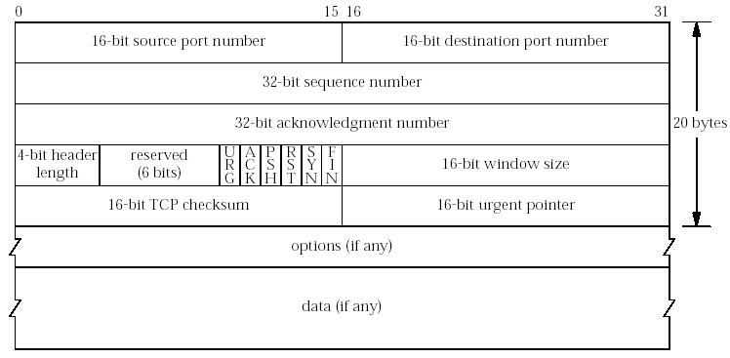
Transport Layer: TCP Header
multiplexing
/demultiplexing
Reliable
transport
congestion
control
flow control
error
detection
Email
WWW
FTP
Telnet
Email
WWW
FTP
Telnet
UDP
TCP
TCP
UDP
IP
IP
Ethernet
Wireless
FDDI
Ethernet
Wireless
Cable/DSL

Slide 23
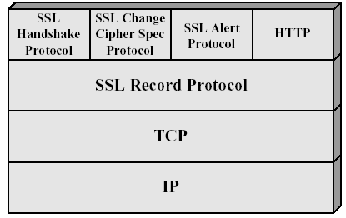
Secure Socket Layer Architecture
HTTP
POP3

Slide 24
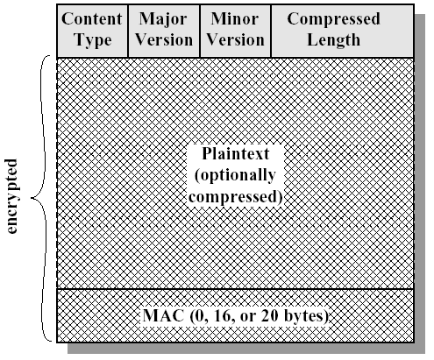
SSL Record-Layer Packet Format
20: change_cipher
21: alert
22: handshake
23: application

Slide 25
Summary: The Big Picture of the Internet
Hosts and routers:
~ 1 bil. hosts
autonomous systems organized roughly hierarchical
backbone links at 100 Gbps
Software:
datagram switching with virtual circuit support at backbone
layered network architecture
use end-to-end arguments to determine the services provided by each layer
the hourglass architecture of the Internet
Email
WWW
FTP
Telnet
SSL
TCP
UDP
IP4/6
Ethernet
Wireless
Cable/DSL

Slide 26
Protocol Formats

Slide 27
Outline
Admin. and recap
Application layer overview

Slide 28
Application Layer: Goals
Conceptual + implementation aspects of network application protocols
client server paradigm
peer to peer paradigm
network app. programming
Learn about applications by examining common applications
smtp/pop
dns
http (1, 1.1, /2)
content distribution
peer-to-peer

Slide 29
Network Applications vs. Application-layer Protocols
Network application: communicating, distributed processes
a process is a program that is running within a host
a user agent is a process serving as an interface to the user
web: browser
streaming audio/video: media player
processes communicate by an application-layer protocol
e.g., email, Web
Application-layer protocols
one “piece” of an app
define messages exchanged by apps and actions taken
implementing services by using the service provided by the lower layer, i.e., the transport layer
application
transport
network
data link
physical
application
transport
network
data link
physical

Slide 30
App. and Trans.: App. Protocols and their Transport Protocols
An application needs to choose the transport protocol
Application
layer protocol
smtp [RFC 821]
telnet [RFC 854]
http [RFC 2068]
ftp [RFC 959]
proprietary
(e.g., Vocaltec)
NFS
proprietary
Underlying
transport protocol
TCP/SSL
TCP
TCP/SSL
TCP
typically UDP
TCP or UDP
typically UDP but moving to http
Application
e-mail
remote terminal access
Web
file transfer
Internet telephony
remote file server
streaming multimedia

Slide 31
Client-Server Paradigm
Typical network app has two pieces: client and server
application
transport
network
data link
physical
Client (C):
initiates contact with server (“speaks first”)
typically requests service from server
for Web, client is implemented in browser; for e-mail, in mail reader
Server (S):
provides requested service to client
e.g., Web server sends requested Web page; mail server delivers e-mail
request
reply
application
transport
network
data link
physical

Slide 32
Client-Server Paradigm: Key Questions
application
transport
network
data link
physical
request
Key questions to ask about a C-S application
- Is the application extensible?
- Is the application scalable?
- How does the application handle server failures (being robust)?
- How does the application handle security?
reply
application
transport
network
data link
physical

Slide 33
Outline
Admin. and recap
Application layer overview
Network applications
Email

Slide 34
Electronic Mail
Still active
80B emails/day
3.9B active email boxes
A highly recommended reading: a history of Email development
linked on the Schedule page

Slide 35
Demo: SMTP
C: auth login
S: 334 VXNlcm5hbWU6
C: eG11Y25ucw==
S: 334 UGFzc3dvcmQ6
C: MzM0ZjU2MDVkZjE1MDRmOQ==
S: 235 OK Authenticated
C: mail from:xmucnns@sina.com
S: 250 ok
C: rcpt to:qiaoxiang@xmu.edu.cn
S: 250 ok
C: data
S: 354 End data with <CR><LF>.<CR><LF>
C: Date:2022-9-22 12:36
C: From:xmucnns@sina.com
C: To:qiaoxiang@xmu.edu.cn
C: Subject:test smtp
C:
C: Hello, Qiao.
C:
C: .
S: 250 ok queue id 11479549283321
C: quit
S: 221 smtp-97-27.smtpsmail.fmail.bx.sinanode.com
S: Connection closed by foreign host.

Slide 36
Electronic Mail: Components
outgoing
message queue
user mailbox
user
agent
Three major components:
User agents
Mail servers
Protocols
Mail transport protocol
SMTP
Mail access protocols
POP3: Post Office Protocol [RFC 1939]
IMAP: Internet Mail Access Protocol [RFC 1730]
mail
server
user
agent
SMTP
mail
server
user
agent
SMTP
mail
server
SMTP
user
agent
POP3 or
IMAP SMTP
user
agent
user
agent

Slide 37
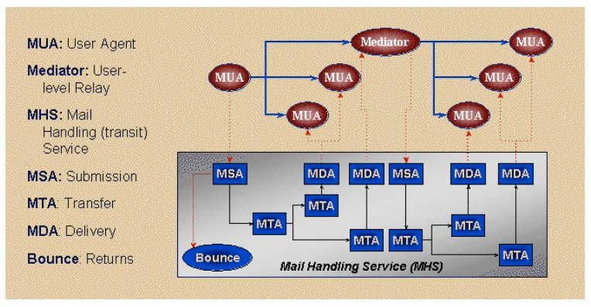
Email Transport Architecture
http://www.maawg.org/sites/maawg/files/news/MAAWG_Email_Authentication_Paper_2008-07.pdf

Slide 38
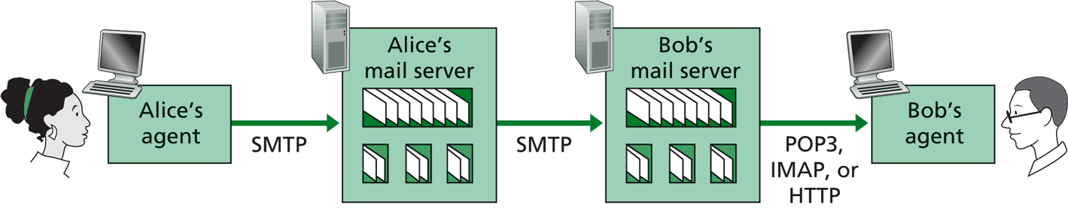
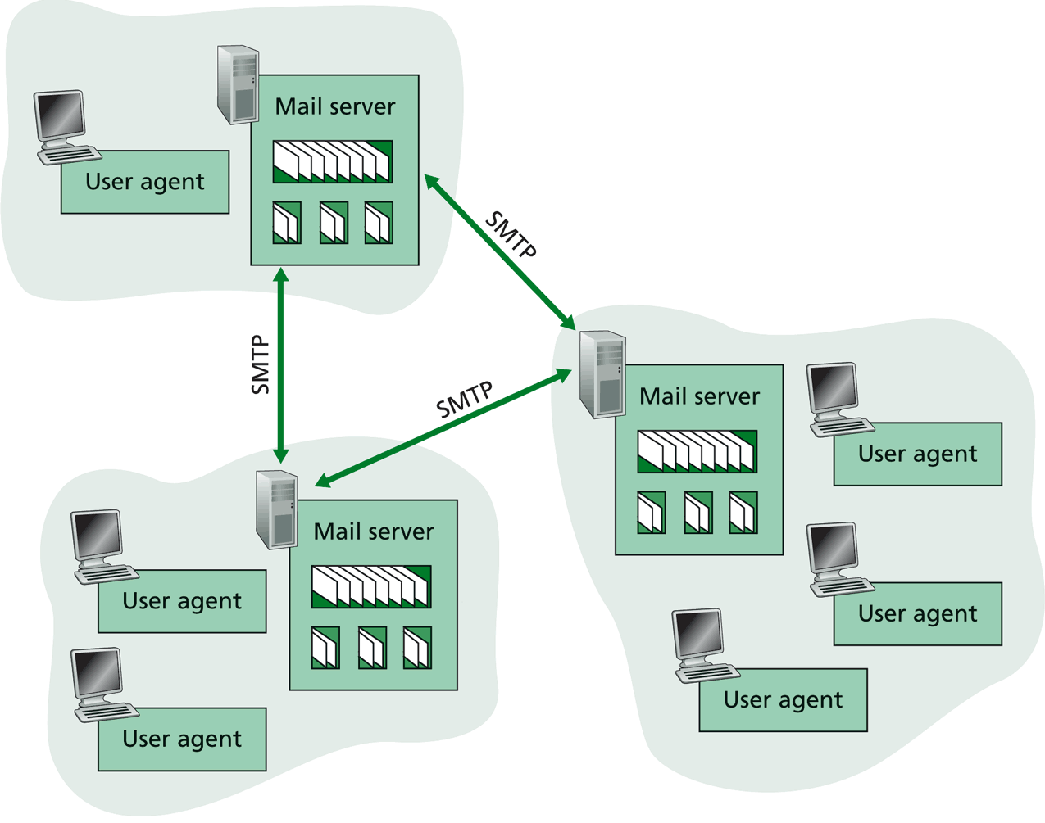
SMTP: Mail Transport Protocol Messages (Envelop Messages)
C: auth login
S: 334 VXNlcm5hbWU6
C: eG11Y25ucw==
S: 334 UGFzc3dvcmQ6
C: MzM0ZjU2MDVkZjE1MDRmOQ==
S: 235 OK Authenticated
C: mail from:xmucnns@sina.com
S: 250 ok
C: rcpt to:qiaoxiang@xmu.edu.cn
S: 250 ok
C: data
S: 354 End data with <CR><LF>.<CR><LF>
C: Date:2021-9-22 12:36
C: From:xmucnns@sina.com
C: To:qiaoxiang@xmu.edu.cn
C: Subject:test smtp
C:
C: Hello, Qiao.
C:
C: .
S: 250 ok queue id 11479549283321
C: quit
S: 221 smtp-97-27.smtpsmail.fmail.bx.sinanode.com
S: Connection closed by foreign host.
Email text different from SMTP protocol message
%telnet smtp.sina.com 25

Slide 39
Mail Message Data
SMTP: protocol for exchanging email msgs
RFC 822: standard for text message format:
Header lines, e.g.,
To:
From:
Subject:
Body
the “message”, ASCII characters only
header
blank
line
body
Benefit of separating protocol and msg: easier extensibility

Slide 40
Message Format: Multimedia Extensions
MIME: multimedia mail extension, RFC 2045, 2056
Additional lines in msg header declare MIME content type
From: xmucnns@sina.com
To: qiaoxiang@xmu.edu.cn
Subject: Network map.
MIME-Version: 1.0
Content-Type: image/jpeg Content-Transfer-Encoding: base64
base64 encoded data .....
.........................
......base64 encoded data
MIME version
multimedia data
type, subtype,
parameter declaration
method used
to encode data
encoded data
Benefit of MIME type: self describing data type, adding extensibility.

Slide 41
Multipart Type: How Attachment Works
From: xmucnns@sina.com
To: qiaoxiang@xmu.edu.cn
Subject: Network map.
MIME-Version: 1.0
Content-Type: multipart/mixed; boundary=98766789
--98766789
Content-Transfer-Encoding: quoted-printable
Content-Type: text/plain
Hi,
Attached is network topology map.
--98766789
Content-Transfer-Encoding: base64
Content-Type: image/jpeg
base64 encoded data .....
.........................
......base64 encoded data
--98766789--

Slide 42
POP3 Protocol: Mail Retrieval
Authorization phase
client commands:
user: declare username
pass: password
server responses
+OK
-ERR
Transaction phase, client:
list: list message numbers
retr: retrieve message by number
dele: delete
quit
S: +OK sina pop3 server ready
C: user xmucnns
S: +OK welcome to sina mail
C: pass 334f5605df1504f9
S: +OK 4 messages (32377 octets)
C: list
S: +OK 4 messages (32377 octets)
S: 1 10410
S: 2 10748
S: 3 7859
S: 4 3360
S: .
C: retr 4
S: +OK 3360 octets
C: dele 2
C: quit
S: +OK
user successfully logged in
POP3 server signing off
%telnet pop.sina.com 110
Notes:
http://www.electrictoolbox.com/article/networking/pop3-commands/

Slide 43
Exercise
Register an email address at sina.com
Send an email to the registered email address using smtp
Retrieve using pop

Slide 44
Evaluation of SMTP/POP/IMAP
user
agent
mail
server
user
agent
Key questions to ask about a C-S application
- extensible?
- scalable?
- robust?
- security?
SMTP
mail
server
user
agent
SMTP
SMTP
mail
server
user
agent
POP3 or
IMAP SMTP
user
agent
user
agent

Slide 45
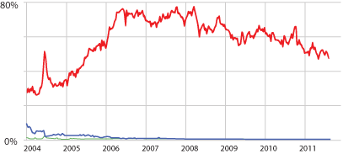
Email Security: Spam
Spam (Google)
Notes:
https://support.google.com/mail/answer/1366858?hl=en
http://www.securelist.com/en/analysis/204792282/Spam_in_January_2013
https://www.trustwave.com/support/labs/spam_statistics.asp
http://en.wikipedia.org/wiki/Bayesian_spam_filtering
http://www.pcworld.com/article/252206/google_explains_gmails_spam_filtering_process.html

Slide 46
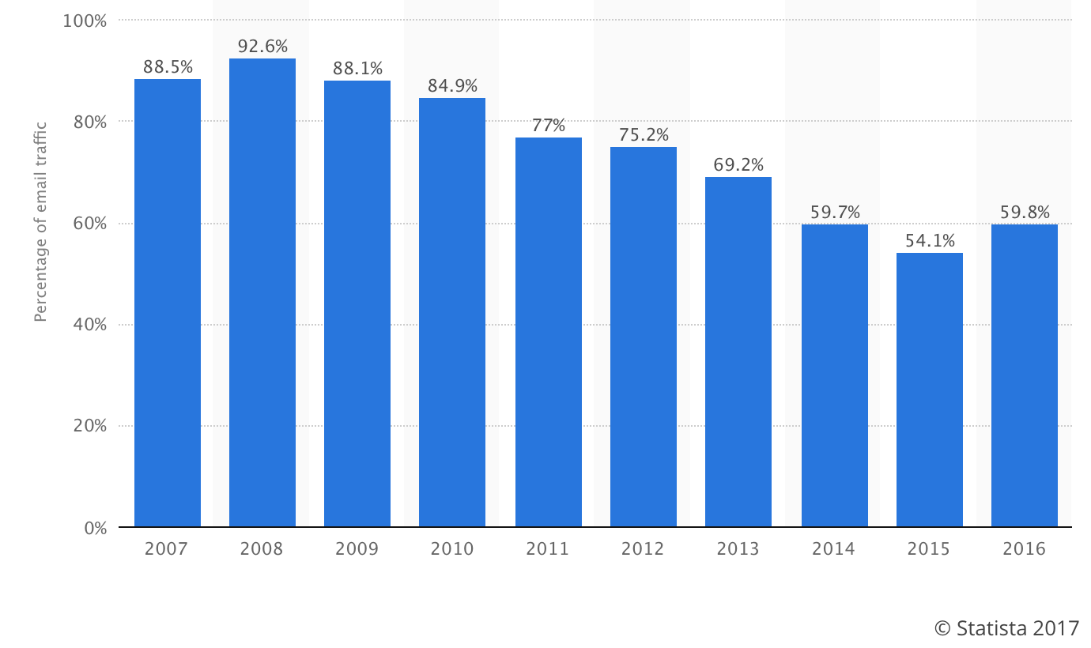
Email Security Issue: Spam
Source: https://www.statista.com/statistics/420400/spam-email-traffic-share-annual/

Slide 47
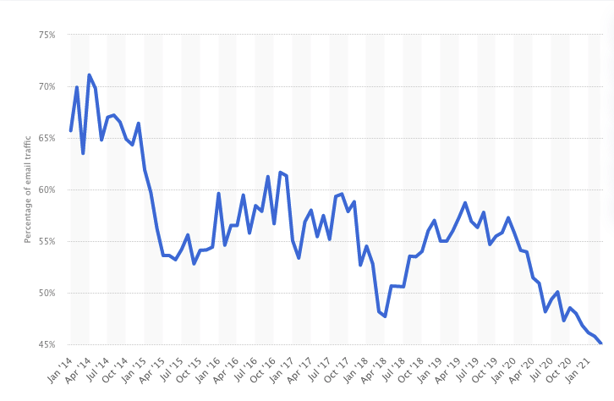
Email Security Issue: Spam
Source: https://www.statista.com/statistics/420391/spam-email-traffic-share/

Slide 48
Discussion: How May One Handle Email Spams?
Notes:
https://support.google.com/mail/answer/1366858?hl=en
http://support.simpledns.com/KB/a62/configuring-dns-records-for-domainkeys-dkim.aspx
http://www.slideshare.net/kka7/what-you-need-to-know-about-email-authentication

Slide 49
Detection Methods Used by GMail
Known phishing scams
Message from unconfirmed sender identity
Message you sent to Spam/similarity to suspicious messages
Administrator-set policies
https://support.google.com/mail/answer/1366858?hl=en
Notes:
https://support.google.com/mail/answer/1366858?hl=en
http://support.simpledns.com/KB/a62/configuring-dns-records-for-domainkeys-dkim.aspx

Slide 50
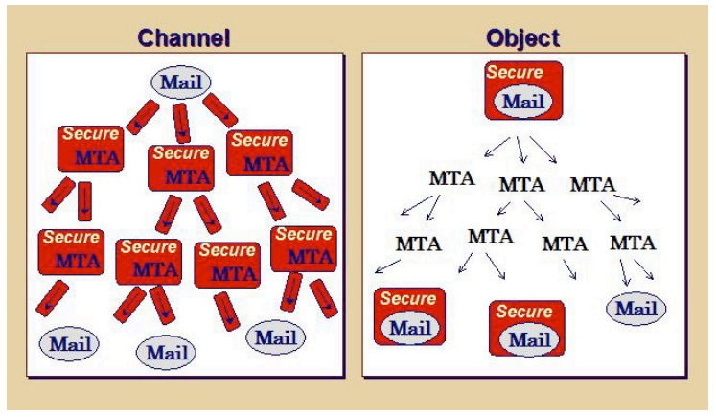
Email Authentication Approaches
Sender Policy Frame (SPF)
DomainKeys Identified Mail (DKIM) Authenticated Results Chain (ARC)
Notes:
https://support.google.com/mail/answer/1366858?hl=en
http://support.simpledns.com/KB/a62/configuring-dns-records-for-domainkeys-dkim.aspx
https://dmarc.org/presentations/ARC-Overview-2016Q3-v01.pdf

Slide 51
Sender Policy Framework (SPF RFC7208)
https://tools.ietf.org/html/rfc7208
MUA
smtp/submission
Is my neighbor m a permitted sender for the domain?
MTA
smtp
Border Outbound MTA m
smtp
Border Inbound MTA
neighbor MTA
pop/imap
validating MTA
MUA
Notes:
https://support.google.com/mail/answer/1366858?hl=en
http://support.simpledns.com/KB/a62/configuring-dns-records-for-domainkeys-dkim.aspx

Slide 52
Key Question for SPF?
How does SPF know if its neighbor MTA is a permitted sender of the domain?
Notes:
http://support.simpledns.com/KB/a62/configuring-dns-records-for-domainkeys-dkim.aspx
<selector>._domainkey.example.com
dig txt <selector>._domainkey.<domain> +short

Slide 53
DomainKeys Identified Mail (DKIM; RFC 5585)
A domain-level digital signature authentication framework for email, using public key crypto
E.g., mail.sina.com signs that the message is sent by mail.sina server
Basic idea of public key signature
Owner has both public and private keys
Owner uses private key to sign a message to generate a signature
Others with public key can verify signature
Assumption: difficult to get private key even w/ public key distributed
Notes:
mailing lists or account forwarding
https://blog.returnpath.com/how-to-explain-authenticated-received-chain-arc-in-plain-english-2/
https://support.google.com/mail/answer/1366858?hl=en
http://support.simpledns.com/KB/a62/configuring-dns-records-for-domainkeys-dkim.aspx

Slide 54
DomainKeys Identified Mail (DKIM)
MUA
smtp/submission
Is the message signed by the private key of the signing domain?
Signing MTA
smtp
MTA
smtp
VerifyingMTA
pop/imap
MUA
Notes:
https://support.google.com/mail/answer/1366858?hl=en
http://support.simpledns.com/KB/a62/configuring-dns-records-for-domainkeys-dkim.aspx

Slide 55
Example: RSA
1. Choose two large prime numbers p, q.
(e.g., 1024 bits each)
2. Compute n = pq, z = (p-1)(q-1)
3. Choose e (with e < n) that has no common factors
with z. (e, z are “relatively prime”).
4. Choose d such that ed-1 is exactly divisible by z.
(in other words: ed mod z = 1 ).
5. Public key is (n,e). Private key is (n,d).

Slide 56
RSA: Signing/Verification
0. Given (n,e) and (n,d) as computed above
1. To sign message, m, compute h = hash(m), then sign with private key
d
d
s = h mod n
(i.e., remainder when h is divided by n)
2. To verify signature s, compute
e
e
h’ = s mod n
(i.e., remainder when s is divided by n)
Magic
happens!
d
e
h = (h mod n)
mod n
The magic is a simple application of Euler’s generalization of
Fermat’s little theorem

Slide 57
Key Question about DKIM?
How does DKIM retrieve the public key of the author domain?
Notes:
http://support.simpledns.com/KB/a62/configuring-dns-records-for-domainkeys-dkim.aspx
<selector>._domainkey.example.com
dig txt <selector>._domainkey.<domain> +short

Slide 58
Summary: Some Key Remaining Issues about Email
Basic: How to find the email server of a domain?
Scalability/robustness: how to find multiple servers for the email domain?
Security
SPF: How does SPF know if its neighbor MTA is a permitted sender of the domain?
DKIM: How does DKIM retrieve the public key of the author domain?

